Slide 1
Model Trees for Identifying Exceptional Players in the NHL Draft
Yejia Liu and Oliver Schulte
School of Computing Science
Simon Fraser University
Vancouver, Canada
Notes:
If you use “insert slide number” under “Footer”, that text box only displays the slide number, not the total number of slides. So I use a new textbox for the slide number in the master.
This is a version of “Equity”.

Slide 2
Overview
The goal: given statistics from junior league, rank players for draft picks (Shuckers 2016)
Ranking should
have predictive power for future NHL performance
be explainable to hockey experts
Innovations:
use model trees for new predictive model
combines advantages of cohort-based （similarity-based) and regression-based models
predict whether a junior player will play at least one NHL game
rank draft picks by their chance of GP > 0
Notes:
time: about 15 min
- we follow Shuckers problem formulation and evaluation framework
model trees have not been applied to this problem
ranking by chance of playing > 0 games is also new

Slide 3
Our Draft Dataset

Slide 4
Dataset Description
Source: nhl.com, eliteprospects.com, draftanalyst.com, David Wilson
Demographics (height, age, weight, country etc.) + Performance Stats (games played, points, etc.)
Available at https://github.com/liuyejia/Model_Trees_Full_Dataset
Check out our Draft Dataset Browser https://datavs.haoxp.xyz/#/

Slide 5
Dataset Browser

Slide 6
NHL Performance Metric
We use #NHL games played after first 7 seasons.
See also Shuckers 2016, Tingling 2011
Very similar results with Time-On-Ice.
Hindsight Ranking: Rank drafted players by #NHL games
Excess-zero problem: about half the players drafted play 0 NHL games.
* Schuckers, M. & Statistical Sports Consulting, L. L. C. (2016), 'Draft by Numbers: Using Data and Analytics to Improve National Hockey League (NHL) Player Selection', MIT Sloan Sports Analytics Conference.
* Tingling, P.; Masri, K. & Martell, M. (2011), 'Does order matter? An empirical analysis of NHL draft decisions', Sport, Business and Management: an International Journal.
Notes:
from now on we refer to #NHL games = #NHL games after 7 seasons

Slide 7
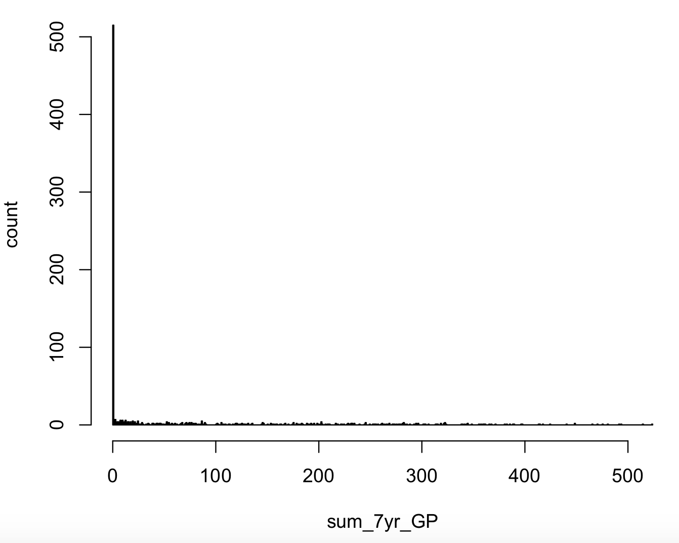
From Score to Hindsight Ranking
Interactive plotter available at https://datavs.haoxp.xyz/
#Games Played | Rank | Player
782 | 1 | Sidney Crosby
740 | 2 | Patrick Kane
752 | 3 | Sam Gagner
.....

Slide 8
Predicting NHL Appearance

Slide 9
New Predictive Task: Will A Player appear in the NHL?
No excess-zero problem
Of independent interest (e.g. player agencies)
Can rank junior players by their chance of playing at least one NHL game

Slide 10
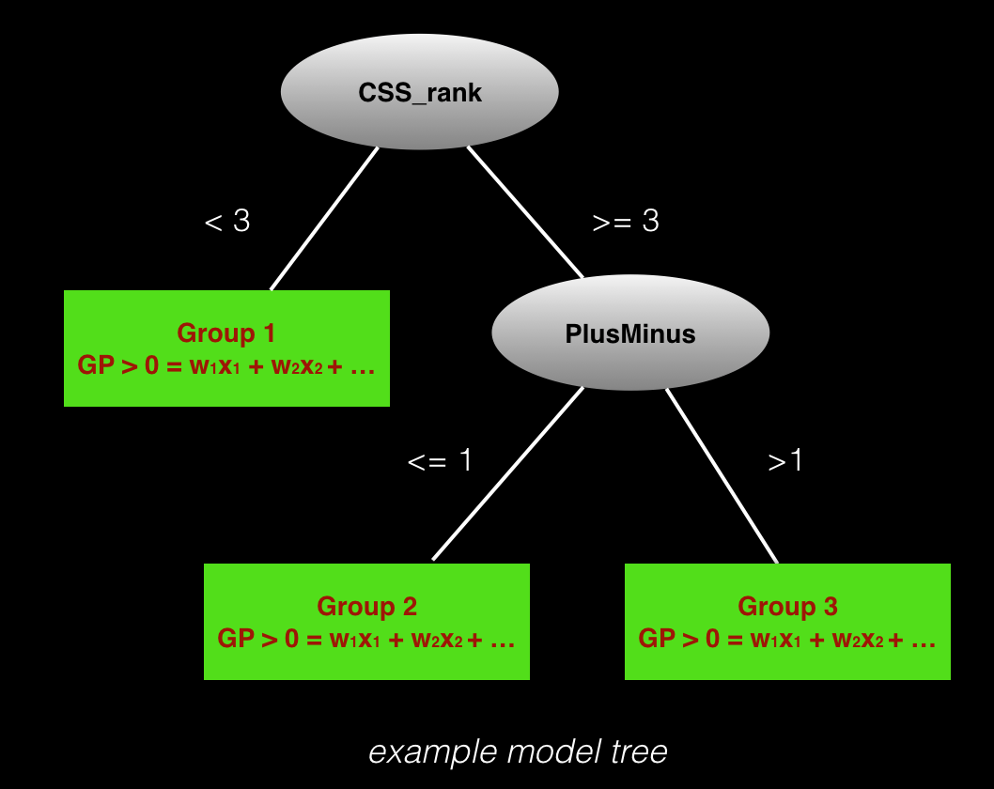
New Prediction Form: Model Tree
Like a decision tree, but with logistic regression in the leaves
Learns groups of comparables and regression models
Notes:
can also be used with linear regression
advantages of cohort-based and regression based

Slide 11
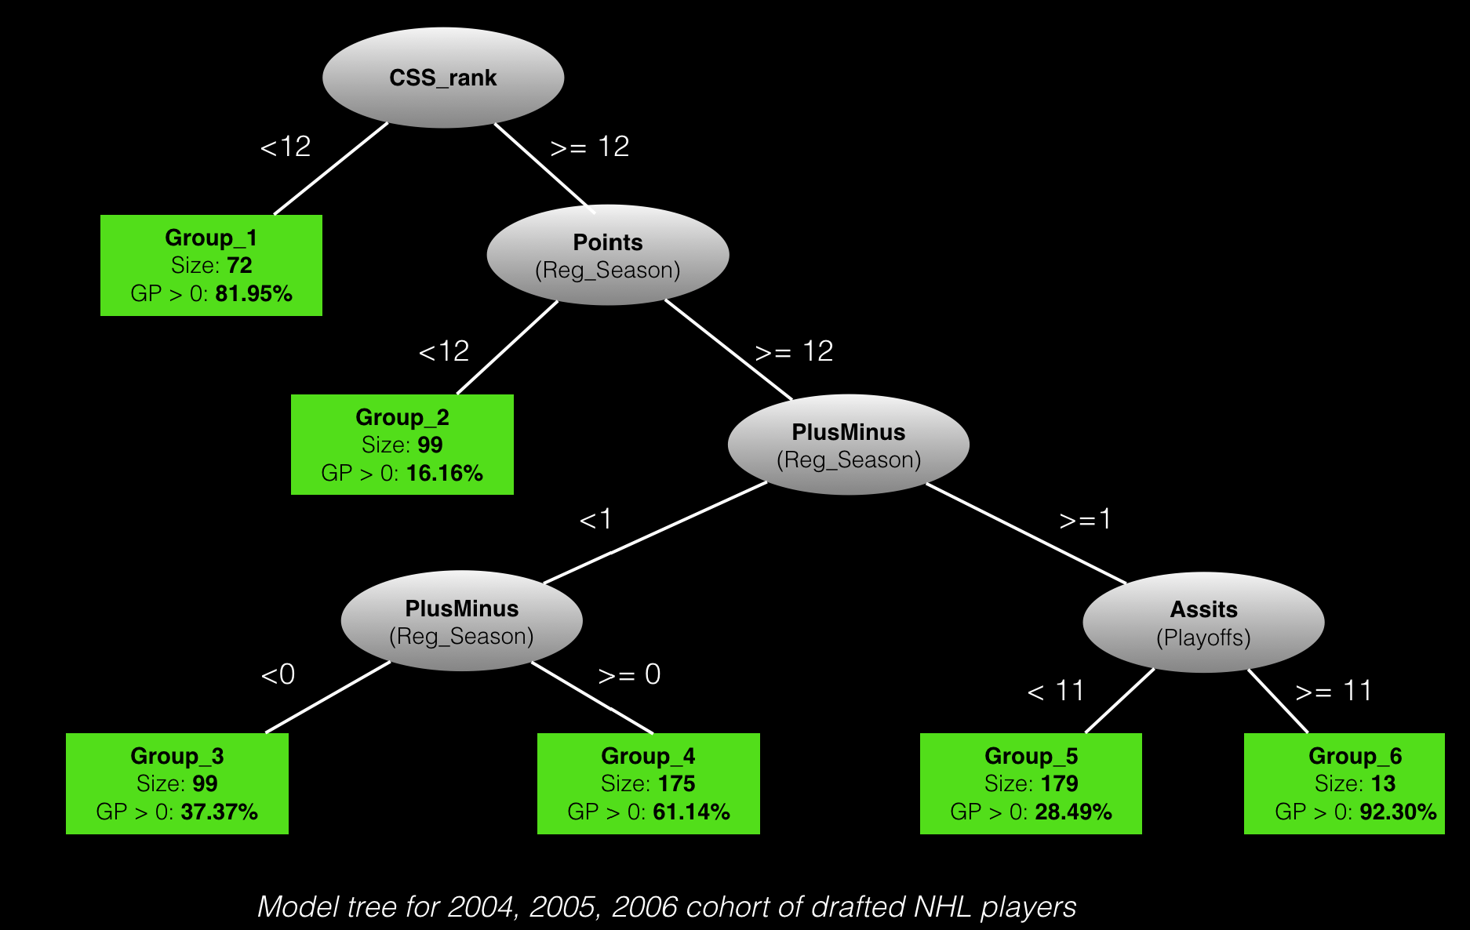
Learning Groups of Comparables
The tree learns which groups of players are statistically different (using Weka)
Group | Player
1 | Sidney Crosby
1 | Patrick Kane
6 | Brad Marchand
6 | Matthieu Carie
6 | Kyle Cumiskey
Notes:
can also be used with linear regression
advantages of cohort-based and regression based
e.g. different depending on their stats, their league, their

Slide 12
Predictive Performance

Slide 13
From Numeric Scores to Rankings
Our evaluation follows Shuckers 2016.
Compare hindsight ranking to
team ranking = draft order
our model ranking, by estimated chance of playing at least one NHL game
* Schuckers, M. & Statistical Sports Consulting, L. L. C. (2016), 'Draft by Numbers: Using Data and Analytics to Improve National Hockey League (NHL) Player Selection', MIT Sloan Sports Analytics Conference.

Slide 14
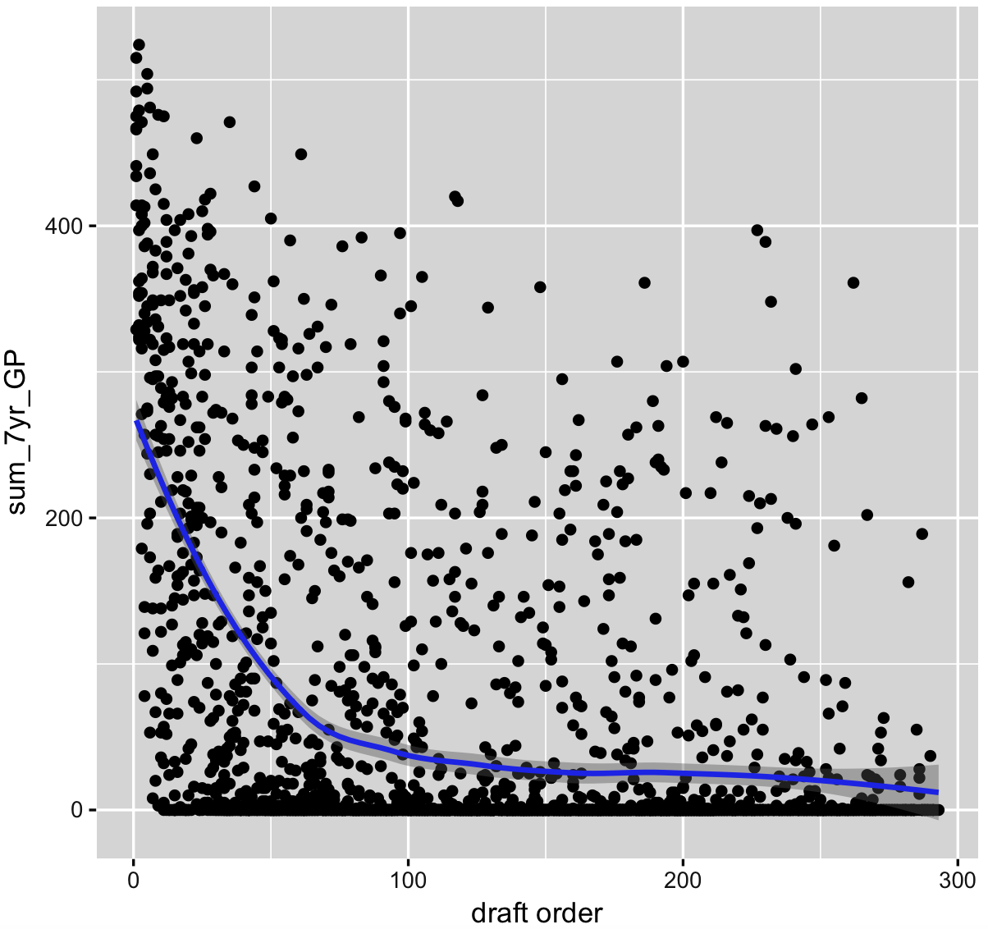
Draft Order
Sum_7yr_GP vs. Draft Order
Draft Order | Rank | Player
1 | 1 | Sidney Crosby
2 | 2 | Bobby Ryan
3 | 3 | …
.....

Slide 15
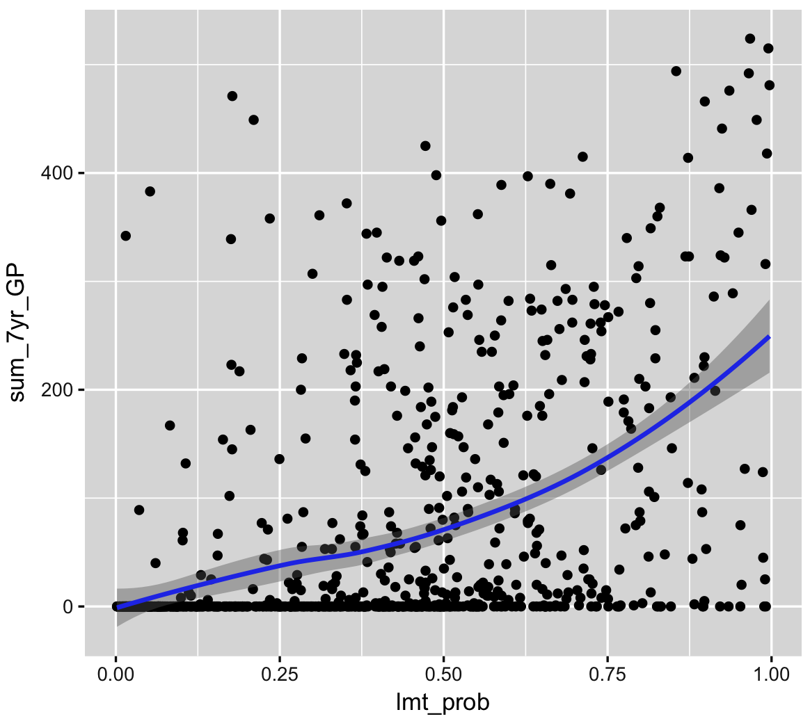
Logistic Model Tree Ranking
Sum_7yr_GP vs. Predicted_Chance_of_Playing
Pr (playing > 0 games) | Rank | Player
0.9872 | 1 | Sidney Crosby
0.9711 | 2 | Patrick Kane
0.95 | 3 | …
.....

Slide 16
Which Ranking is the closest to hindsight ranking?
Use Spearman rank correlation.
Essentially, correlation among ranks (not scores)
Training Data NHL Draft Years | Out of Sample Draft Years | Draft Order Spearman Rank Correlation | Tree Model Classification Accuracy | Tree Model Spearman Rank Correlation
1998, 1999, 2000 | 2001 | 0.43 | 82.27% | 0.83
1998, 1999, 2000 | 2002 | 0.3 | 85.79% | 0.85
2003, 2004, 2005 | 2007 | 0.46 | 81.23% | 0.84
2003, 2004, 2005 | 2008 | 0.51 | 63.56% | 0.71
Notes:
similar results for Kendall’s tau ranking

Slide 17
Identifying Exceptional Players
Explaining the rankings

Slide 18
Identifying Strong and Weak Points
“The numbers are the beginning of the conversation”. Cam Lawrence, Florida Panthers
We can leverage the weights to identify the player features that contribute the most to raising/lowering a player’s ranking
The log-probability difference of playing at least one game between a random player i and an average player in group g is $\sum_{j=1}^{m}{w_{j}(x_{ij}−\overline{x_{gj})}}$
Find the features j that contribute the most to this difference ${argmax}_{j} {|w}_{j}(x_{ij}−\overline{x_{gj}})|$
Notes:
it’s important not just to give a ranking but explain it

Slide 19
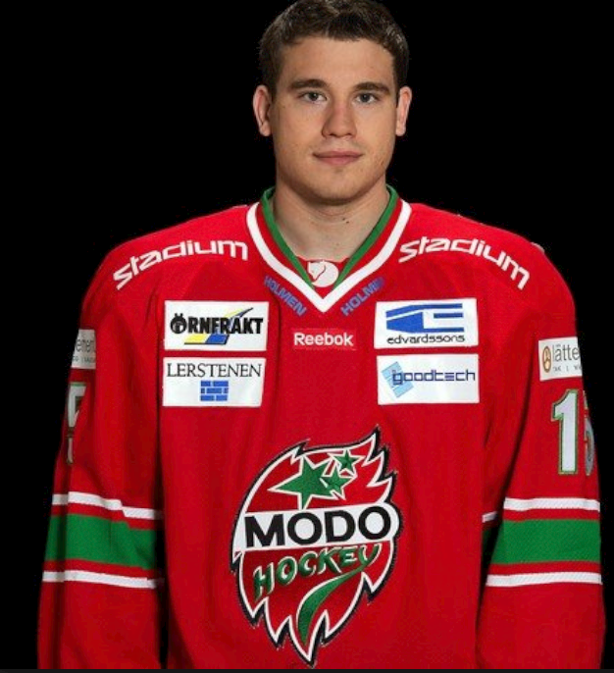
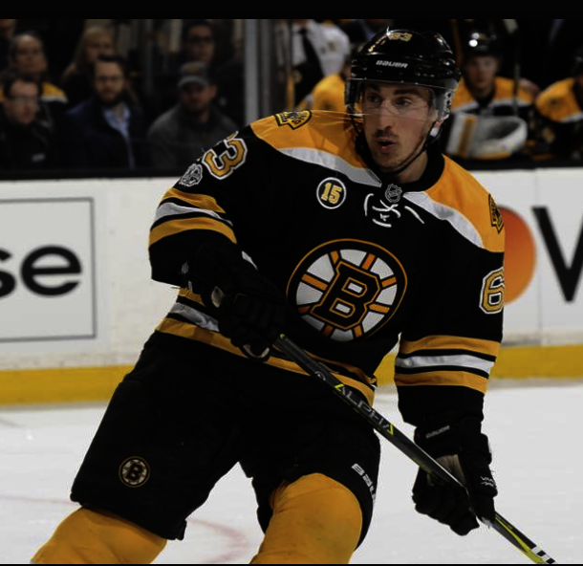
Underestimated Players: Kyle Cumiskey and Brad Marchand
Not ranked by CSS at all
Overall pick at 222
132 NHL games, Won a Stanley Cup (2015), Represented Canada in the World Championship
1998, 1999, 200
Ranked 80 by CSS
Overall pick at 71
534 NHL games, won a Canada Cup/World Cup (2016)
Notes:
For Marchand, the model identifies his playoff statistics as outstanding
For Cumiskey, the model identifies his number of games played as outstanding

Slide 20
Conclusion
Published an NHL draft dataset with browser
Introduce model trees, which
assign players to groups that are statistically distinct
build separate prediction models for separate groups
Build a model tree to predict whether a potential draft pick will play >0 NHL games
The learned groups can be easily interpreted by a hockey expert
The tree ranking correlates well with ranking by actual success (= #NHL games played)

Slide 21
Thank you!
&
Questions?
contact: yejial@sfu.ca, oschulte@cs.sfu.ca

