Slide 1
FROM GRAPES AND PRUNES TO APPLES AND APPLES:
USING MATCHED METHODS TO
ESTIMATE OPTIMAL ZONE ENTRY DECISION-MAKING
IN THE NHL

Slide 2


Asmae Toumi
Michael Lopez
Editor-in-Chief , Hockey-Graphs
Data Analyst, MGH Institute of Tech,
Harvard Medical School
Director of Data and Analytics, NFL
Professor of Statistics, Skidmore College

Slide 3
WHAT ARE ZONE ENTRIES?
1
Notes:
Why are they important?
What did previous research show?

Slide 4
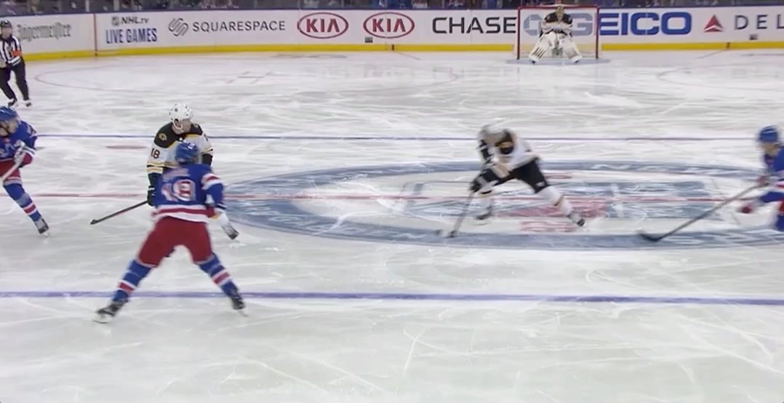
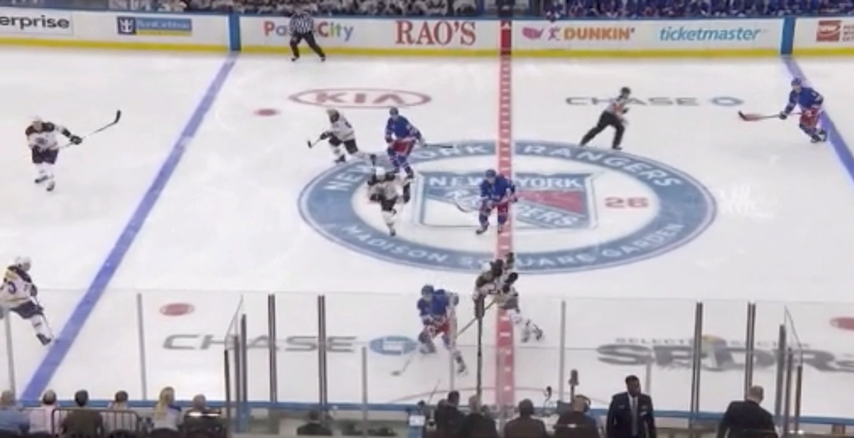
HOW TO USE
Carry-in
Dump-in
Source: Alison Lukan
Notes:
Why is this important?

Slide 5

Every data set collected showed entries with possession being more than twice as effective as dump-ins at 5-on- 5. The neutral zone play that sets a team up to enter the offensive zone with possession is a critical driver of success.
Eric Tulsky (2013)
Notes:
It's important because a lot of research has shown that zone entries are twice as effective as dump-ins at 5v5 and so they're a critical driver of success

Slide 6
Our goal:
estimate the potential benefit that teams can gain by carrying the puck in vs. dumping it

Slide 7
But… hasn’t this been done before?

Slide 8
Previous research did not account for certain confounders
A causal inference framework would account for confounders and allow an apples-to-apples comparison
Notes:
First of all, previous research research did not account for certain confounders that we have now access to thanks to tracking data being made available to us,
and second,
adopting a casual inference framework would allow us to account for all the confounders and in doing so we would be fulfilling our mission that the title of this project mentions, which is comparing apples to apples

Slide 9
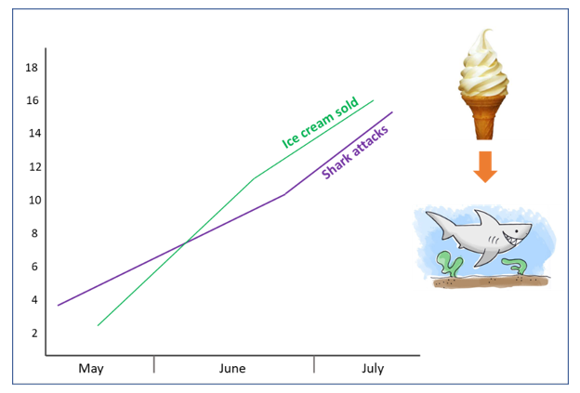
WHAT IS CAUSAL INFERENCE?
2
Notes:
Let's first try to get a sense of what causal inference is all about. We've all heard of the saying, "correlation isnt causation" right? but what if...

Slide 10
What if there was a way to know under which circumstances
correlation is causation?
Only if control for all confounders…
Is there a framework that does that?
Notes:
What if there WAS a way to know under which circumstances correlation actually is causation?
The answer is possibly yes, but you'd have to control for all the confounders. Confounders by the way is a variable that both influences one of the other variables in your model and your outcome also. So the question is, is there any framework that would allow us to control for confounders?
And the yes answer is yes it’s

Slide 11
CAUSAL
INFERENCE
Notes:
Just because there’s a framework tho, doesn’t make it easy at all. Causal inference is actually very hard, especially in our case dealing with observational data.
Causal inference also has its own language, so let’s go through some important terms

Slide 12
CAUSAL INFERENCE DEFINITIONS
CAUSALITY
Is linked to a manipulation (treatment) that is applied to a unit
UNIT
The ”thing” that received the treatment
… or didn’t receive it. The “thing” could also be exposed to an alternative action.
POTENTIAL OUTCOME
Before the treatment, there are two potential outcomes
…and then we actually observe one of them.
Notes:
The notion of what we call causality is linked to a manipulation, like a treatment, intervention, action or strategy that is applied to a unit
So what is a unit? A unit is the ”thing” that the receives the treatment or intervention. The “thing” can be different things like a person, a team, a school, so any physical entity.
For simplicity, we usually like to think in only two possibilities: receiving or not receiving the treatment
A unit (either receiving or not receiving a treatment) is linked to a potential outcome
The potential part refers to the idea that, for a given unit, only one outcome is realized after the intervention; the other is, well, potential but we can’t observe it
So let’s go through a simplistic example to get a better sense of what these concepts mean

Slide 13
A person may or may not receive a drug if sick
unit
treatment
One potential outcome is years survived after receiving the drug
outcome
The other potential outcome is years survived
if the person hadn’t received the drug
counterfactual
Notes:
The counterfactual here is the outcome that is only potential, so an outcome that we don’t observe.

Slide 14
DEFINITION OF CAUSAL EFFECT
The causal effect of receiving treatment for a unit is the comparison of potential outcomes called Y. For example:
Y (drug) – Y (no drug)
The comparison of potential outcomes is also called the treatment effect
Notes:
What researchers are interested in, is estimating the causal effect of a certain treatment and the way we define this, is the following: (read slide)
In our last example, that would be Y(receiving drug) minus Y(NOT receiving no drug)
And this comparison is what we call the treatment effect.
This sounds good, and not too hard to understand, but there is something that we haven’t really touched upon so far that adds a lot of complexity, and that is what we call: [NEXT SLIDE]

Slide 15
FUNDAMENTAL PROBLEM OF CAUSAL INFERENCE
For a given unit, we cannot observe both potential outcomes, just one.
Because of this, unit-level causal effects cannot be determined
Notes:
annnnnnd

Slide 16
Solution?
Randomized Control Trials

Slide 17
One of the main benefits of an RCT is that randomization helps us to isolate the effect we are interested in measuring by making sure the two comparison groups are otherwise similar on all relevant variables

Slide 18
But… a randomized control trial isn’t always possible
How do we correct for this?
Propensity score matching!
BART!
Notes:
You can imagine it’s not at all ethical to be choosing who gets the life-saving drug and who doesn’t, right? And that’s for experiments, and you can imagine again that gets even harder when you’re only dealing with observational data because the assignment has already been done for you.

Slide 19
What do these methods help us do?
Estimate population level causal-effects
ATE
ATT
Average Treatment Effect
Average Treatment Effect
on the Treated
Notes:
And there’s two flavors of this, the first one is ATE, which stands for the average treatment effect for the whole population, and the second flavor is different in that it is the average treatment effect specifically on the treated.

Slide 20
(Reminder)
Our goal:
estimate the potential benefit that teams can gain by carrying the puck in vs. dumping it
Notes:
So for our purposes, the unit is teams, and the treated are those who carried the puck in and the control are those that dumped it in.

Slide 21
Our data
Zone entry tracking data from Stathletes
  2017-2018 and 2018-2019 seasons
  n = 277,661 entries at 5v5
      n = 158,808 carry-ins
      n = 118,853 dump-ins
  From Evolving-Hockey:
      Goals Plus-Minus per 60min
      Expected Goals
Notes:
Carry-ins are defined as Possessed Puck Entry or Puck is passed across the blueline to enter the zone
Goals plus minus per 60min allowed us to account for player skill
And expected goals was our outcome

Slide 22
Exploratory Data Analysis

Slide 23
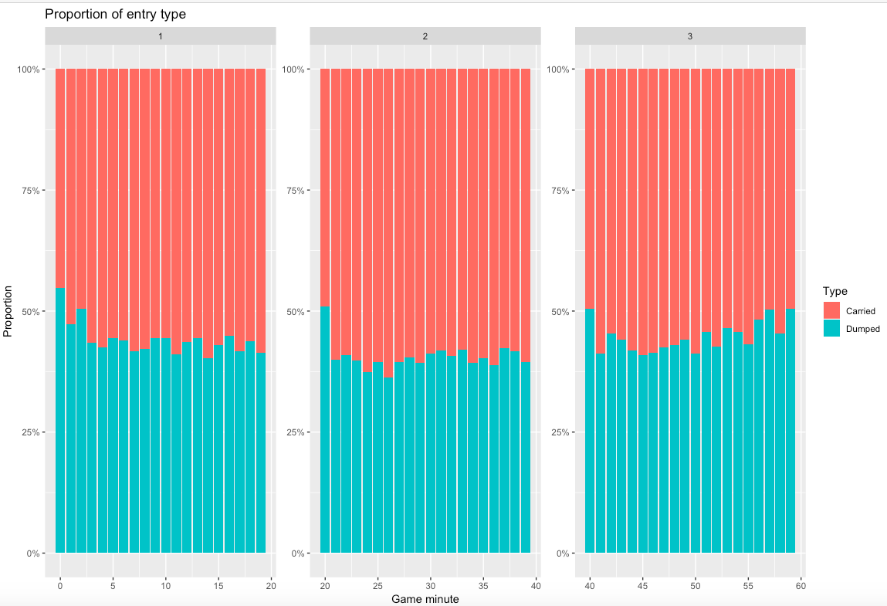

Slide 24
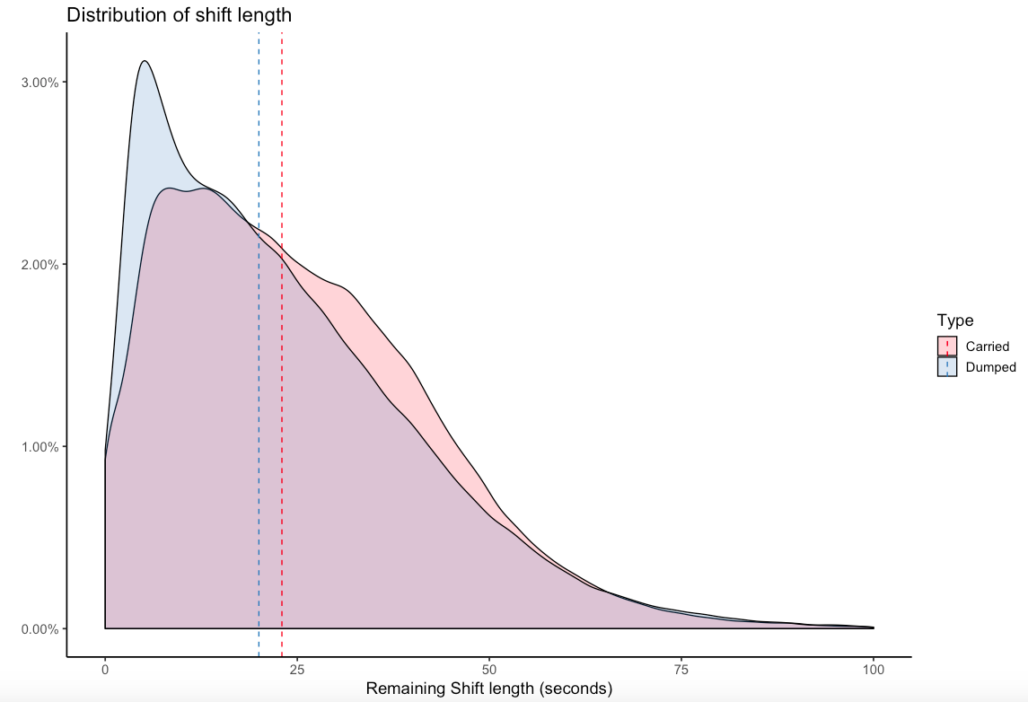

Slide 27
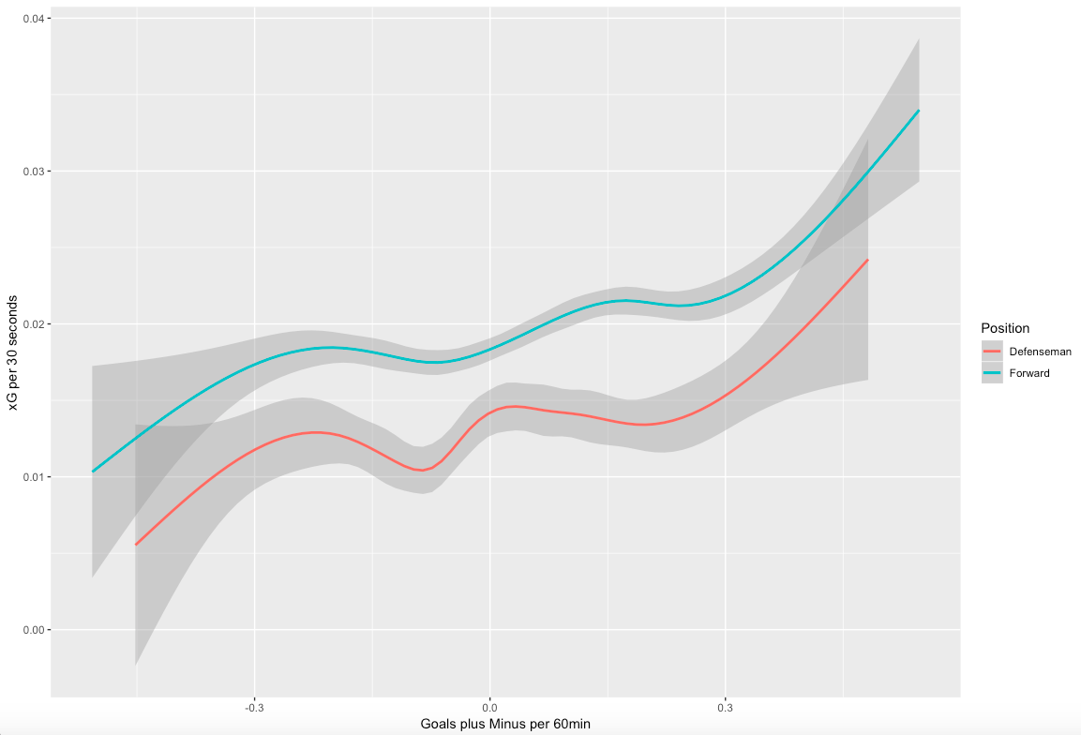

Slide 28
What we really want to do is assess if there is a difference in a carry-in after adjusting for potential confounders
If we don’t adjust for confounders, we’d have treatment selection bias
(In other words, we would not only be observing the effect of a carry-in on xG, but also the effect of player skill on xG)

Slide 29
PROPENSITY SCORE MODEL
4
Notes:
So, the first method that allows us to determine those two Average treatment effects we’ve just gone over is Propensity Score Model

Slide 30
PROPENSITY SCORE
MATCHING
Technique that estimates the effect of a treatment by accounting for the covariates that predict receiving the treatment (aka the confounders).
Notes:
The reduction of bias due to the confounders is what truly allows us to make an apples to apples comparison in order to estimate the true benefit of a treatment

Slide 31
PROCESS OF PROPENSITY
SCORE
MATCHING
LOGISTIC REGRESSION MODEL
MATCHING
ESTIMATE ATT
Notes:
In order to perform a PSM, we have to carry out the following steps, first we …… then we estimate the ATT. ATT again is the average treatment effect on the treated. We chose ATT over the other flavor ATE because carry-ins are considered the gold standard and so we want to be able to estimate the causal benefit of a carry-in specifically among those who carried it in.

Slide 32
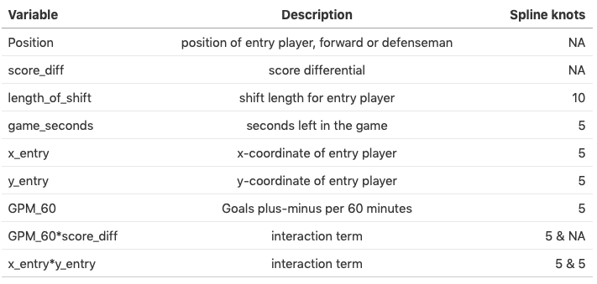
1. Multiple logistic regression
Propensity score model estimates the probability e(X) of a player carrying the puck in (propensity scores) given game characteristics of each carry-in:
Notes:
First, we run a multiple logistic regression model to obtain the probability of a player carrying the puck in given the following covariates, so position of the player that carried it in, the score differential at the time of entry, how long the player has been out there, seconds left in the game, the location of the entry and the skill level of the player
We also included some interaction terms, which is useful for modelling purposes when you know your variable has a different effect on the outcome depending on the value of another variable Interaction: An interaction occurs when an independent variable has a different effect on the outcome depending on the values of another independent variable.
Spline knots are used for curve fitting. (when you think something is nonlinear but smooth, splines are a good way to capture what’s in the data without overfitting)
The probabilities are what we call propensity scores. These are important for the next process, which is

Slide 33
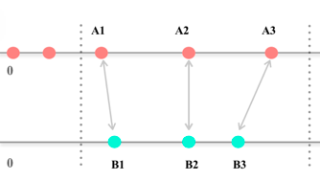
2. Matching (overview)
Process:
Randomly select one player with a carry-in
Match this patient who has the closest propensity score with all players who dumped it in (for a certain threshold)
Continue matching until all possible pairs are identified
1
Increasing probability of receiving treatment
Source: Open Case Study Team
Notes:
First, we run a multiple logistic regression model to obtain the probability of a player carrying the puck in given the following covariates, so position of the player that carried it in, the score differential at the time of entry, how long the player has been out there, seconds left in the game, the location of the entry and the skill level of the player
We also included some interaction terms, which is useful for modelling purposes when you know your variable has a different effect on the outcome depending on the value of another variable Interaction: An interaction occurs when an independent variable has a different effect on the outcome depending on the values of another independent variable.
Spline knots are used for curve fitting. (when you think something is nonlinear but smooth, splines are a good way to capture what’s in the data without overfitting)
The probabilities are what we call propensity scores. These are important for the next process, which is

Slide 34
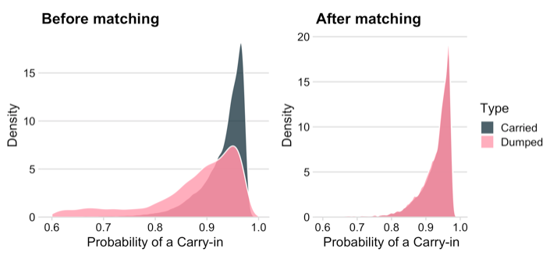
2. Matching
n = 153,498 matched pairs
Notes:
Matching involves taking those covariates and propensity scores and performing one to one matches with replacement, so you take each unit that carried it in and you match it with a unit in the control group
A good way to check the quality of the matching is to see what the density curves look like before matching and after matching. On the left hand side is before matching and you can see that there isn’t much overlap. On the right handside is after matching and you can see that there is almost perfect overlap
Once you have good matches like this, you can go on to the final step, which is estimating the average treatment effect

Slide 35
3. Estimate ATT
With our propensity score model, the estimated ATT’s for the three outcomes considered:
Approximately, there is 1 extra goal produced every 50 carry-ins given that there are ~ 30 carry-ins per team per game
Notes:
Matching involves taking each subject in the treatment group and matching them with a subject in the comparator group based on their covariates and the propensity score.
The estimated ATT’s in the table above represent the difference in the outcomes for an entry that was a carry-in (not a dump-in). Approximately, there is 1 extra goal produced every 50 carry-ins given that there are about 30 carry-ins per game per team. Additionally, xG against are not any worse after a carry-in. Of note, given the large number plays ( n = 153,498 ), the standard errors were very small.

Slide 36
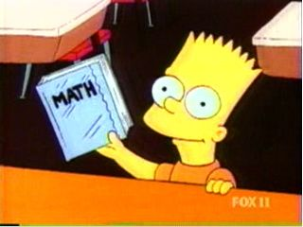
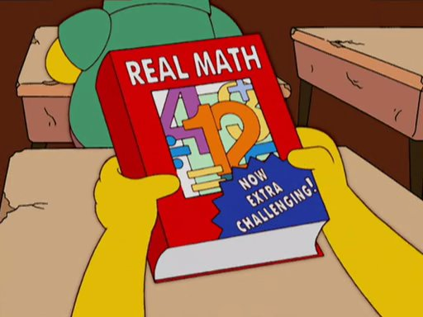
BART
5
Notes:
There’s a second method that we used called BART which is very popular recently for many reasons and we’re going to go over why that is.

Slide 37
BART
Bayesian Additive Regression Trees – BART – is a Bayesian nonparametric modeling procedure
Advantages:
  relatively easy to implement
  produces posterior distributions
  treatment effects more accurate
  identify heterogenous treatment effects across different groups
Notes:
BART stands for Bayesian additive regression trees, which is a type pf Bayesian nonparametric modeling technique.
Last point: in other words, BART allows us to estimate the benefit of carrying it in for each variable.

Slide 38
Like with PSM, BART allows for ATT estimation.
With BART, the estimated ATT was 0.0205, similar to the ATT estimated by the propensity score model.

Slide 39
(Reminder)
BART is able to identify
heterogeneous treatment effects

Slide 40
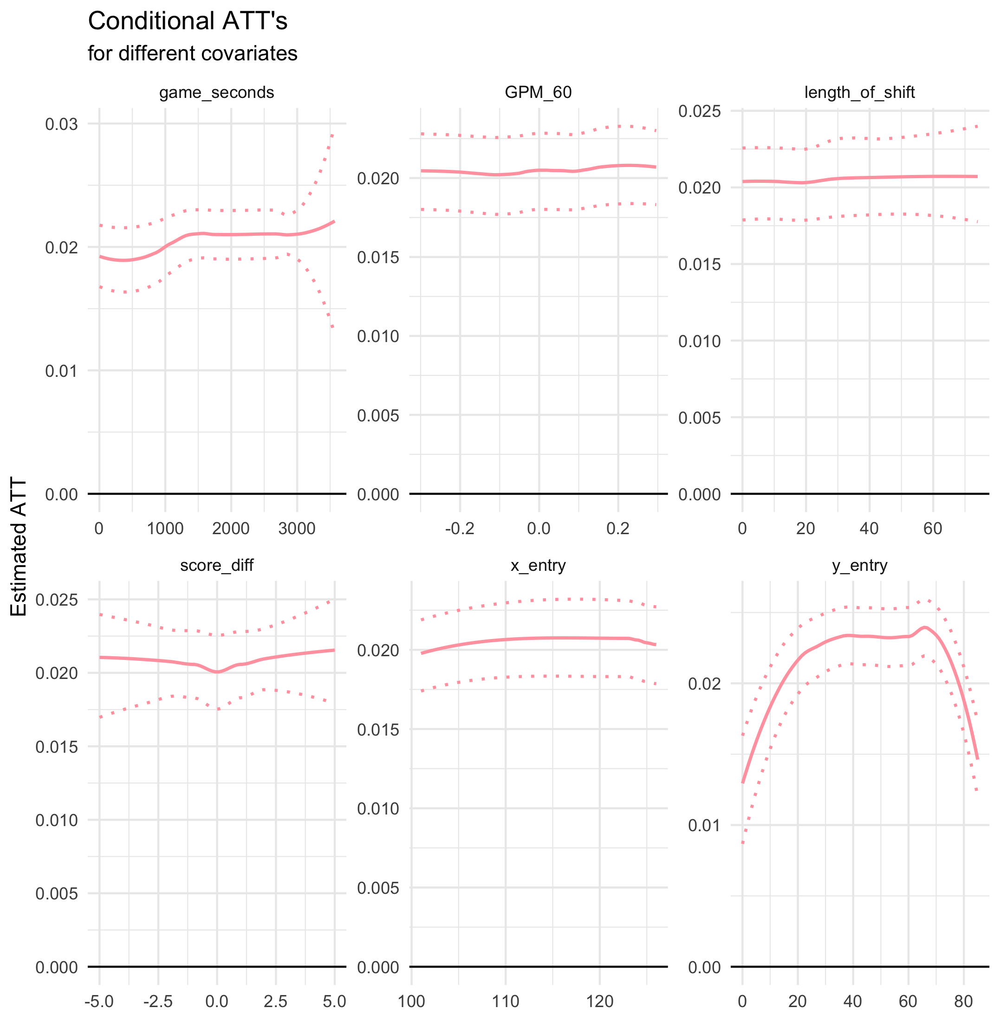
Conditional Average Treatment effect on the Treated (CATT) for different covariates.
The solid lines represent the true treatment effect as it varies with the covariates
The dotted lines represent the marginal 95% posterior intervals for the treatment effect at each covariate value from a treated observation.

Slide 41
Remember this chart?
Notes:
Another heterogeneous treatment effect that we were interested in is comparing forwards to defensemen and it appears that it approximately 20% more beneficial for a forward to carry it in
The next natural question is, does that benefit change if you account for the skill level of that forward or defenseman?

Slide 42
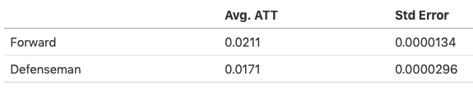
Comparing defensemen to forwards, it is approximately 20% more beneficial for a forward to carry it in
Notes:
Another heterogeneous treatment effect that we were interested in is comparing forwards to defensemen and it appears that it approximately 20% more beneficial for a forward to carry it in
The next natural question is, does that benefit change if you account for the skill level of that forward or defenseman?

Slide 43
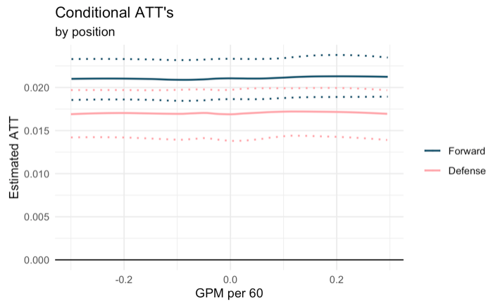
Notes:
And it appears that it does not given that the curves stay pretty very stable

Slide 44
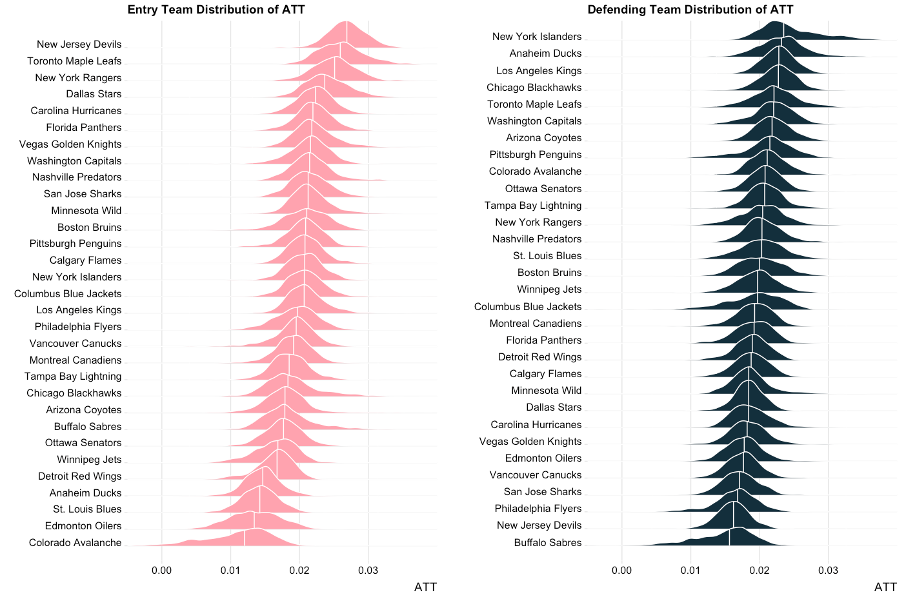
more benefit
Better to carry in against these teams
less benefit
worse
Notes:
We also thought it may be of value to look at team specific treatment effects.
The way we can read is, on the top you have the teams where it’s more beneficial for them to carry it in, and as you go down, the benefit goes down as well.
On the left hand side, the way you read this is, it’s more beneficial to carry in against the teams on the top and as you go down, it gets worse to carry it in against those teams.
The challenge is that here it’s hard to make any conclusions out of this given that we need more data to be able to interpret these graphs appropriately. And it will involve a lot more domain knowledge on team tactics and trends to be able to really make sense of these trends before you can even begin to give teams or coaches any sort of prescriptive analysis.

Slide 45
Next Directions
  Continue to explore team-level effects
  Account for more confounders
    Location of entry players pre-zone entry
    Location of opposing players pre- and post-entry
    And more!

Slide 46
FINAL THOUGHTS
Prediction and causation are different; we endeavored to do the latter
Causal inference is really hard
It’s very difficult to estimate causal effects from observational data (i.e. non-experimental)
Causal conclusions should be regarded as tentative

Slide 47




Thank you!
github.com/asmae-toumi/zone-entries
@asmae_toumi
@StatsbyLopez
atoumi.cu@gmail.com

