Slide 1
The Probability and Severity of Man Games Lost Due to Injury in an NHL regular Season
Jeremy Sylvain & Michael Schuckers

Slide 2
Goal
Statistical models for a player’s
Injury probability
Injury severity

Slide 3
Introduction:
● Teams that get injured struggle to make playoffs
● The amount of time missed due to injures affects decisions made by coaches and managers as to who to call up from farm teams
● Variables chosen were seen to potentially increase the probability and severity of injury

Slide 4
Background:
● In 2016-17, the correlation between percent cap hit of injured players per game and points per game is -0.31 (nhlinjuryviz.blogspot.com)
● In 2016-17 3 most injured teams VAN, WPG, and BUF, all failed to make the playoffs*
● The 3 least injured teams WSH, CGY, and STL all made the playoffs and WSH and STL both moved on to the second round*
*mangameslost.com

Slide 5
Data:
● Data From mangameslost.com and hockey-reference.com
● Data collected from 2009-2016 to allow us to collect stable estimates
Variable | Definition
INJ | Games a player lost due to injury
GP | Games played by a player
TOI-GM | Average time on ice played per game in all situations
HPG | Hits a player gives divided by games played
BPG | Shots a player blocks divided by games played
AGE | Age of player as of January 1st, of each season in years
AGE² | Age of a player squared in years

Slide 6
Example
● Bobby Ryan 2013-2014
Variable | INJ | GP | TOI.GM | HPG | BPG | AGE | AGE²
Stat | 12.00 | 70.00 | 14.10 | 1.41 | 0.43 | 26.81 | 718.97

Slide 7
Data:
● Data all situations (ES, PP, PK) aggregated
Season | 2009-10 | 2010-11 | 2011-12 | 2012-13 | 2013-14 | 2014-15 | 2015-16
Number of Players | 862 | 982 | 985 | 902 | 957 | 979 | 963
Percent of player with INJ>10 | 18.7% | 21.9% | 21.5% | 13.6% | 22.2% | 22.1% | 21.4%
Average Games Missed for Injured Players | 5.86 | 7.05 | 7.25 | 4.01 | 6.83 | 6.67 | 6.65

Slide 8
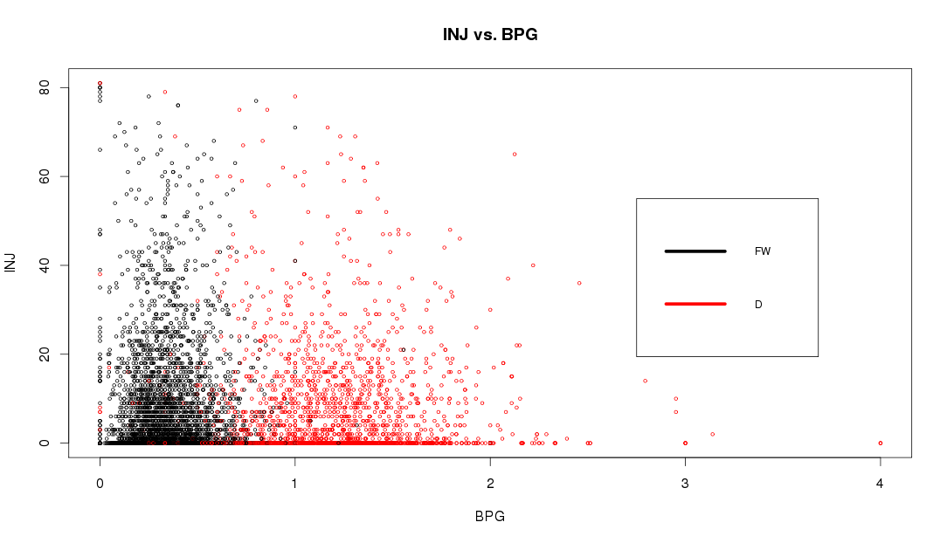
Data:
● Broke data down by both forwards and defensemen as different factors might effect the models differently

Slide 9
Analysis:
● HPG and BPG are collision factors
● Time on ice per game (TOI.GM) is included to account for exposure
● To account for susceptibility due to aging we include player’s age (AGE) and a quadratic term (AGE²)

Slide 10
Models

Slide 11
Injury Probability Model:
● Used logistic regression
● INJPROB=1, if INJ>0
● Predicts the probability of injury
● Model is run for each season and position (FW or D)
Probability Model (Logistic Regression):
INJPROB~HPG+BPG+TOI.GM+AGE+ AGE²

Slide 12
Injury Severity model:
● To model the severity or length of an NHL injury we used a log linear regression model
● Model is based on a Poisson distribution
● Model is run for each position (FW or D)
Severity Model (Poisson Regression):
INJ~HPG+BPG+TOI.GM+AGE+AGE²

Slide 13
Results
Fit models by position, by season, and for all seasons 2009-2016
Report all season results by position
Full results on poster

Slide 14
Results:
Injury Probability Model for Forwards
● TOI.GM significant in each season
● HPG(2), AGE(1), and AGE²(1) were significant some seasons
● TOI.GM, AGE, and AGE², significant in the all seasons model
Coefficients and Their Significance
Forwards | TOI.GM | HPG | BPG | AGE | AGE²
All Seasons | **0.1489 | 0.0767 | 0.0477 | **0.2358 | *-0.0028
NOTE: “*” level of significance, “**” (p<0.01) and “*” (p<0.05)

Slide 15
Results:
Injury Probability Model for Defense
● TOI-GM significant in each season except for 2012-2013
● HPG(2) AGE(1) and AGE²(1) were significant in some seasons
● TOI.GM, HPG, AGE, AGE² were significant in the all seasons model
Coefficients and Their Significance for the Injury Probability Model
Forwards | TOI.GM | HPG | BPG | AGE | AGE²
All Seasons | **0.1363 | **0.2094 | 0.0647 | *0.2627 | -0.0030
NOTE: “*” level of significance, “**” (p<0.01) and “*” (p<0.05)

Slide 16
Results:
Injury Severity Model for Forwards
● AGE and AGE² were significant each season
●TOI.GM(6), HPG(6), and BPG(5) were significant in some seasons
● All variables were significant in the all seasons model
Coefficients and Their Significance
Forwards | TOI.GM | HPG | BPG | AGE | AGE²
All Seasons | **0.0466 | **0.0325 | **-0.1300 | **0.2894 | **-0.0039
NOTE: “*” level of significance, “**” (p<0.01) and “*” (p<0.05)

Slide 17
Results:
Injury Severity Model for Defense
● AGE and AGE² were significant each season
● TOI.GM(5), HPG(6), BPG(4), were significant in some seasons
● TOI.GM, HPG, AGE, and, AGE² were significant in the all season models
Coefficients and Their Significance
Forwards | TOI.GM | HPG | BPG | AGE | AGE²
All Seasons | **0.0190 | **0.0613 | 0.0071 | **0.3180 | **-0.0042
NOTE: “*” level of significance, “**” (p<0.01) and “*” (p<0.05)

Slide 18
Application
● 2016-2017 Ottawa Senators

Slide 19
Simulation
Fit all season model
Apply model to each Ottawa Senator
Predict injury probability, and injury severity
Store total man games lost
Repeat steps 3 and 4 many times (n=1000)

Slide 20
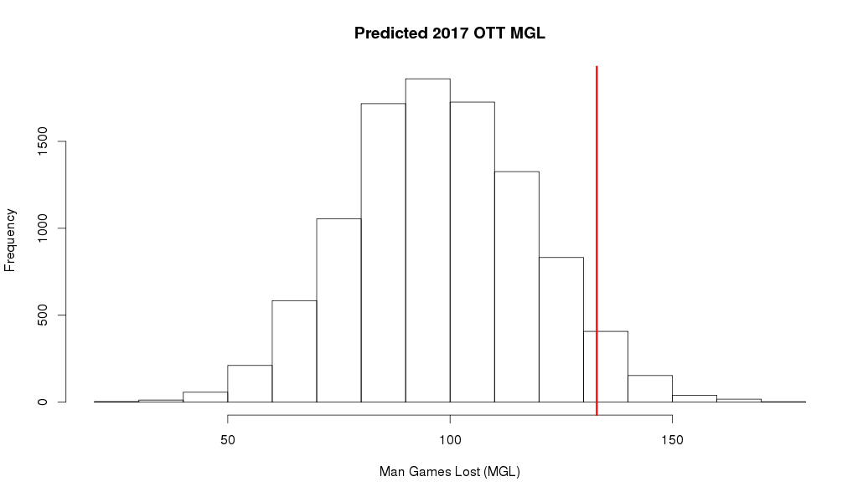
Model Simulation:
● Clarke MacArthur Removed

Slide 21
Discussion:
● Above models are groundwork for study of NHL injuries
● TOI.GM was the most significant factor in predicting probability of an injury
● AGE and AGE² were the most important factors in predicting the severity of an injury

Slide 22
Issues:
● Players who are blocking shots are good at blocking shots
● Hitters are braced for the hit, potentially add frequency of being hit
● Special teams more or less dangerous?
● Modeling long term injuries

Slide 23
Extensions
● Mixture distributions
● Special teams
● Are players injury prone or unlucky?

Slide 24
Thank you
j.sylvain01@gmail.com

