Slide 1
Draft By Numbers
Michael Schuckers
@SchuckersM

Slide 2
NHL Draft Analytics
If you're drafting a guy solely on statistics, I hope you're in my division
- Brian Burke, MIT Sloan Sports Analytics Conference, 2013
https://live.sbnation.com/sloan-sports-conference-2013-ssac/
Statistics are going to tell you something. Where you take that data and where you take that research and apply it and add it to the other data sources you have — that’s where you’ll be successful.
-Brian Burke quoted by Dave Feschuk, Toronto Star, March 2013.
http://www.thestar.com/sports/leafs/2013/03/01/former_toronto_maple_leafs_gm_brian_burke_speaks_out_a_conference.html

Slide 3
What If?
Publicly Available Data
Demographics: Height, Weight, Age, Position, etc.
Performance: PPG, Goals per Game, GAA, PIMs, etc.
Scouting: Central Scouting Service (CSS) rankings
Smartly combine all of that to predict future NHL performance?

Slide 4
Drafting Is Hard
Draft Classes | % of first 210 players drafted with zero GP | 25th percentile of GP, GP>1 | 75th percentile of GP, GP>1 | 25th percentile of TOI, GP>1 | 75th percentile of TOI, GP>1
1998-2002 | 54.6% | 18 | 255 | 78 | 3167
2003-2007 | 55.3% | 18 | 222 | 194 | 3809
Every draft year from 1998 to 2008, median GP = 0
20.6% of draftees play more than 50 games in NHL

Slide 5
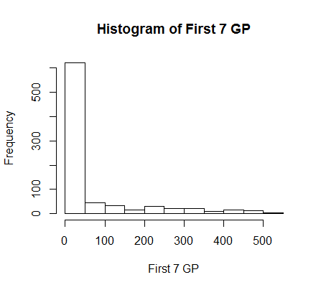
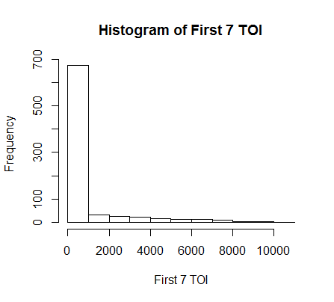
Drafting Is Hard

Slide 6
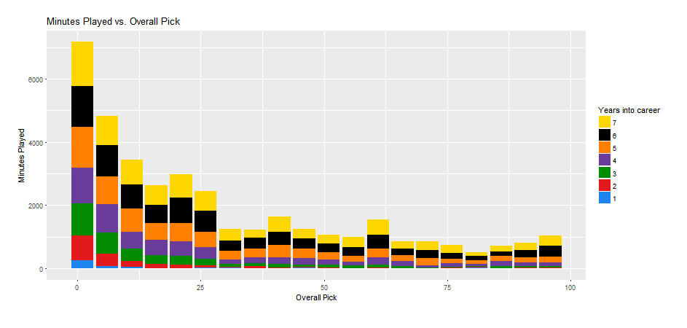
Drafting Is Hard
Feedback loop is slow
Credit: Gordon White, St. Lawrence Univ.

Slide 7
Could we beat NHL Teams at Drafting?
Translation Factors (NHLe): Vollman, Desjardins, + others (many years)
Central Scouting Integrator: Fyffe (2011)
Prospect Cohort Success: Weissbock, Lawrence, Jessop (2015)
You Can Beat the Market: Schuckers & Argeris (2015)

Slide 8
Data
Collected and merged data from 1998, 1999, 2000 draft classes
eliteprospects.com
nhl.com
thedraftanalyst.com
hockeydb.com
hockeyreference.com
Some automated, some manual (be sure to check site usage agreements)

Slide 9
Fun Facts
C D F G 170 270 295 86
C D F G 170 270 295 86
1998,1999,2000 drafts
n=821 players drafted or ranked by CSS
170 C’s, 270 D’s, 295 F’s, 86 G’s
Most common leagues
141 from OHL, 125 from WHL, 98 from NCAA, 81 from QMJHL
5 Robin Olsson’s, 2 forwards, 2 defensemen and a goalie, from Sweden born in either 1989 or 1990

Slide 10
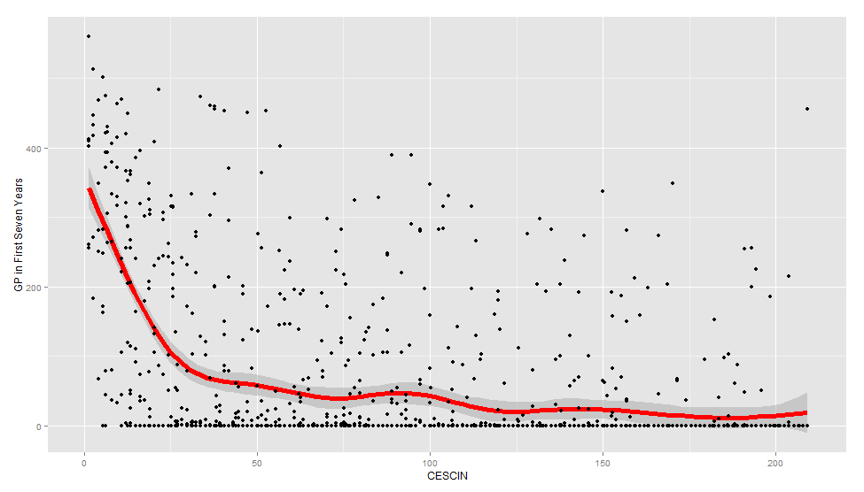
GP vs Cescin

Slide 11
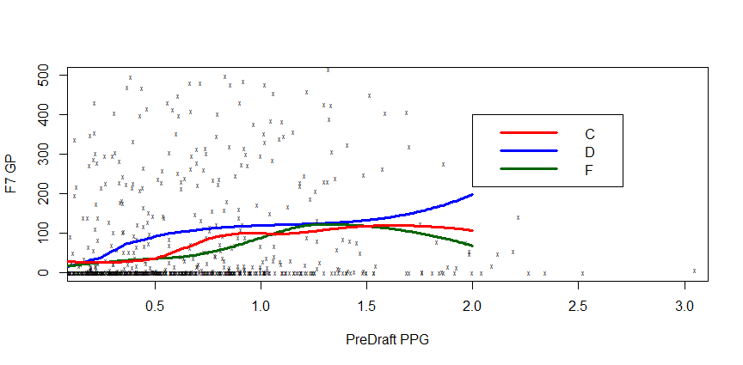
F7GP vs PreDraft PPG by Position

Slide 12
Modelling
Single Model All Positions: C, D, F, G
Responses: F7TOI or F7GP
Regression: Generalized Additive Model with Log Link (multiplicative)
Y~g₁(X₁)+g₂(X₂) + …
Deal with non-linearities in CESCIN, e.g.
gam package in R
Predictors: CESCIN, Wt, Ht, Pos, League
+Interactions by League and Performance

Slide 13
Evaluation
Training Data: 1998,1999,2000 players (drafted + ranked by CSS)
Out of Sample Data: 2007, 2008 players (drafted + ranked by CSS)
Responses: F7TOI, F7GP
Criterion: Spearman Rank Correlation (Order matters)
Predicted Order vs Performance Order

Slide 14
Results
Training Data NHL Draft Years | Out of Sample Draft Year | NHL Performance Metric | NHL Draft Order | Draft by Numbers Order
1998, 1999, 2000 | 2007 | TOI | 0.547 | 0.650
1998, 1999, 2000 | 2007 | GP | 0.547 | 0.659
1998, 1999, 2000 | 2008 | TOI | 0.553 | 0.619
1998, 1999, 2000 | 2008 | GP | 0.557 | 0.616

Slide 15
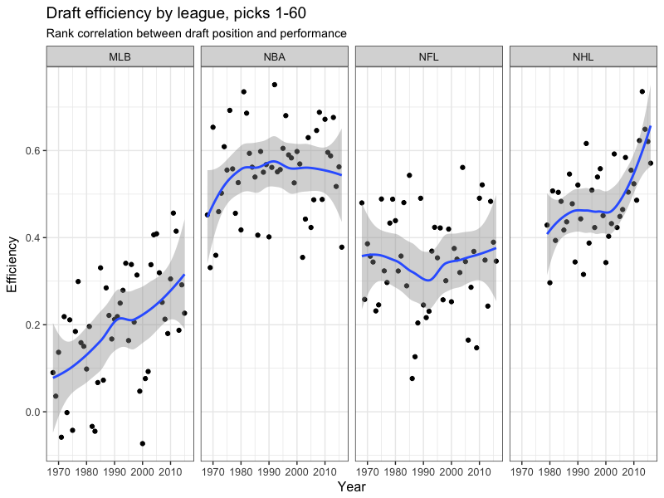
Mike Lopez recently looked at top 60 picks across leagues
(https://statsbylopez.com/2017/04/25/evaluating-the-evaluators/)

Slide 16
Predictions for 2016 NHL Draft
Rank | Player | Height | Weight | Pos | League | CSS Final
1 | Auston Matthews | 74 | 210 | C | NLA | 1
2 | Patrik Laine | 76 | 206 | LW/RW | Liiga | 2
3 | Charles McAvoy | 72 | 208 | D | NCAA | 6
4 | Mikhail Sergachev | 74 | 208 | D | OHL | 8
5 | Logan Brown | 78 | 220 | C | OHL | 7
6 | Matthew Tkachuk | 74 | 200 | LW | OHL | 2
7 | Tyson Jost | 71 | 191 | C/LW | BCHL | 16
8 | Jakob Chychrun | 74 | 205 | D | OHL | 4
9 | Jesse Puljujarvi | 76 | 203 | RW | Liiga | 3
10 | Adam Mascherin | 70 | 206 | C/LW | OHL | 42

Slide 17
Improvements
More than one year previous performance data
Better data for more recent drafts (Sv% from PreDraft League)
Add data on national team selection, Pre Draft team quality
# of CSS ranked player on Pre Draft team (Yakupov/Galchenyuk)

Slide 18
Thank you
schuckers@stlawu.edu
@schuckersM

