Slide 1
NHL Shot Probability Maps
Michael Schuckers
St. Lawrence University schuckers@stlawu.edu
Powerpoint slides based upon poster presentation at 2010 Joint Statistical Meetings
Vancouver, BC
August 2, 2010

Slide 2
DATA
Based on all NHL regular season shots 08-09 and 09-10
  Excludes penalty shots, empty net shots, shootouts
Spatial mapping of probability of a goal
Offensive Zone: Blue line to Goal line
  [Blue line at left, Goal at Right]

Slide 3
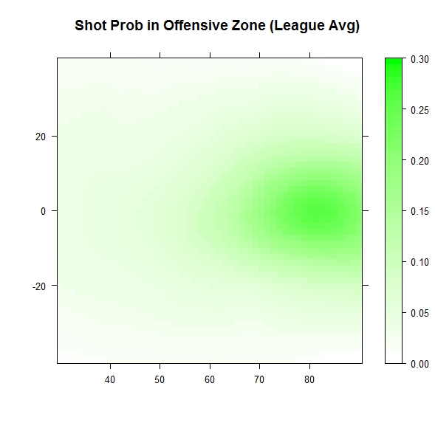
League Average (Darker is higher)
Blue Line
Goal Line
GOAL

Slide 4
Goal probability maps
Maps are differences from league-wide average probability of a goal at a given location
  Red above average (Good for shooters)
  Blue below average (Good for goalies)
  White is league average

Slide 5
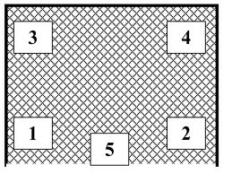
Difference from League Average for each of the 5 holes/zones

Slide 6
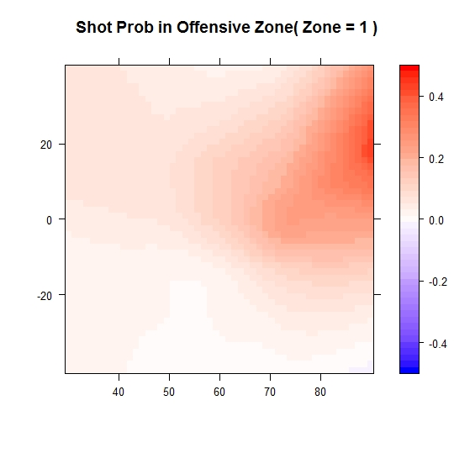
GOAL

Slide 7
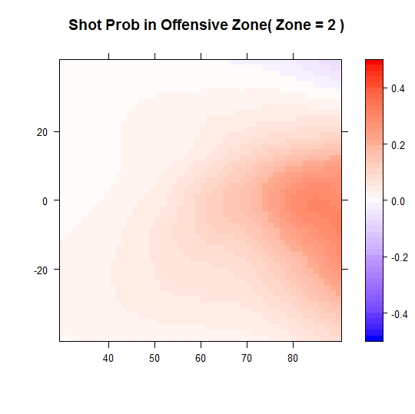
GOAL

Slide 8
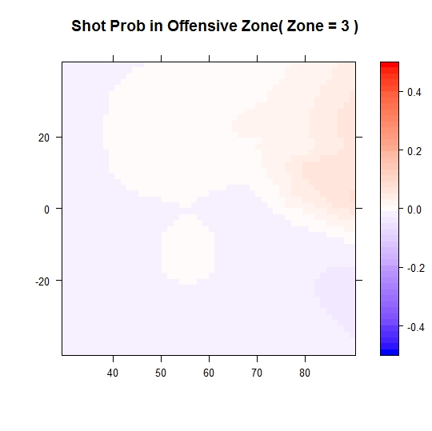
GOAL

Slide 9
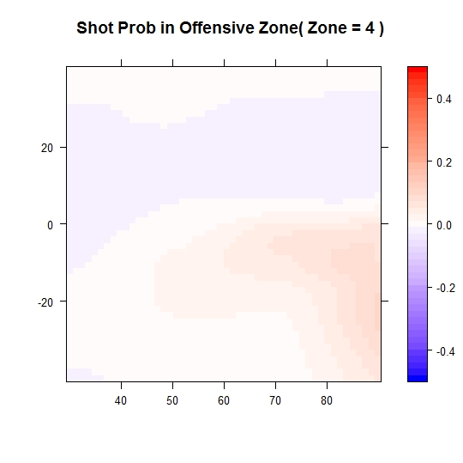
GOAL

Slide 10
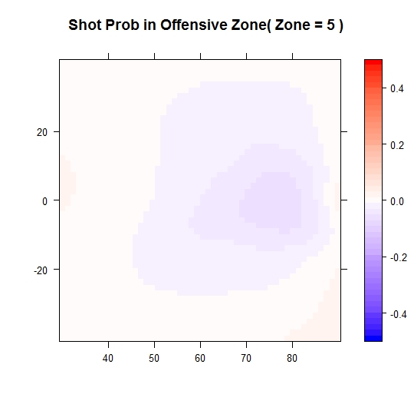
GOAL

Slide 11
Forwards
Red is above average (GOOD)
Blue is below average (BAD)

Slide 12
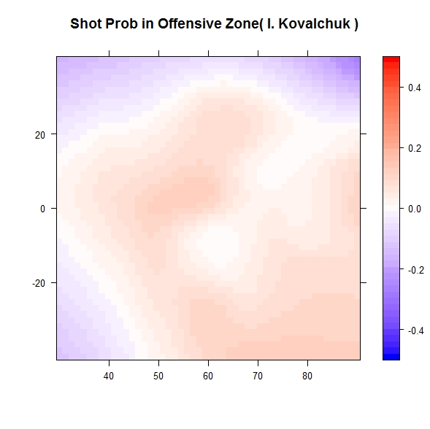
GOAL

Slide 13
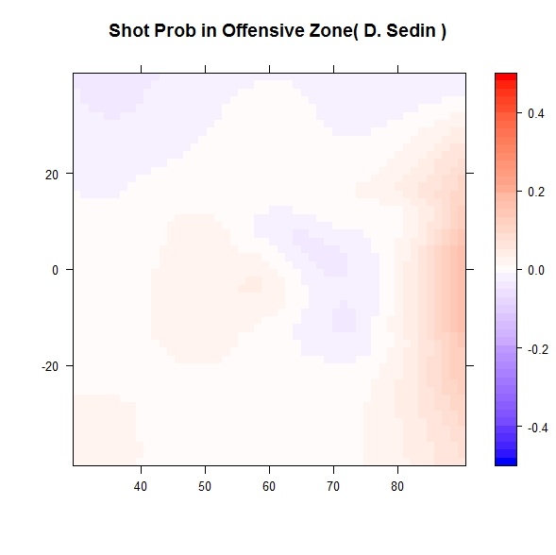
GOAL

Slide 14
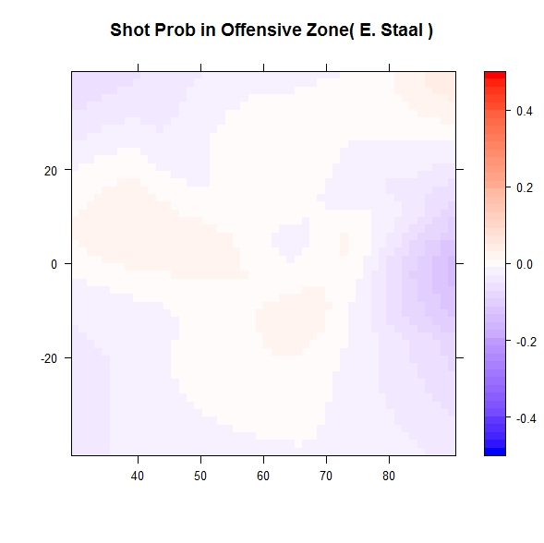
GOAL

Slide 15
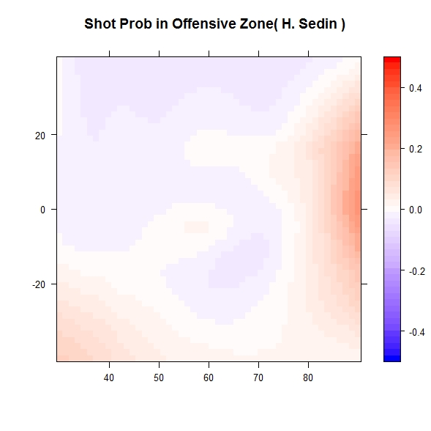
GOAL

Slide 16
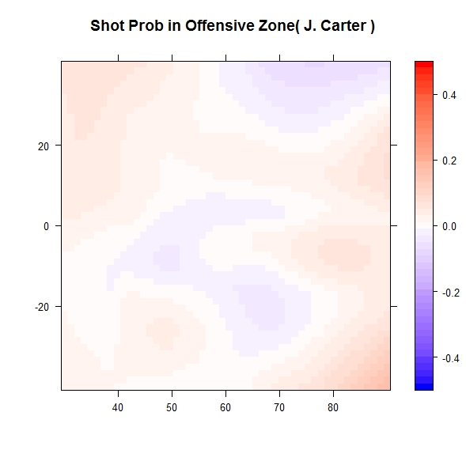
GOAL

Slide 17
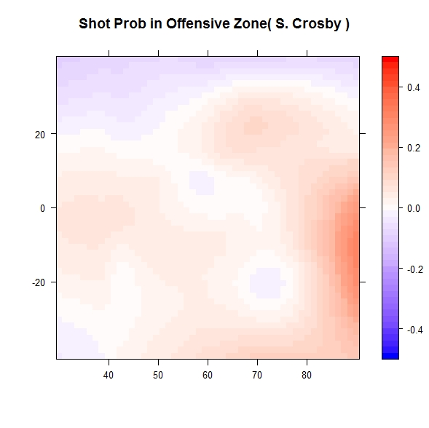
GOAL

Slide 18
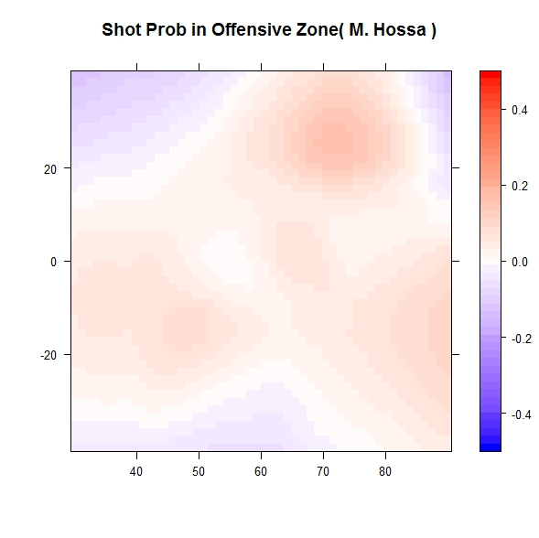
GOAL

Slide 19
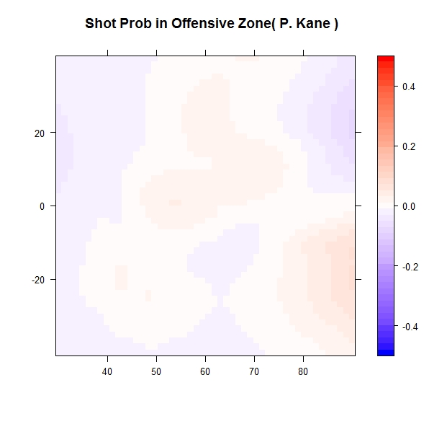
GOAL

Slide 20
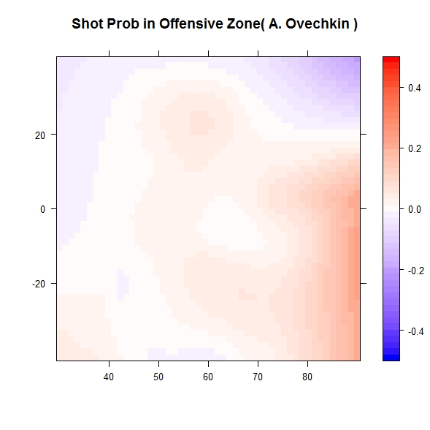
GOAL

Slide 21
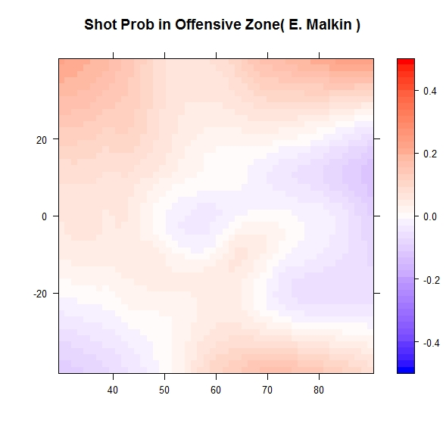
GOAL

Slide 22
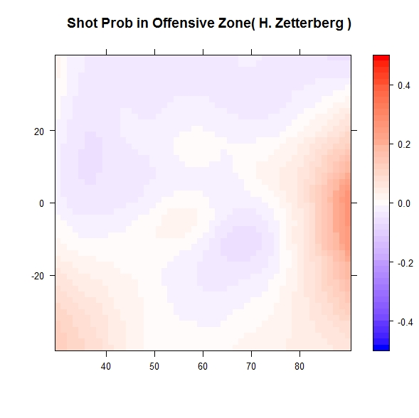
GOAL

Slide 23
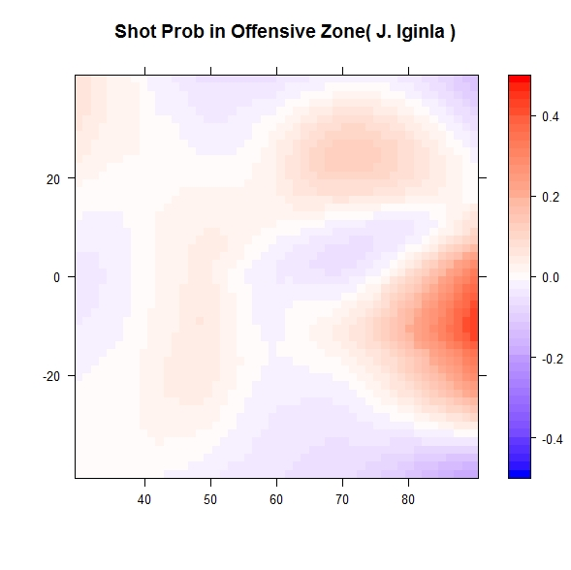
GOAL

Slide 24
GOAL

Slide 25
Goalies
Red is above average (BAD)
Blue is below average (GOOD)

Slide 26
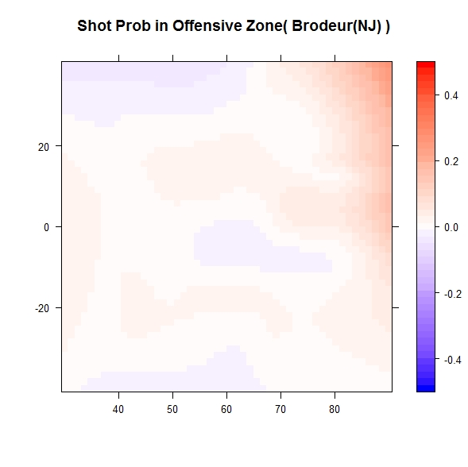
GOAL
Martin Broudeur – Goalie – New Jersey Devils

Slide 27
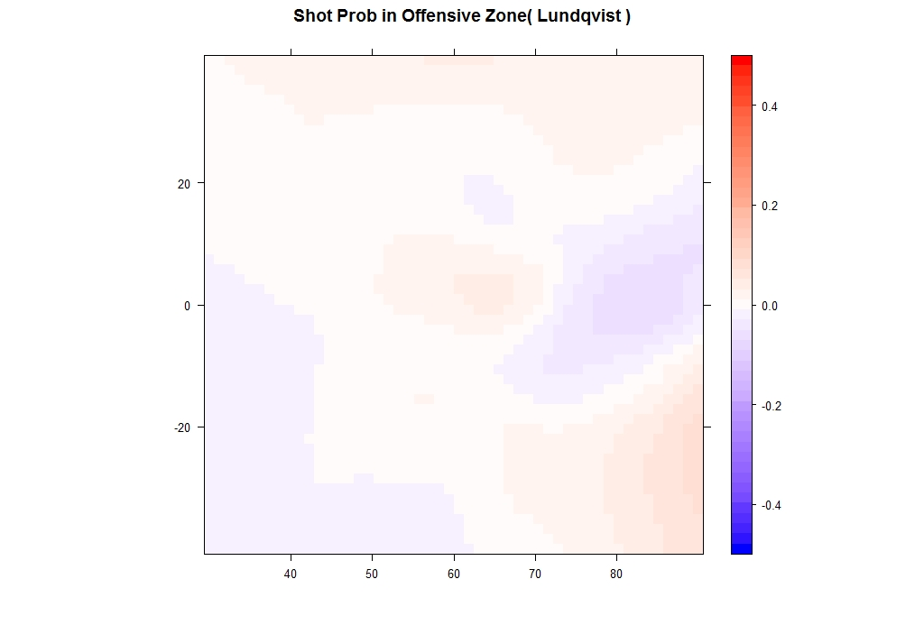
GOAL

Slide 28
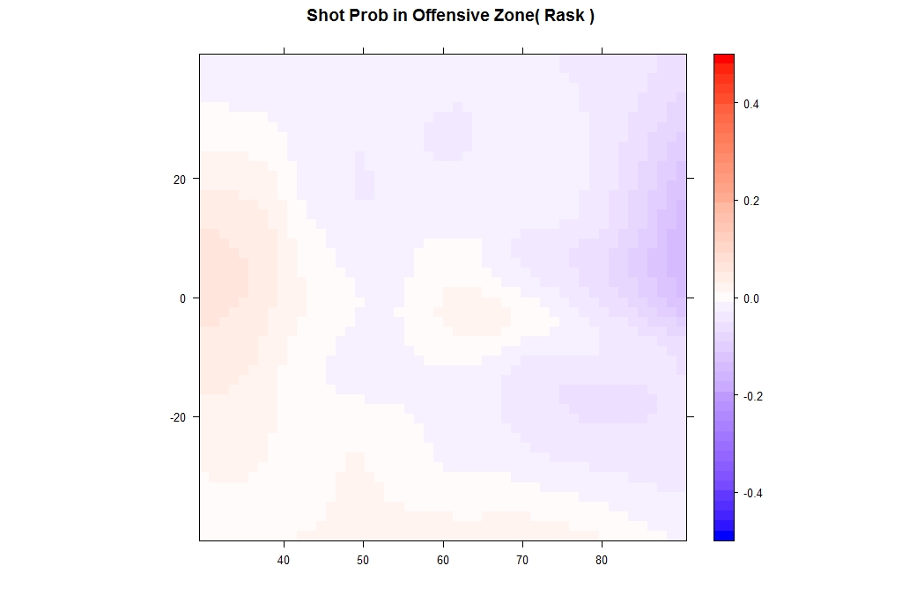
GOAL

Slide 29
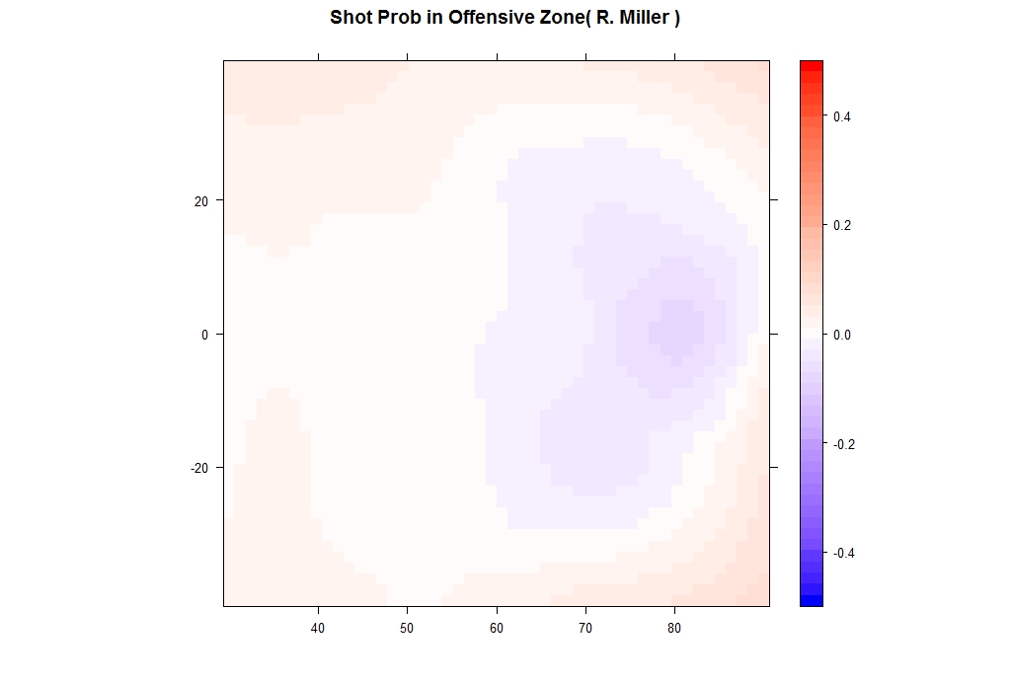
GOAL

Slide 30
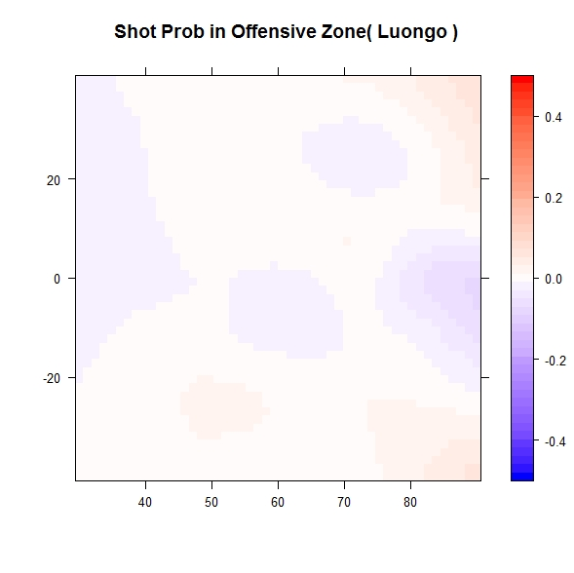
GOAL

Slide 31
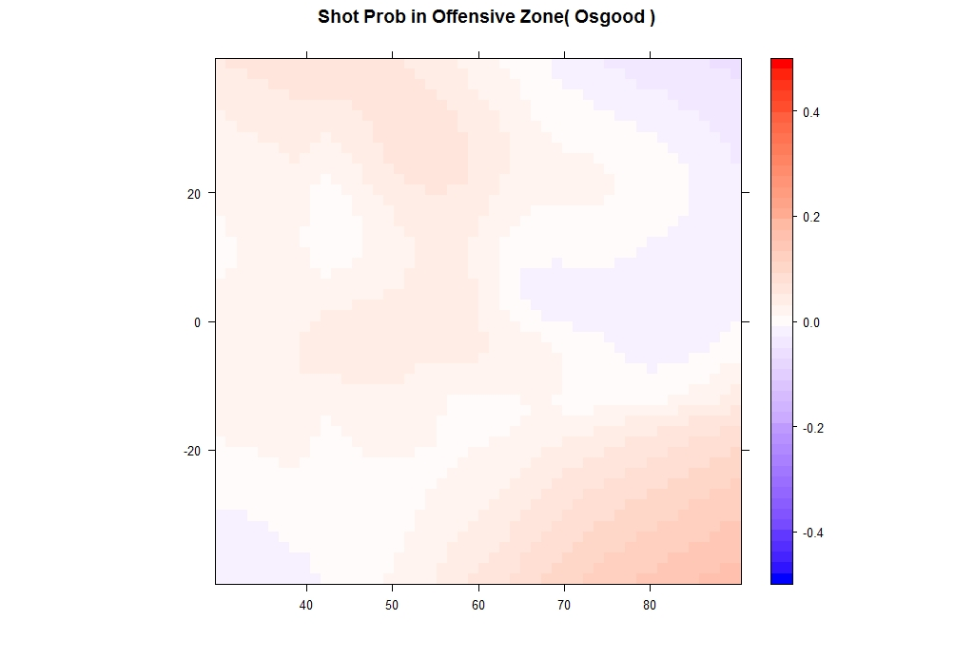
GOAL

Slide 32
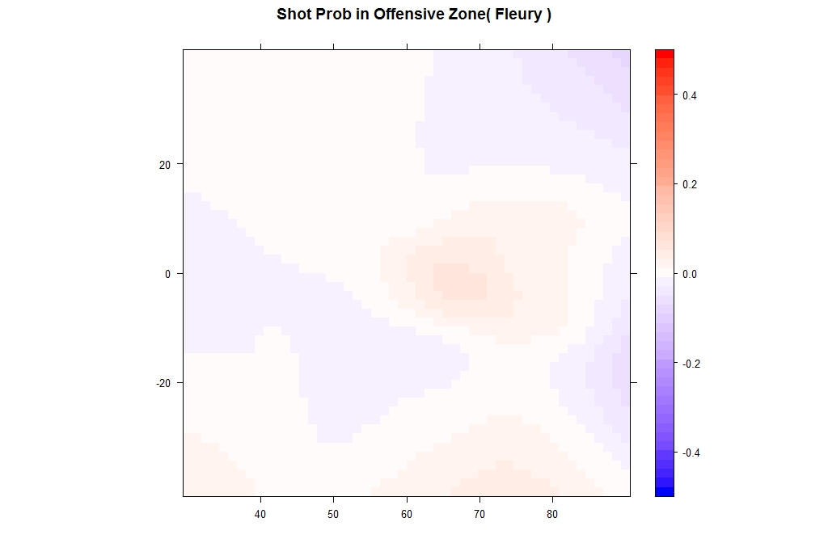
GOAL

Slide 33
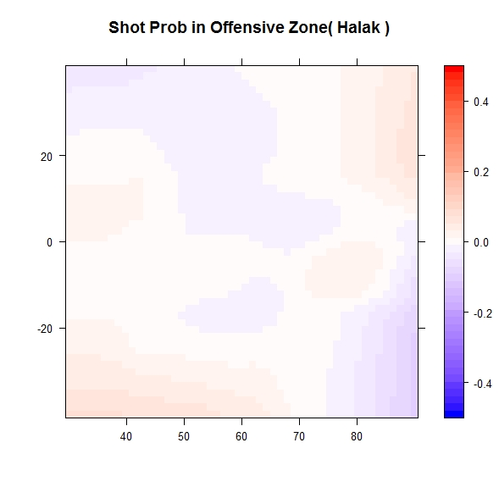
GOAL

Slide 34
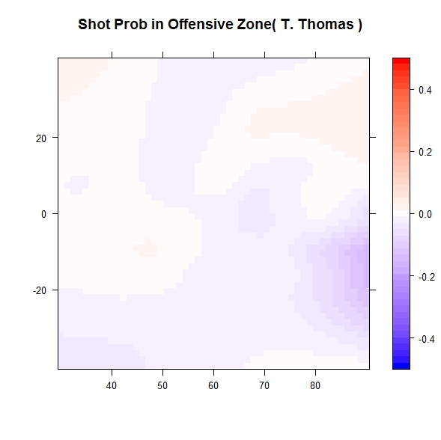
GOAL

Slide 35
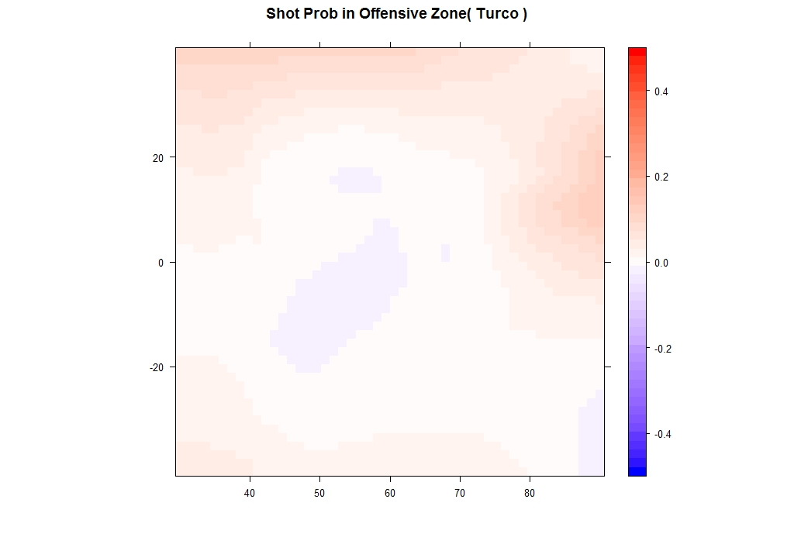
GOAL

Slide 36
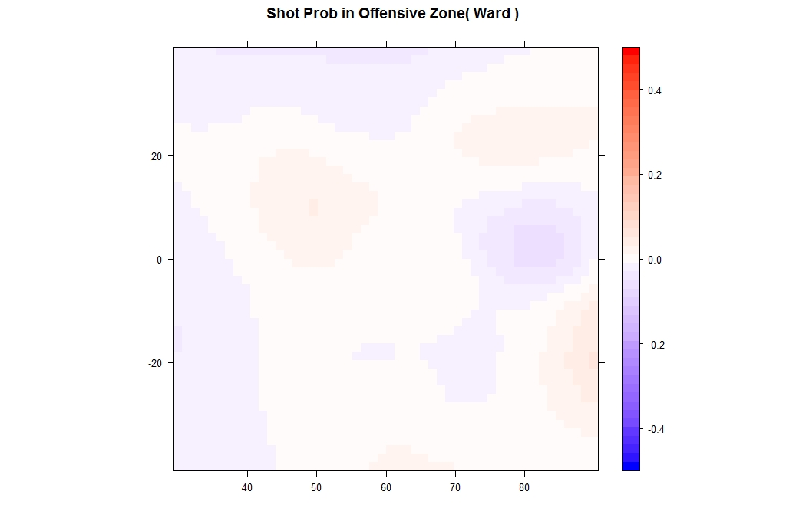
GOAL

Slide 37
GOAL

