Slide 1
An NHL Draft Value Pick Chart
Michael E. Schuckers*
St. Lawrence University
Statistical Sports Consulting
Canton, NY schuckers@stlawu.edu
*Thanks to Chris Smith SLU ‘09, Chris Wells, Steve Bowman, Brian Chezum

Slide 2
Background
2011 Paper in JQAS
  Alternative NFL Draft Value Pick Chart
Hockey Projects
Does not seem to be published work on NHL Draft (Blog posts, Tango (2007))

Slide 3
National Hockey League Draft
30 teams
7 rounds, one pick per team per round
  Plus compensatory picks
Picks traded for players or other draft picks

Slide 4
Data
All players selected 1988 to 1997
  Current vs Career
  First 210 selections per year (n=2100)
Demographics & Performance metrics
Goal: Value Pick Chart for NHL based on performance

Slide 5
Data
Demographics
  Player Name, Team drafted from, NHL Team selected by, Position (F, D, G),
Career Performance
  F/D: NHL Games Played, Goals, Assists, Points, PIM, Plus/Minus
  G: NHL Games Played, Save %, Wins, Losses, SO Wins/Losses, Goals Against Average

Slide 6
Data
Demographics
  Player Name, Team drafted from, NHL Team selected by, Position (F, D, G),
Career Performance
  F/D: NHL Games Played, Goals, Assists, Points, PIM, Plus/Minus
  G: NHL Games Played, Save %, Wins, Losses, SO Wins/Losses, Goals Against Average

Slide 7
Basic Summaries
2100 players
  1212 F, 696 D, 192 G (12: 6 : 2)
  53% of selected players never play in the NHL
  FNS of GP (0, 0, 0, 152, 1652)
  Mean GP of 166.2

Slide 8
Number Selected by Round & Position
Round | D | F | G
1 | 105 | 175 | 20
2 | 78 | 192 | 30
3 | 97 | 181 | 22
4 | 110 | 156 | 34
5 | 103 | 166 | 31
6 | 95 | 181 | 24
7 | 108 | 161 | 31
Chisquared Test (p=0.09)
Notes:
Seem to be some trends:
D not taken much in 2nd round
G few in
None of these seem to be significant

Slide 9
GP Percentiles by Position
Percentile | D | F | G
25th | 0 | 0 | 0
50th | 0 | 0 | 0
75th | 69 | 193 | 83
90th | 644 | 749 | 357
95th | 834 | 970 | 535
99th | 1148 | 1243 | 742
Mean | 149 | 187 | 95
Notes:
Notes on this
Fewer 50% of players selected at each position make NHL for even a single game
Top 10% of F play longer than top 10% of D who play longer than top 10% of G’s
NHL Scout

Slide 10
Summary of GP by Round
Percentile | 1st | 2nd | 3rd | 4th | 5th | 6th | 7th
25th | 45 | 0 | 0 | 0 | 0 | 0 | 0
50th | 436 | 22 | 10 | 0 | 0 | 0 | 0
75th | 878 | 281 | 208 | 32 | 22 | 3 | 0
90th | 1071 | 736 | 691 | 293 | 381 | 393 | 80
95th | 1200 | 859 | 892 | 594 | 580 | 628 | 372
99th | 1363 | 1135 | 1175 | 901 | 989 | 1032 | 903
Mean | 482 | 192 | 182 | 84 | 86 | 87 | 50

Slide 11
Mean GP (SD) by Round and Position
Position | 1st | 2nd | 3rd | 4th | 5th | 6th | 7th
F | 530 (457) | 210 (316) | 207 (330) | 104 (223) | 110 (227) | 93 (233) | 31 (119)
D | 435 (398) | 163 (306) | 167 (307) | 64 (172) | 57 (186) | 89 (228) | 72 (218)
G | 320 (305) | 148 (218) | 42 (83) | 59 (140) | 45 (120) | 36 (101) | 68 (174)

Slide 12
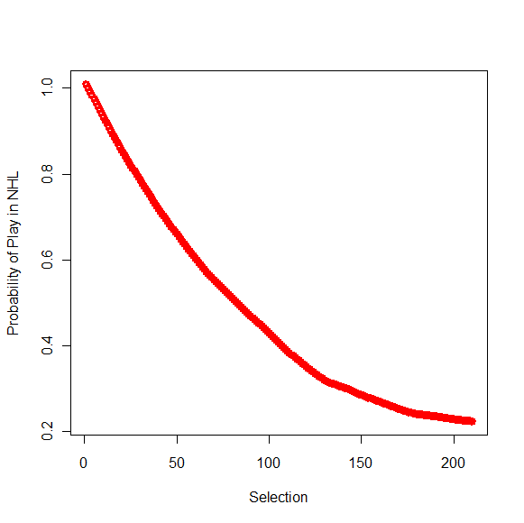
Probability of Play in NHL by Selection

Slide 13
Probability of 200 Games
Position | D | F | G
23.1% | 20.8% | 25.2% | 18.8%
Round | 1st | 2nd | 3rd | 4th | 5th | 6th | 7th
23.1% | 60.3% | 27.3% | 25.7% | 13.3% | 14.3% | 14.0% | 7.3%
Notes:
0.27333333 0.25666667 0.13333333 0.14333333 0.14000000 0.07333333

Slide 14
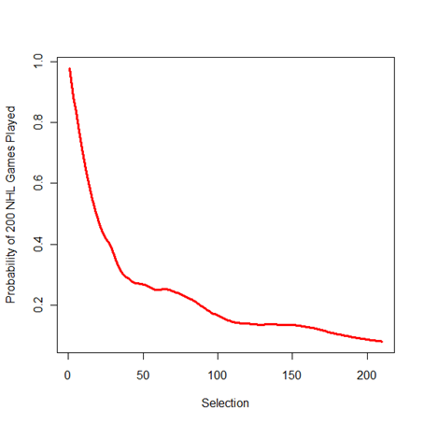
Probability of 200 games (2.5 seasons) by Selection

Slide 15
Where do go players come from
Conditional distribution of Round given Position among
those that play more than 200 games.
Position | Round 1 | Round 2 | Round 3 | Round 4 | Round 5 | Round 6 | Round 7
F | 0.35 | 0.18 | 0.17 | 0.08 | 0.10 | 0.09 | 0.03
D | 0.43 | 0.12 | 0.14 | 0.08 | 0.06 | 0.09 | 0.08
G | 0.33 | 0.25 | 0.08 | 0.11 | 0.09 | 0.06 | 0.08

Slide 16
Goal
How do I value a draft pick?
  Schuckers (2011)
  Performance of players at that selection in past
    Adjustments
      Needs
      Finances

Slide 17
Games Played by Selection

Slide 18
Towards Value Pick Chart
LOESS
GP as response
Spline
  1st 45 picks (small span, in R span = 0.2)
  Remaining picks (larger span in R span = 0.5)
Value for trades based upon performance

Slide 19
Value Pick Chart

Slide 20
Who Drafted Well
Compare Team Performance
Expansion during this period (1988 to 1997)
Compared for each team V = Σ (GP – E(GP) )/n
  E(GP) from Value Pick Chart
  n is number of picks for team

Slide 21
Teams Drafting
Best
Worst
Buffalo (V=52.1)
New Jersey (V=36.1)
St. Louis (V=31.9)
Detroit (V=27.3)
Boston (V=24.5)
Chicago (V= -56.9)
Edmonton (V= -44.3)
Tampa Bay (V=-37.8)
Calgary (V=-37.7)
Washington (V=-27.1)
Notes:
Boston Bruins Detroit Red Wings St. Louis Blues New Jersey Devils
24.485818 27.297287 31.936391 36.061174 42.468461
Buffalo Sabres
52.108146
Chicago Blackhawks Edmonton Oilers Tampa Bay Lightning Calgary Flames Washington Capitals
-56.857012 -44.321103 -37.844607 -37.733420 -27.140310

Slide 22
Summary
Analysis of NHL Draft
Develop NHL Draft Pick Value Chart

Slide 23
Thank You! schuckers@stlawu.edu michael.schuckers@statsportsconsulting.com

