Slide 1
An evaluation of NFL team drafting performance (1991-2001)
Michael Schuckers
St. Lawrence University
Statistical Sports Consulting
michael.schuckers@statsportsconsulting.com
Thanks to Jim Curro (data entry), Brian Chezum (discussion)

Slide 2
Background
NFL Draft Value Pick Chart (VPC)
“Created” by Jimmy Johnson c. 1994(?)
Loser’s Curse (2005, 2010)
Values of players based upon 2nd contract

Slide 3
Similar work
Revised versions of the VPC
Pro Football Reference
http://www.pro-football-reference.com/blog/?p=527
NFL Draft 101
http://www.nfldraft101.com/draft/articles/407/Updating_the_NFL_Draft_Trade_Value_Chartjsp

Slide 4
From The Draft by Pete Williams (2006, St. Martin's Press)
[Billy] Beane's philosophies were chronicled in the best-selling book "Moneyball" by Michael Lewis. [Rich] McKay [of the Atlanta Falcons] enjoyed the work of Lewis, a fellow Princeton graduate, and admired Beane for going against the grain of the rest of the league. At the same time McKay saw no application to football..
Emphasis is mine

Slide 5
Goals
Value draft picks based upon on-field performance
Common metric all positions
Limiting
Reasonable?

Slide 6
Data
All Picks from 1991-2001
Focus on 1st 256 (2010 draft had 255 selections)
Source: www.pro-football-reference.com measures of players performance

Slide 7
Variables
Demographics
Year Selected, Round, Team making selection, Player Name, Position, College Selected From
Performance (General)
Last Year in NFL, Number of 1st Team All Pro Selection, Pro Bowl Selections, Games Started, Games Played, Career Approximate Value*

Slide 8
Variables
Performance Specific – QB
Passes Completed, Passes Attempted, Total Passing Yards, Total Passing TDs, Total Interceptions Thrown,
Performance Specific – RB
Rush Attempts, Rush Yds, Rush TDs,
Performance Specific – Receivers
Receptions, Receiving Yds, Receiving TD
Performance Specific – Defense
Tackles, INT, Sacks

Slide 9
Basics
N=2853
Position Breakdown
DB K KR LB QB RB TE WR DL OL
519 48 1 384 128 297 172 357 471 476

Slide 10
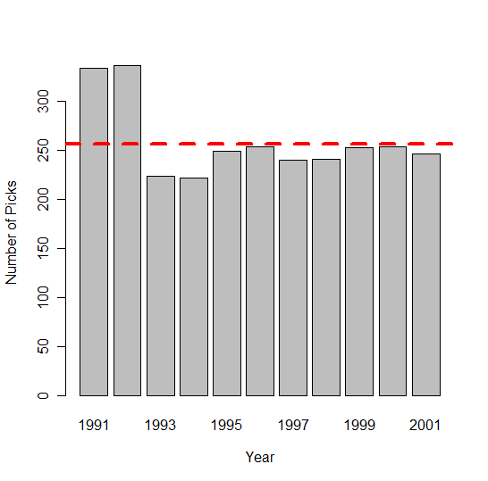
Draft Picks by Year 1991-2001
2010 Draft n=255
2009 Draft n=256

Slide 11
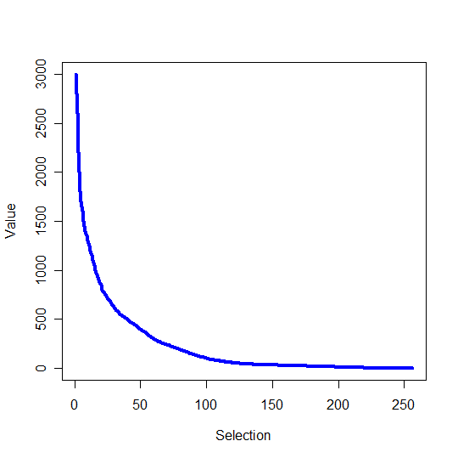
NFL Value Pick Chart
http://sports.espn.go.com/nfl/draft06/news/story?id=2410670

Slide 12
Approach
Non-parametric
Smooth function
LOESS in R, degree=2, span =0.5

Slide 13
General performance measures

Slide 14
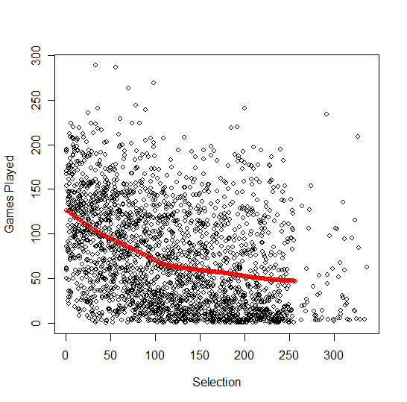
Games Played v. Selection

Slide 15
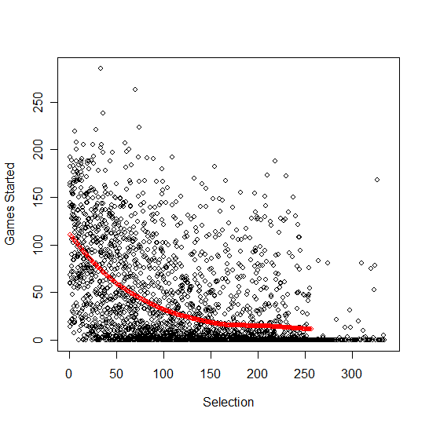
Games Started v. Selection

Slide 16
NFL Value Pick Chart
http://sports.espn.go.com/nfl/draft06/news/story?id=2410670

Slide 17
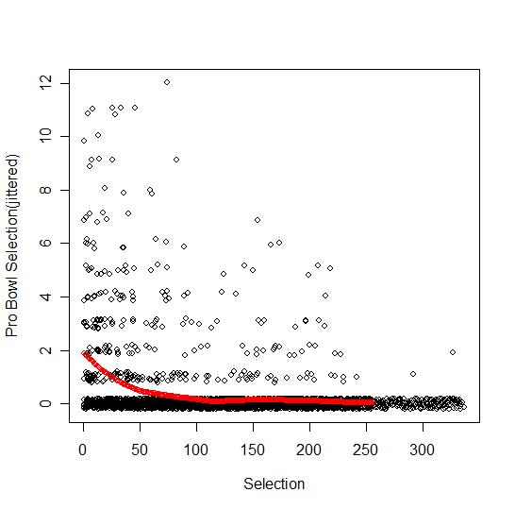
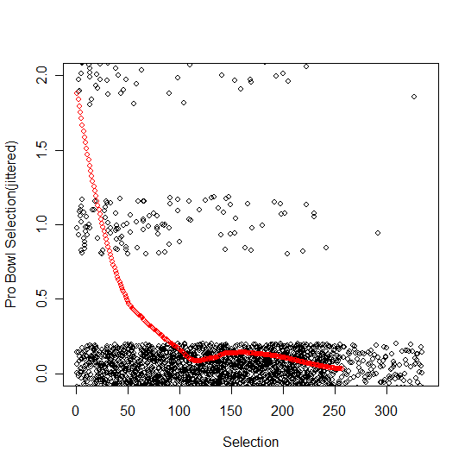
Pro Bowl v Selection

Slide 18
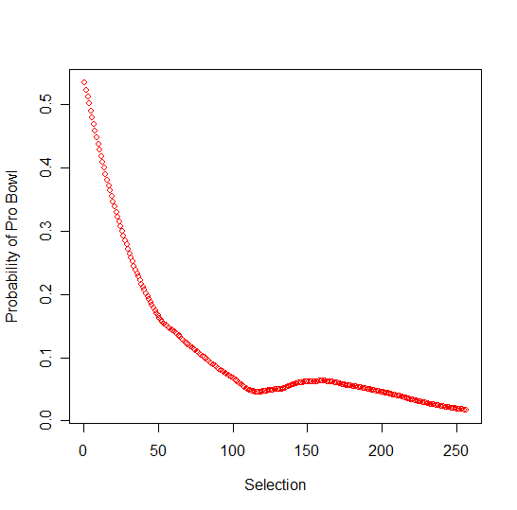
Probability of Pro Bowl

Slide 19
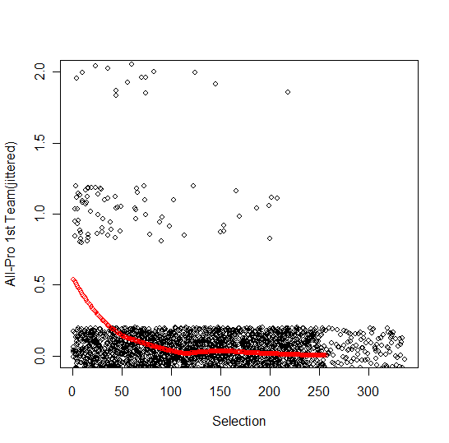
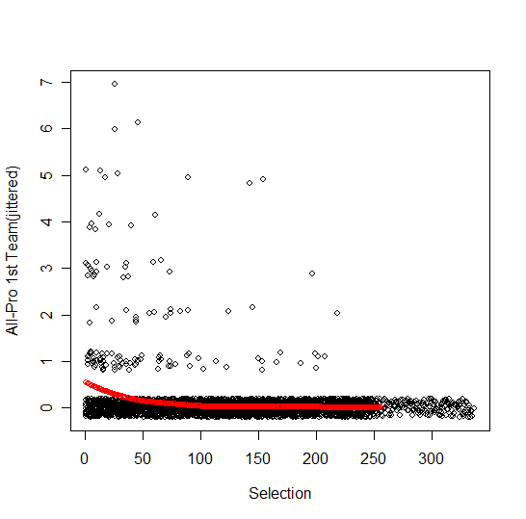
All Pro 1st Team v Selection

Slide 20
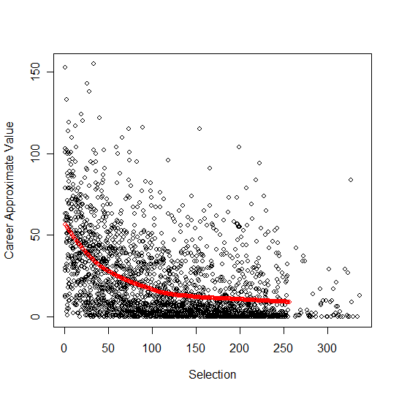
Career Approximate Value
Source: Pro-football-reference.com

Slide 21
Specific performance measures

Slide 22
Quarterbacks

Slide 23
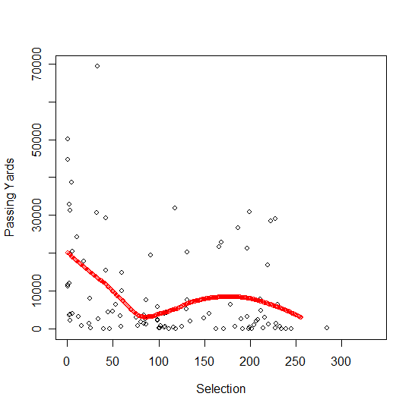
QB’s – Passing Yards

Slide 24
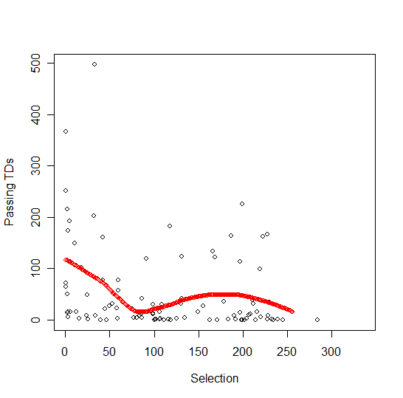
QBs – Passing TDs

Slide 25
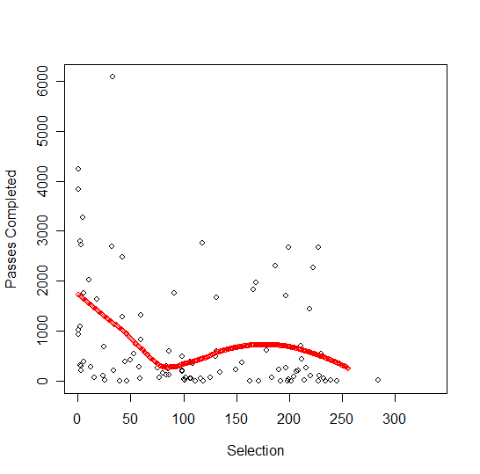
QBs- Passes Completed

Slide 26
NFL Value Pick Chart
http://sports.espn.go.com/nfl/draft06/news/story?id=2410670

Slide 27
Running backs

Slide 28
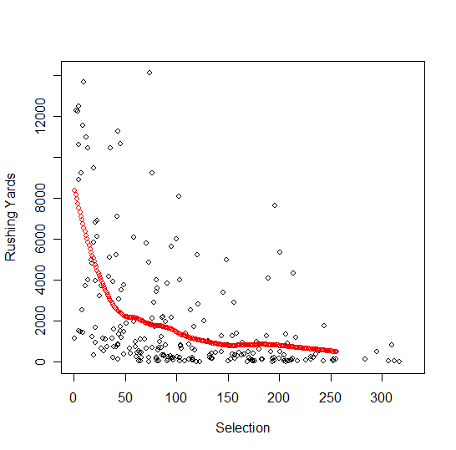
RB’s Rushing Yards

Slide 29
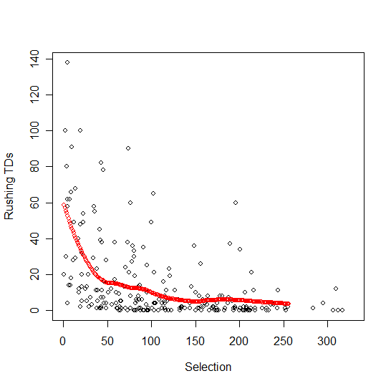
RBs -- Rushing TDs

Slide 30
NFL Value Pick Chart
http://sports.espn.go.com/nfl/draft06/news/story?id=2410670

Slide 31
Wide receivers

Slide 32
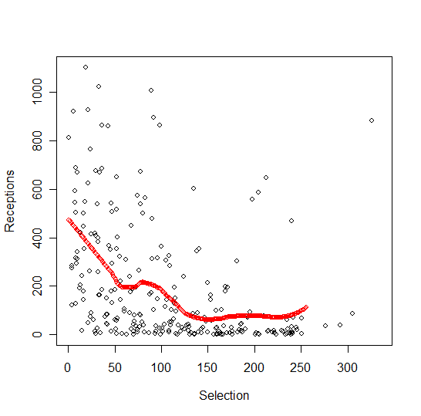
WRs Receptions

Slide 33
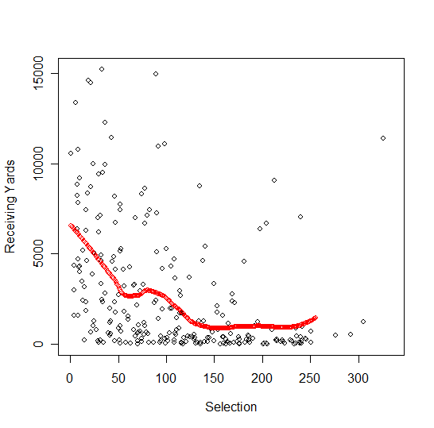
WRs – Receiving Yards

Slide 34
WRs Receiving TDs

Slide 35
NFL Value Pick Chart
http://sports.espn.go.com/nfl/draft06/news/story?id=2410670

Slide 36
Tight ends

Slide 37
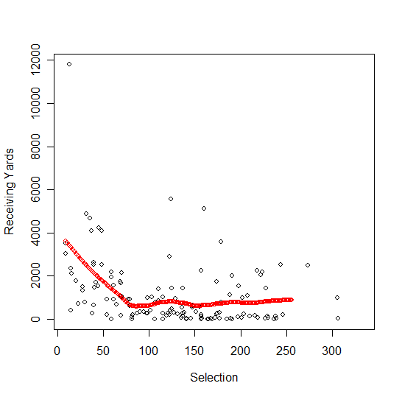
TE’s –Receiving Yards

Slide 38
TE’s – Receiving TD’s

Slide 39
NFL Value Pick Chart
http://sports.espn.go.com/nfl/draft06/news/story?id=2410670

Slide 40
Offensive lineman

Slide 41
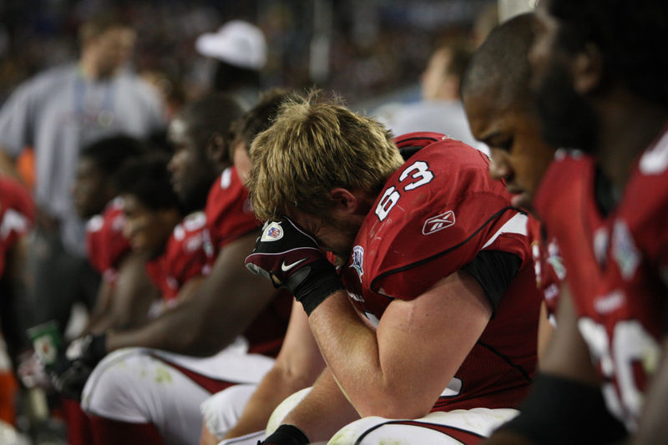

Slide 42
Defensive players

Slide 43
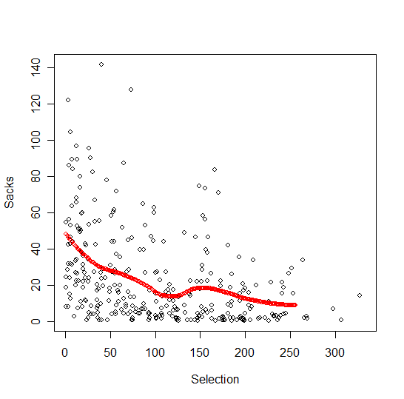
DL’s-- Sacks

Slide 44
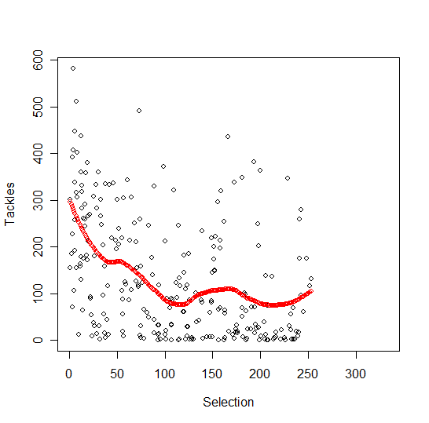
DL’s -- Tackles

Slide 45
LB’s -- Tackles

Slide 46
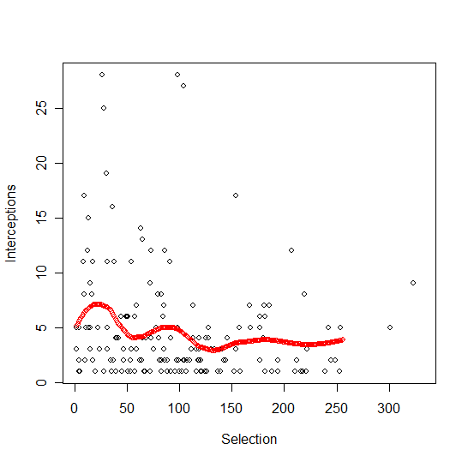
LB’s -- Interceptions

Slide 47
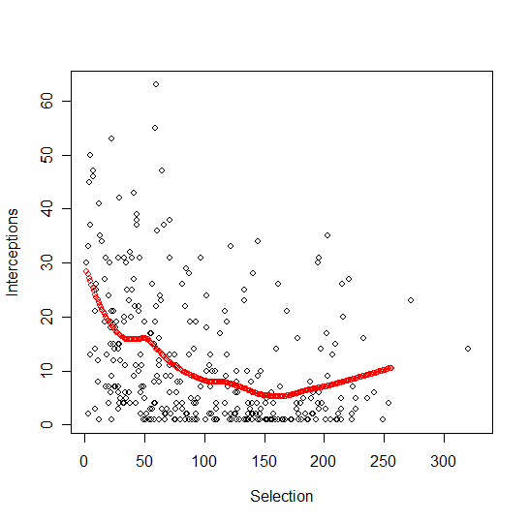
DB’s -- Interceptions

Slide 48
Summary
Current VPC seems not to agree with performance based metrics/decline of VPC too steep
Metrics (GS, CarAV, G, Position metric – {LB Ints, QB’s} ) seem to have similar pattern
Pro Bowl metrics seem to be steeper
Bumps likely due to samples size (QB’s, TE’s) ??
GS vs GS + PB
GS simpler
GS more similar to position level performance

Slide 49
Games Started as Value (Equal Sum)

Slide 50
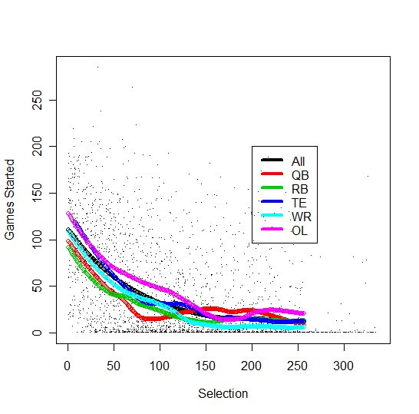
Games Started by Offensive Position

Slide 51
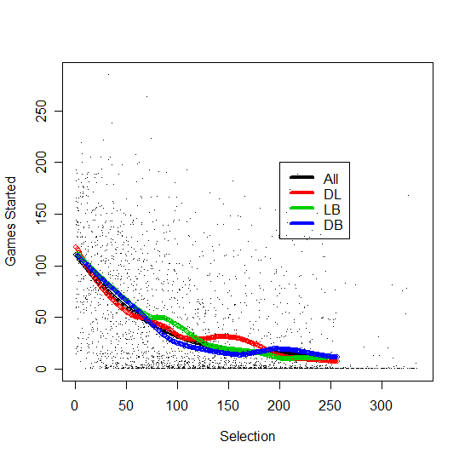
Games Started by Defensive Position

Slide 52
Limitations
Changes over time
Active players
Edge behavior/Monotonicity
Other revenue sources (jerseys, tickets, etc.)
Value on getting need

Slide 53
An Alternative to the NFL Draft Pick Value Chart Based upon Player Performance
M. Schuckers
(to appear, 2011?)
Journal of Quantitative Analysis in Sports

Slide 54
BEST/WORST PICKS (1991-2001)

Slide 55
Assessing an Individual Pick
Performance based upon Value over Expectation
Z-score for each pick
GS=Games Started
M_{GS}= Predicted Games Started from Loess
S_{GS}= Smoothed Standard Deviation from Raw Mean

Slide 56
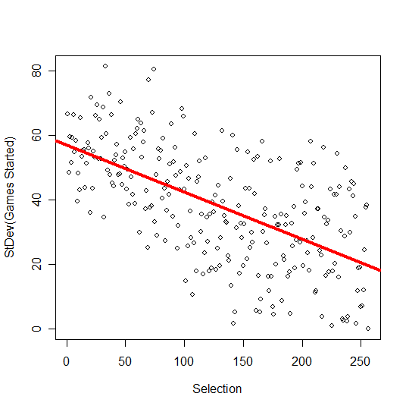
SD(GS) vs Selection

Slide 57
Evaluation of Teams
Only players through Selection 256
Couple of Methods:
Sum of Z-scores over all years (1991-2001)
Median of Yearly Sum (1991-2001)
Best Single Drafts by Sum (1991-2001)

Slide 58
GS by Year (mean GS=36.5)
Draft Year | Total Games Played | Players Still Active | Sum Z
1991 | 8523 | 2 | 13.56
1992 | 8554 | 1 | -5.67
1993 | 10236 | 5 | 46.39
1994 | 8337 | 3 | -0.75
1995 | 8678 | 5 | -7.10
1996 | 10017 | 8 | 20.43
1997 | 8672 | 17 | -6.77
1998 | 9181 | 25 | 3.59
1999 | 8737 | 35 | -4.80
2000 | 8931 | 49 | -2.15
2001 | 8531 | 64 | -14.76

Slide 59
Win Pct (1995-2005)
Best:
Denver 0.648
Green Bay 0.642
Pittsburgh 0.623
New England 0.608
Kansas City 0.580
Worst:
Browns 0.320
Cardinals 0.341
Detroit 0.381
Cincinnati 0.386
New Orleans 0.398

Slide 60
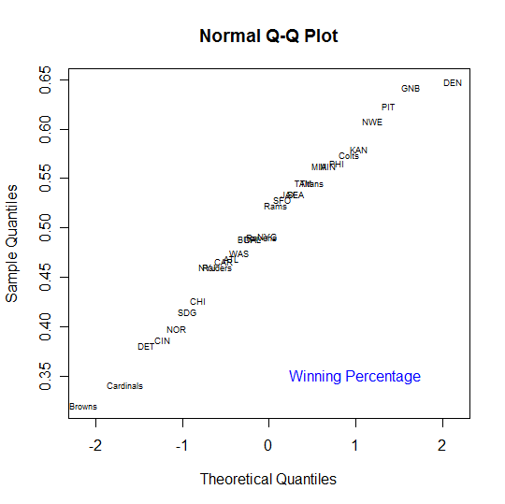

Slide 61
Total Standardized Draft Quality
Best
Green Bay 22.83
Titans 18.41
Pittsburgh 17.46
Tampa Bay 11.92
Colts 11.01
Worst
San Diego -18.62
New Orleans -13.55
Philadelphia -11.70
Washington -9.90
Chicago -9.89

Slide 62
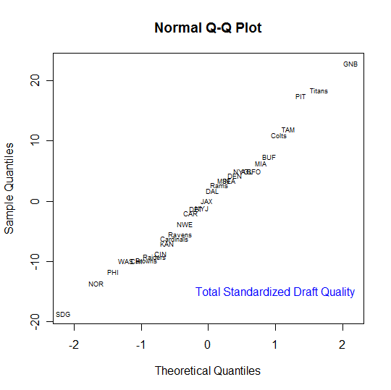

Slide 63
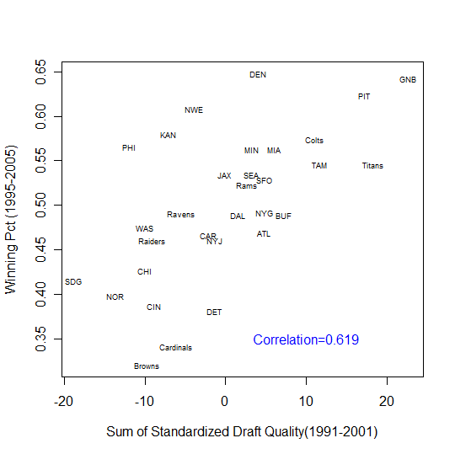

Slide 64
Median Yearly Standardized GS
Best:
Green Bay 3.06
Pittsburgh 1.88
Titans 1.30
Miami 1.19
Detroit 1.15
Worst:
Kansas City -2.40
Cincinnati -2.01
San Diego -1.97
New Orleans -1.81
New England -1.58

Slide 65
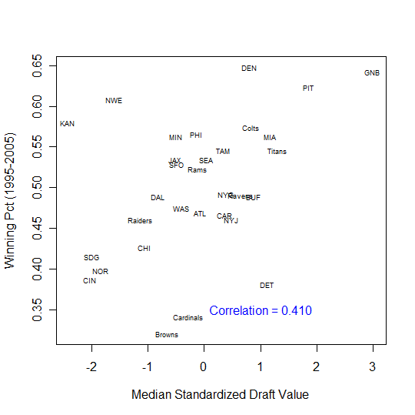

Slide 66
Evaluation of Teams

Slide 67
5 Best/Worst NFL Drafts 1991-2001
Best
Dallas 1993
Titans 1991
Kansas City 1996
Pittsburgh 1996
New England 1995
Worst
Browns 2000
Detroit 1997
Philadelphia 1992
Dallas 1995

Slide 68
Best: Dallas 1993
Rnd Pick Name Pos GS GS.z
716 2 46 Kevin Williams WR 68 0.1096503
724 2 54 Darrin Smith LB 140 1.7042106
754 3 84 Mike Middleton DB 0 -0.8782472
764 4 94 Derrick Lassic RB 3 -0.7294979
766 4 96 Ron Stone G 142 2.5274200
838 6 168 Barry Minter LB 61 1.3941602
866 7 196 Brock Marion DB 154 4.9065573
873 8 203 Dave Thomas DB 53 1.3976275
883 8 213 Reggie Givens LB 0 -0.5525918

Slide 69
Best: Titans 1991 (picks less than 256)
Rnd Pick Name Pos GS GS.z
28 2 28 Mike Dumas DB 53 -0.4888527
38 2 38 Darryll Lewis DB 95 0.5007535
44 2 44 John Flannery G 46 -0.3587692
71 3 71 Steve Jackson DB 26 -0.4298808
79 3 79 Kevin Donnalley G 144 2.2530194
101 4 101 David Rocker DT 4 -0.6522368
102 4 102 Marcus Robertson DB 144 2.6869948
129 5 129 Gary Wellman WR 3 -0.5250520
183 7 183 Kyle Freeman LB 0 -0.5026457
214 8 214 Gary Brown RB 47 1.2707588
240 9 240 Shawn Jefferson WR 130 5.3616208

Slide 70
Worst: Browns 2000
Rnd Pick Name Pos GS GS.z
2354 1 1 Courtney Brown DE 60 -0.88708814
2385 2 32 Dennis Northcutt WR 61 -0.26630882
2416 3 63 Travis Prentice RB 11 -0.83459655
2432 3 79 JaJuan Dawson WR 4 -0.83330856
2448 4 95 Lewis Sanders DB 29 -0.11618454
2463 4 110 Aaron Shea TE 30 0.04405931
2483 5 130 Anthony Malbrough DB 1 -0.57449962
2499 5 146 Lamar Chapman DB 0 -0.53622010
2536 6 183 Spergon Wynn QB 3 -0.40343933
2559 6 206 Brad Bedell T 4 -0.39411300
2560 7 207 Manuia Savea G 0 -0.54578538
2562 7 209 Eric Chandler DE 0 -0.54800430
2578 7 225 Rashidi Barnes DB 0 -0.56353709

Slide 71
Worst: Detroit 1997
Rnd Pick X Pos GS GS.z
1624 1 5 Bryant Westbrook DB 55 -0.8927175
1654 2 35 Juan Roque T 3 -1.3331054
1673 2 54 Kevin Abrams DB 11 -0.9286417
1749 4 130 Matt Russell LB 0 -0.6008528
1754 5 135 Pete Chryplewicz TE 3 -0.4970569
1780 5 161 Duane Ashman DE 0 -0.4904492
1787 6 168 Tony Ramirez T 10 -0.1788967
1825 7 206 Terry Battle RB 0 -0.5428349
1851 7 232 Marcus Harris WR 0 -0.5580671
1858 7 239 Richard Jordan LB 3 -0.4253834

Slide 72
10 Best Value Draft Picks (1991-2001)
Year Rnd Pick Tm Name Pos GS GS.z
1994 7 218 DEN Tom Nalen C 188 6.914220
1995 7 230 GNB Adam Timmerman G 172 6.788772
1999 7 237 ATL Todd McClure C 150 6.141543
1999 7 210 IND Hunter Smith P 173 6.023353
1991 9 240 HOU Shawn Jefferson WR 130 5.361621
1992 9 232 NWE David Dixon G 134 5.238909
1991 8 207 TAM Marty Carter DB 151 5.098981
1996 7 242 PIT Carlos Emmons LB 121 5.027348
1993 7 196 DAL Brock Marion DB 154 4.906557
1997 7 229 NYJ Jason Ferguson DT 127 4.831925

Slide 73
10 Worst Value Draft Picks (1991-2001)
Year Rnd Pick Tm Name Pos GS GS.z
2001 1 10 GNB Jamal Reynolds DE 0 -1.785399
1994 1 5 IND Trev Alberts LB 7 -1.748016
1991 1 15 PIT Huey Richardson LB 0 -1.699386
1995 1 1 CIN Ki-Jana Carter RB 14 -1.698342
1997 1 15 MIA Yatil Green WR 1 -1.681093
1993 1 18 PHO Ernest Dye T 2 -1.613480
1992 1 1 IND Steve Emtman DE 19 -1.610162
1999 1 3 CIN Akili Smith QB 17 -1.607826
1991 1 16 SEA Dan McGwire QB 5 -1.590201
1997 1 11 ATL Michael Booker DB 10 -1.585566

Slide 74
Conclusions
Big Idea: New VPC based upon past player performance
Metric is Career Games Started
Evaluation Draft Performance
Directly project value of current player for draft pick

Slide 75
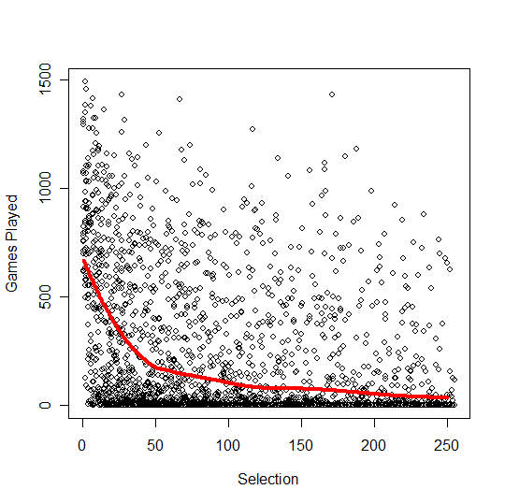
NHL – Games Played

Slide 76
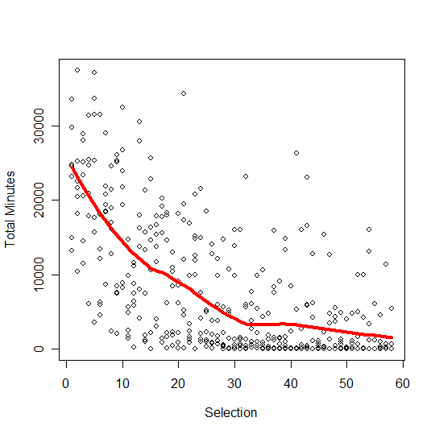
NBA Total Minutes(left), Games Played (right)

Slide 77
Best: Kansas City 1996
Rnd Pick Name Pos GS GS.z
1393 1 28 Jerome Woods DB 105 0.4964318
1423 2 58 Reggie Tongue DB 116 1.2826683
1433 3 68 John Browning DT 96 1.0285191
1463 4 98 Donnie Edwards LB 180 3.4554970
1500 5 135 Joe Horn WR 114 2.4852846
1541 6 176 Dietrich Jells WR 4 -0.3615101
1576 7 211 Ben Lynch C 2 -0.4738458
1606 7 241 Jeff Smith C 33 0.9538257
1610 7 245 Darrell Williams DB 0 -0.5606509

Slide 78
Best: Pittsburgh 1996
Rnd Pick Name Pos GS GS.z
1394 1 29 Jamain Stephens T 15 -1.1932078
1437 3 72 Steve Conley LB 0 -0.9810447
1457 3 92 Jon Witman RB 42 0.1518247
1491 4 126 Earl Holmes LB 131 2.7824169
1497 4 132 Jahine Arnold WR 0 -0.5922146
1528 5 163 Israel Raybon DE 0 -0.4887181
1565 6 200 Orpheus Roye DT 128 4.0766019
1568 6 203 Spence Fischer QB 0 -0.5414892
1607 7 242 Carlos Emmons LB 121 5.0273476

Slide 79
Best: New England 1995
Rnd Pick Name Pos GS GS.z
1139 1 23 Ty Law DB 189 1.9624840
1173 2 57 Ted Johnson LB 106 1.0605415
1190 3 74 Curtis Martin RB 166 2.6384115
1204 3 88 Jimmy Hitchcock DB 61 0.5402612
1228 4 112 Dave Wohlabaugh C 128 2.4776137
1311 6 195 Dino Philyaw RB 0 -0.5228948
1350 7 234 Carlos Yancy DB 0 -0.5607959

Slide 80
Worst: Philadelphia 1992
382 2 48 Siran Stacy RB 0 -1.2212074
409 3 75 Tommy Jeter DT 0 -0.9555331
426 4 92 Tony Brooks RB 0 -0.8143327
436 4 102 Casey Weldon QB 0 -0.7401731
463 5 129 Corey Barlow DB 0 -0.6038098
494 6 160 Jeff Sydner WR 0 -0.4913034
521 7 187 William Boatwright G 0 -0.5091307
548 8 214 Chuck Bullough LB 1 -0.5168530
575 9 241 Ephesians Bartley LB 0 -0.5594555

Slide 81
Worst: Dallas 1995
Rnd Pick Name Pos GS GS.z
1162 2 46 Sherman Williams RB 3 -1.1862166
1175 2 59 Kendell Watkins TE 0 -1.1042215
1179 2 63 Shane Hannah G 0 -1.0652639
1208 3 92 Charlie Williams DB 11 -0.5612914
1226 4 110 Eric Bjornson TE 41 0.3133107
1245 4 129 Alundis Brice DB 2 -0.5513046
1246 4 130 Linc Harden LB 0 -0.6008528
1282 5 166 Edward Hervey WR 0 -0.4891209
1284 5 168 Dana Howard LB 0 -0.4873392
1352 7 236 Oscar Sturgis DE 0 -0.5591573

Slide 82
Worst: Washington 1992
Rnd Pick Name Pos GS GS.z
338 1 4 Desmond Howard WR 29 -1.3756044
381 2 47 Shane Collins DE 10 -1.0337090
408 3 74 Paul Siever G 0 -0.9633674
446 4 112 Chris Hakel QB 0 -0.6779540
502 6 168 Ray Rowe TE 0 -0.4873392
530 7 196 Calvin Holmes DB 0 -0.5255766
558 8 224 Darryl Moore G 0 -0.5642811
586 9 252 Boone Powell LB 0 -0.5690944

