Slide 1
Pose Estimation in hockey videos using convolutional neural networks
Helmut Neher, Mehrnaz Fani, David Clausi, Alex Wong, John Zelek

Slide 2
What are some challenges when evaluating hockey player performance?
Data derived manually is time consuming
Data may reflect dependence on other players
Limited amount of data

Slide 3
Previous Works
Delta SOT by Rob Vollman
Modified Corsi, DIGR, THoR by Michael Shuckers et al.
Scoring rates are modeled using home-ice advantage by Andrew Thomas et al.
Scoring models based on time of scoring and opponent by Leto Peel et al.

Slide 4
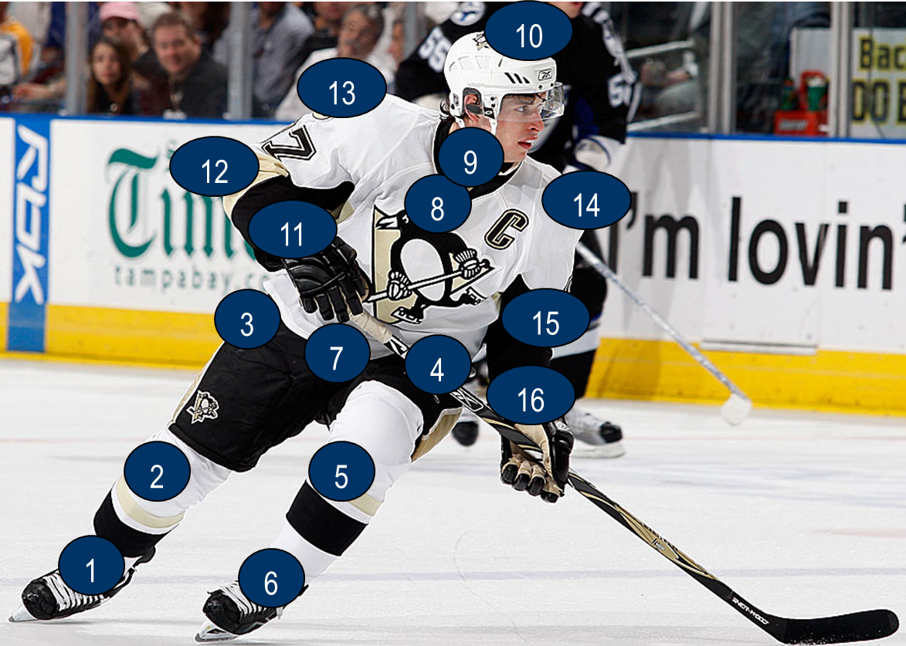
Pose Estimation
Pose estimation is estimating the locations of limbs, joints, and overall configuration of a player
Knowing the locations of the limbs, and joints shooting techniques and actions of a player can be assessed
Notes:
To solve these challenges, use pose estimation
Hockey analytics is getting more scientific and we are trying to quantitatively understand what a person is doing

Slide 5
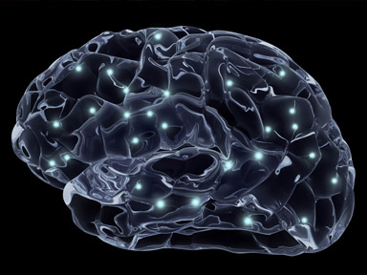
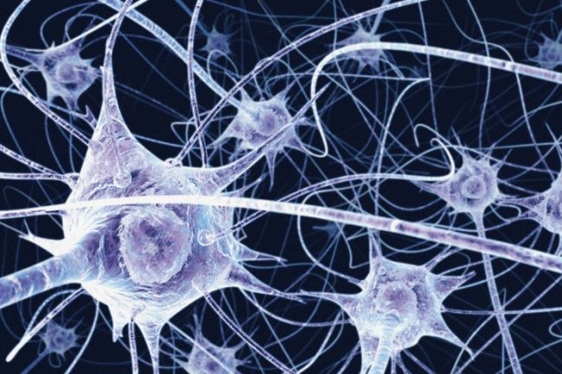
Convolutional Neural Networks (CNNs)
Imitates the learning process of a human brain
Brain consists of a billion neurons interconnected
Each neuron receives input and outputs a signal to the next neuron
Based on connections and signal strength ( or weight), a person learns
Notes:
What is pose estimation?
How to perform pose estimation using images i.e., conventional computer vision techniques and Artificial Intelligence or to be more specific using machine learning or convolutional neural networks
In my research, we used CNNs
What is neuron and what is a network (explain relationship with brain)

Slide 6
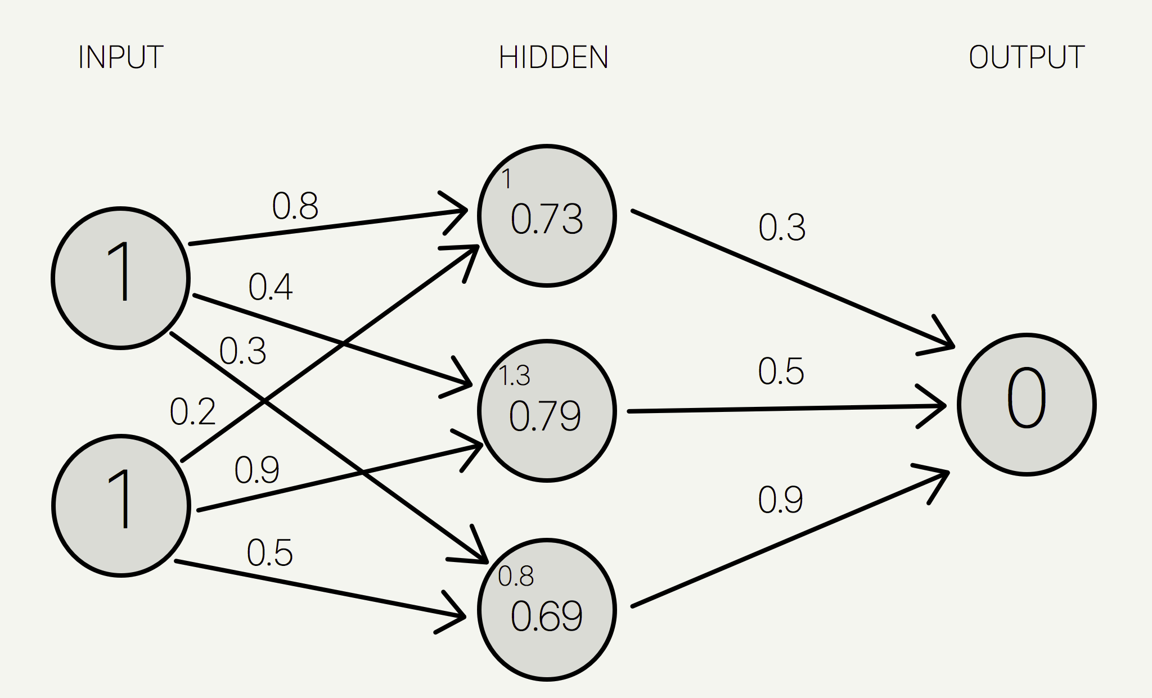
Convolutional Neural NeTworks
Learning is an iterative process of strengthening neurons
A mathematical neuron is a model that receives input (i.e., an image) and iteratively learns by adjusting (training) weights
Process of learning is completed when the output accurately determines the input
Convolutional neural network is a artificial neural network
Notes:
EXPLAIN THE METHOD OF TRAINING A BRAIN i.e., like how a child learns
Fortification = increase of weights of your brain which makes you recall it faster
Mention the example of CNNs training pose estimation: how does it do it?
Method is gradient descent
Note that a CNN is a very big neural network with a specific mathematical property called convolutional and has a significant amount of weights.
Mention input and output and weith
How does a human brain learn something (i.e., from examples)? Mention training and weights etc.
Normally network consists of many layers (such as 20 hidden layers)

Slide 7
Heatmaps
Heatmaps are visual outputs of CNNs for pose estimation
Also used to train a CNN
Red indicates high probability of a joint
Blue indicates low probability of a joint
Notes:
Heatmaps.

Slide 8
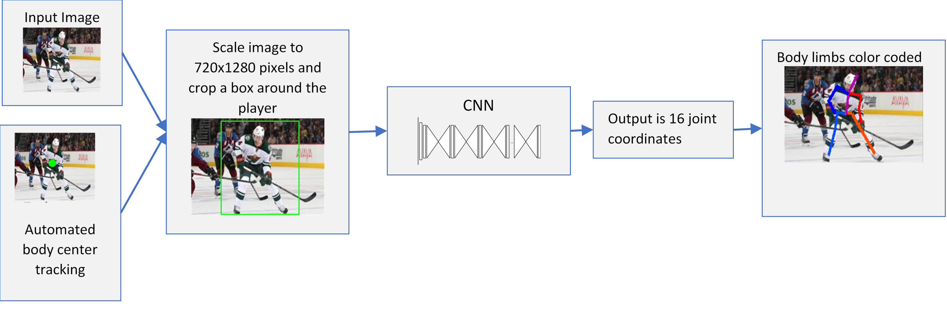
methodology
Notes:
General framework

Slide 9
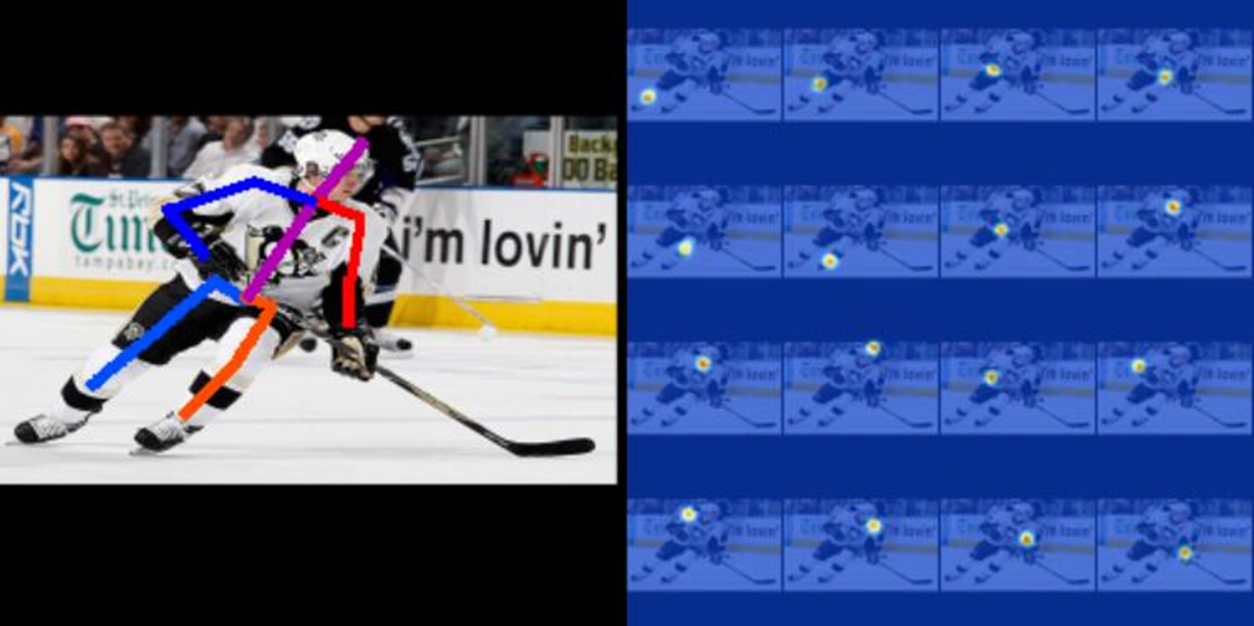
Image Pose Estimation Results
Notes:
Visual Results of the system

Slide 10
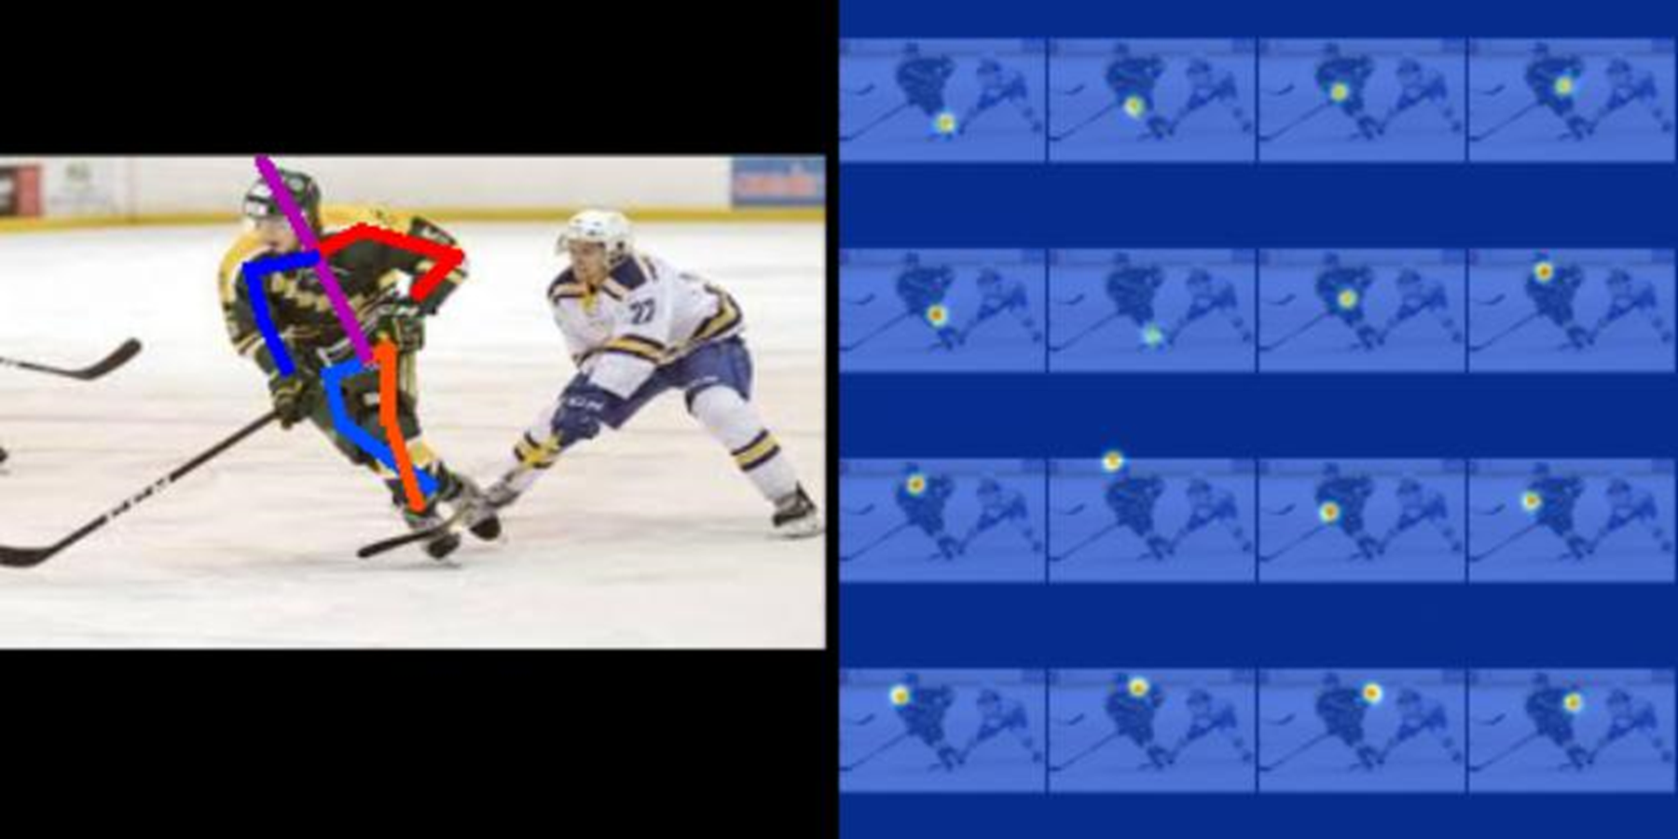
Image pose Estimation Results
Notes:
Another example

Slide 11
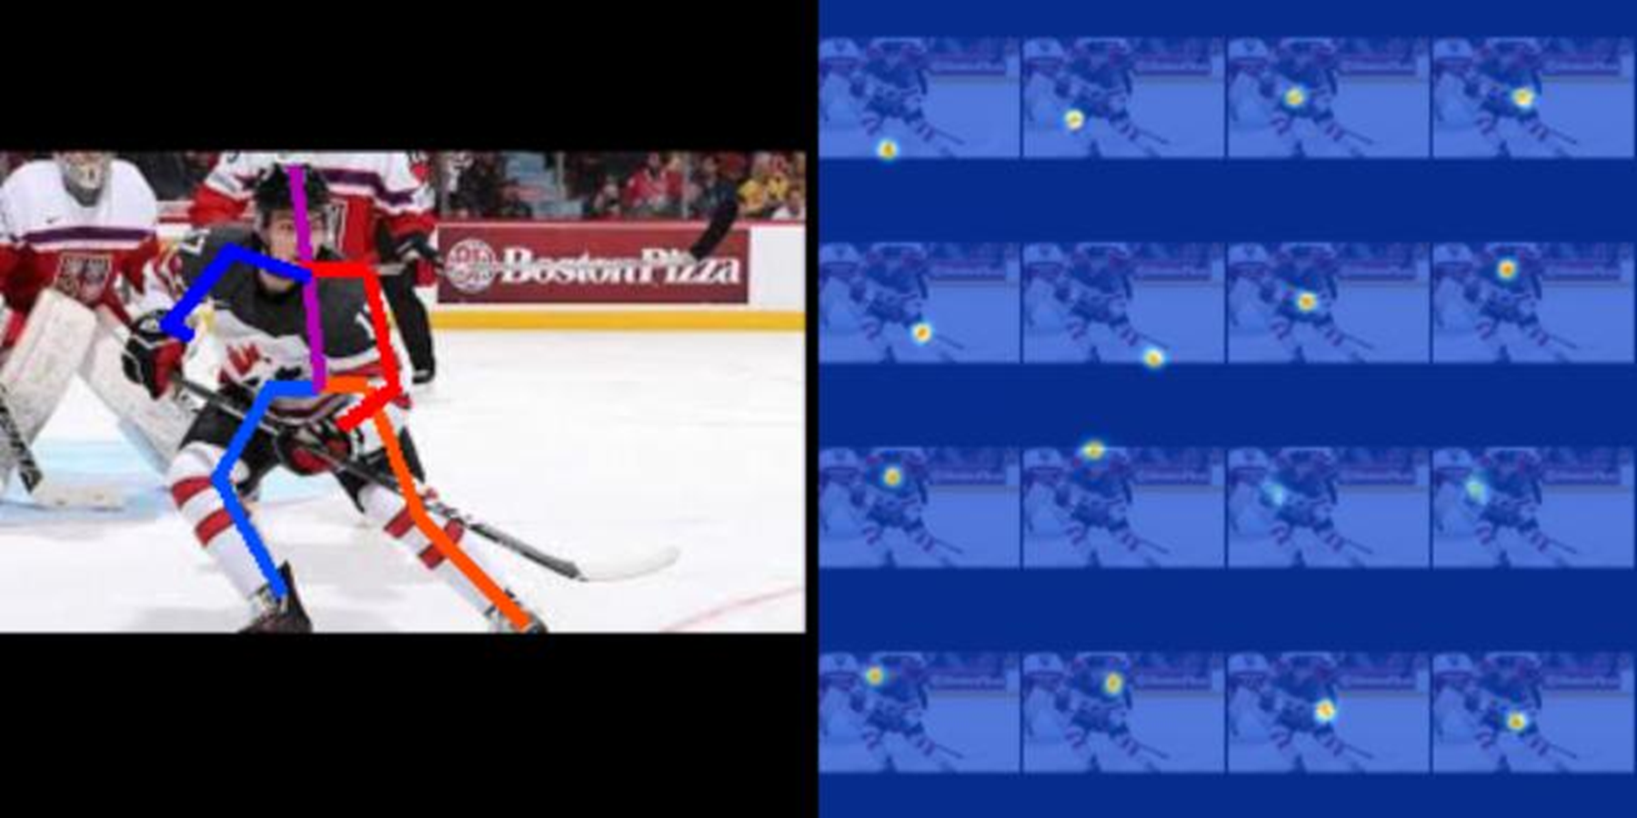
Image Pose Estimation Results
Notes:
Another example

Slide 12
Image Pose Estimation Results
Average accuracy of each limb for 20 images
Joint Name | Accuracy
Head | 90%
Shoulder | 87.5%
Elbow | 70%
Wrist | 65%
Hip | 80%
Knee | 82.5%
Ankle | 90%
Total | 81.56%
Notes:
Actual results in case people actually want to see how well it does.

Slide 13
Video Pose Estimation Results
Notes:
Broadcast view example and application of video

Slide 14
Impact
Pose Estimation can be extended aid in evaluating player performance by:
Applying it to action recognition
Estimating speed of a player
Evaluating technique of a player.
Notes:
What is the impact of this information?
What value does it bring to hockey?
Potential impact of this research include:
Other examples that pose estimation may help hockey players or coaches etc.
Technique
Applied to higher level of play?
Capability and know how they can improve

Slide 15
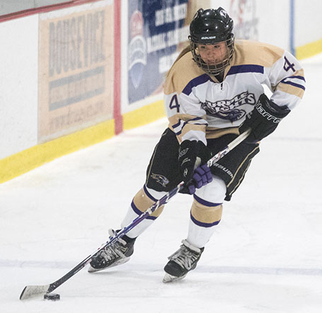
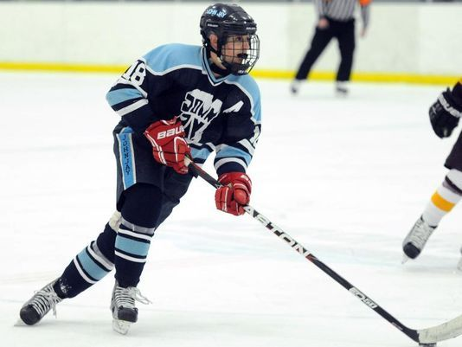
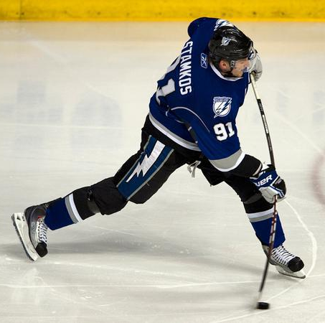
Impact: Action Recognition
Mean of 1000 Runs | Variance of 1000 Runs
65.47% | .0064
Straight Skating
Cross-Over
Pre-Shot
Post-Shot
Notes:
Ok. So I mentioned about how that pose estimation solves the problem. In my paper I described potential uses, I want to show one example of a potential use case that we are currently applying and then describe other ones.
One example is using action recognition.
Creates an automatic method for classifying an action of a hockey player; software can recognize a player of whether he is shooting or whatever.
Show some experimental results
This is a proof of concept; we have actually implemented this

Slide 16
Thank you
Notes:
Spare Slide

