Slide 1
Multilevel Modeling in Hockey Analytics: Untangling Individual and Team Performance In Even-Strength, Power Play, and Short Handed Situations
Sophie Jablansky
University of Maryland
Ottawa Hockey Analytics Conference
May 6, 2017

Slide 2
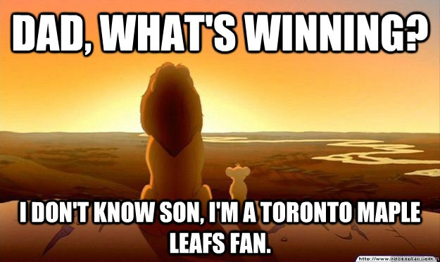
Background
According to Alan Ryder (2008), winning is what ultimately matters, which points to goals as an important metric of team success
There are two major issues with using goals in this way:
Goals are considered rare and random events (Ryder, 2004)
Goals are attributed to individuals, but wins are attributed to teams
How do we resolve this?
Examine shot metrics instead (Vollman, 2016)
Determining which aspects of the individual and the team contribute to performance
Notes:
Of course, there are some problems with just looking at goals: the first is one we talk about a lot. Goals are rare and essentially random events (because of all the different sources of variance that go into scoring)
The second issue, which is less talked about I think, is that individuals score goals, but teams win games
→ And this makes things complicated, because we draft players as individuals, but what ultimately matters is what a team of these individuals do together

Slide 3
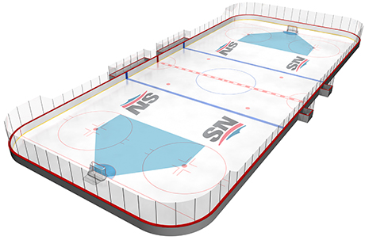
Background
SOG and metrics dealing with possession (Corsi, Fenwick) have had limited success in predicting points (Found, 2016), but scoring chances may offer an improvement by dealing with shots that have a higher probability of scoring
There is a distinction between a team of experts and an expert team, which suggests that a team may be more than the sum of its parts (Eccles, 2004)
In teams that are highly interdependent, team member contributions cannot simply be added together linearly to calculate team performance (Kozlowski & Chao, 2012), which is generally how WOWY and RelTM stats operate
Multilevel modeling is a kind of regression analysis that bypasses the assumption of independent observations and helps break down individual-level and team-level sources of variance
Although people seem to accept that shot quality is measurable and has an impact on goals (Purdy, 2008; Vollman, 2014), they seem to be conflicted as to how important it is
1. Examine shot metrics
2. Determine how individual and team coalesce into performance
How do we address this?

Slide 4
Research Questions
To what extent….
… does a player’s scoring chances predict his season points, controlling for position and time on ice per game?
… does the relation between a player’s scoring chances and season points vary by team?
… do a team’s scoring chances predict individual player points?
…. do these estimates differ by manpower situation?

Slide 5
Proposed Analysis
Data Source:
2015-2016 season
Games played (GP) ≥ 40 of 82 regular season games
N=519 players, J= 30 teams
Player Points modeled as Poisson process
Level 1 (individual) equation:
η_{ij} = β_{0j} + β_{1j}*(Position_{ij}) + β_{2j}*(ScoringChances_{ij}) + β_{3j}*(TOIG_{ij})
Level 2 (team) equations:
β_{0j} = γ₀₀ + γ₀₁Team_SC_{j} + u_{0j}
β_{1j} = γ₁₀ + u_{1j}
β_{2j} = γ₂₀ + γ₂₁Team_SC_{j} + u_{2j}
β_{3j} = γ₃₀ + u_{3j}
A player’s season points are a function of his position, scoring chances for, and time on ice per game
The relations of each predictor with season points is allowed to be different for different teams.
Team scoring chances are related to a player’s number of scoring chances and points.

Slide 6
Question 1: Does a player’s scoring chances predict season points, controlling for position and time on ice per game?
Scoring chances significantly predicts player points in all three manpower situations, but is the strongest predictor when shorthanded.
Scoring chances in SH situations may be breakaways or odd man rushes, which have a better chance of scoring.

Slide 7
Question 2: To what extent does the relation between a player’s scoring chances and season points vary by team?
The relation between a player’s scoring chances and his season points varies by team in even-strength and power play, but not short handed, situations.
For some teams, creating chances is important for scoring goals, but other teams may not need conventional chances to score.

Slide 8
Question 3: To what extent do a team’s scoring chances predict individual player points?
A team’s scoring chances significantly predict an individual player’s season points in even-strength and short handed, but not power play, situations.
Being on a better team (i.e., that produces more scoring chances) does not matter for individual point production on the power play, likely because all teams have a man advantage to leverage.

Slide 9
Discussion and Limitations
The impact of scoring chances varies by manpower situation
Scoring chances have a greater impact on predicted points when shorthanded
Belonging to a team that produces more chances is associated with more individual points, except when on the power play
Scoring chances are important to the extent that teams are actually able to convert them into goals
Toronto was T-7th in ES chances, T-1st in PP chances, and T-9th in SH chances, and ranked 29th in the league standings
Florida was T-28th in ES chances, T-22nd in PP chances, and T-22nd in SH chances, and ranked 4th in the league standings
Different teams may utilize different styles of play
Shortcomings of the models
Do not control for zone starts or exact shot location
Scoring chances has not always been consistently defined and may be subject to rink bias
Position and time on ice may be proxies for skill level or role responsibilities

Slide 10
Future Directions
Consider moving away from the shot quantity vs. shot quality debate, and look more at the broader circumstances preceding goals, including:
Spatial tracking
Player communication and coordination
Overlap in players’ mental models
Acknowledge the inherent conflict between the way performance is evaluated (i.e., wins/losses) and the way statistics are counted (i.e., by individual)
If a team is more than the sum of its parts, then individual player stats are not necessarily the end-all be-all
Analysts may want to find a way to measure emergent properties of the team or the impact of combinations of players

Slide 11
Thank you!
Special thanks to the following folks for their helpful comments and critiques:
Sam Jablansky
Paul Jablansky
Matt Barstead
JP Landi
For more info, email me at sjablans@umd.edu
Or follow me at @sophiejablansky

