Slide 1
The Hot Hand Theory in hockey: A multilevel logistic regression analysis
Likang Ding*, Ivor Cribben, Armann Ingolfsson, Monica Tran
Presentation at International Ottawa Hockey Analytics Conference
* Presenter

Slide 2
Hot Hand Theory: A basketball player who has had a higher-than-average success on recent shots has a higher-than-average chance of scoring on the next shot
The Theory was first analyzed by Gilovich, Vallone and Tversky in 1985
Although fans and NBA players believe in the Theory, the scholars’ analyses do not support it
Their results actually suggest that a higher-than-average performance in the past would lead to lower-than-average probability of scoring on the next shot
The Theory was studied by scholars for sports like basketball and baseball since the 1980s.

Slide 3
Two questions to answer
Is there streakiness in the performance of goaltenders in hockey games?
The answer would be no if the data was generated by i.i.d. Bernoulli trials
If there is streakiness, do more successful trials in the past lead to a higher-than-average saving rate or lower-than-average saving rate on the next shot on goal?
higher-than-average: confidence?
lower-than-average: motivation?

Slide 4
Factors that may influence saving probability
Individual level:
Player
Game level:
Current game score
Home or away ice
…
Shot level:
Shot origin
Shot type
…

Slide 5
Our focus
Goaltenders’ performance in NHL playoffs
How does saving probability depend on player’s recent performance, after controlling for other measurable factors?

Slide 6
Data: every shot during 2008-2016 playoffs
36,235 shots
9 seasons
90 goaltenders
216 goaltender-year groups
Group size: 1 to 678 shots
Average size: 167.8 shots

Slide 7
Variables
Dependent variable: Y = save (1) or goal (0)
Independent variable: X = number of saves on last 5 shots
Scaled by subtracting average
Control variables: Z
Home (1 or 0)
Rebound (1 or 0)
Strength (-2, -1, 0, +1, +2)
Game score (lead, trail, tied)
Shot type (categorical)
Shot origin (2 specifications)

Slide 8
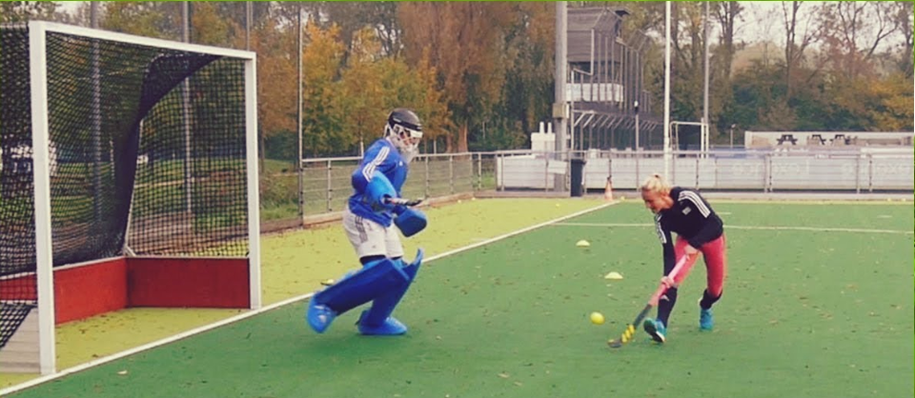
Shot types
Backhand
Deflected
Slap
Snap
Tip-in
Wrap-around
Wrist

Slide 9
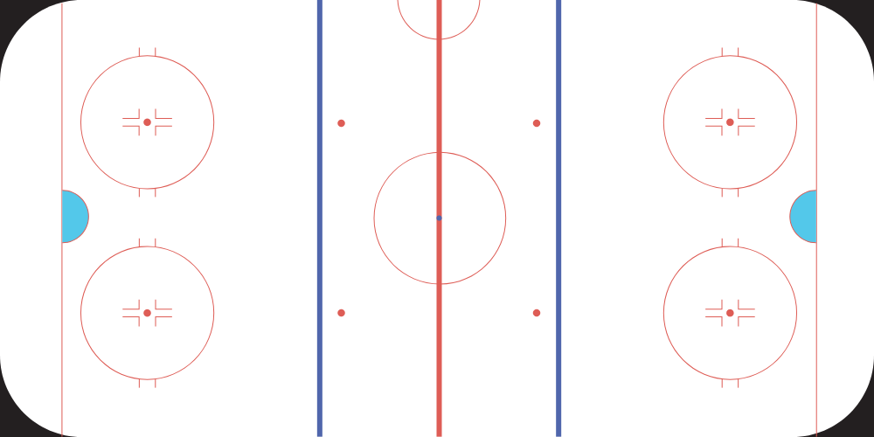
Shot origin: Distance + angle specification
Angle
Distance
Shot origin
Image is a modified version of https://commons.wikimedia.org/wiki/File:InternationalRink.svg from Wikimedia Commons, licensed under GNU Free Documentation License v1.2.

Slide 10
Shot origin: Top + slot + corner specification
Corner
Top
Slot
Image is a modified version of https://commons.wikimedia.org/wiki/File:InternationalRink.svg from Wikimedia Commons, licensed under GNU Free Documentation License v1.2.

Slide 11
Multilevel logistic regression models
No pooling: Separate models for every goalie-season combination
Complete pooling: Single model for all goalie-seasons—one intercept, one slope
Partial pooling: Single model but intercept and slope can vary among goalie-seasons

Slide 12
Multilevel logistic regression models
Scalars
Vectors
$$\operatorname{Pr}\left(Y_{ijk}=1\right)={logit}^{−1}(α_{ij}+β_{ij}X_{ijk}+γ_{ij}Z_{ijk})$$
No pooling:
Complete pooling:
Partial pooling:
$$\operatorname{Pr}\left(Y_{ijk}=1\right)={logit}^{−1}(α+βX_{ijk}+γZ_{ijk})$$
$$\operatorname{Pr}\left(Y_{ijk}=1\right)={logit}^{−1}(α_{ij}+β_{ij}X_{ijk}+γZ_{ijk})$$
$Y_{ijk}=\text{1 }\text{if} \text{Goalie} i \text{in} \text{Year} j \text{made} \text{a} \text{save} \text{on} \text{Shot} k$
${ X}_{ijk}$ is the number of saves in the most recent 5 shots prior to $\text{Shot} k$ for $\text{Goalie} i \text{in} \text{Year} j$
$Z_{ijk}$ is the vector of control variables for $\text{Shot} k$ of $\text{Goalie} i \text{in} \text{Year} j$

Slide 13
Results of partial pooling and complete pooling models, number of saves on last 5 shots, top + slot + corner, within the same game
 | Partial pooling |  |  | Complete pooling
Group | Tim Thomas 2011 | Devan Dubnyk 2015 | Peter Budaj 2013 | NA
Slope/Fixed effect | -0.13 | -0.13 | -0.13 | -0.12
SE | 0.038 | 0.038 | 0.038 | 0.037
Random effect | -0.042 | 0.041 | 0.013 | NA
Group size | 678 | 170 | 23 | NA
Notes:
Complete pooling vs partial pooling
3 examples: smallest group of all, smallest group of No pooling and the largest group
If there is a common effect among goaltenders, the partial pooling model will return the common effect
The other two are subsets of the partial pooling
Write down questions for my talk

Slide 14
Results of partial pooling and no pooling models, number of saves on last 5 shots, top + slot + corner, within the same game
 | Partial pooling |  |  | No pooling
Group | Tim Thomas 2011 | Devan Dubnyk 2015 | Peter Budaj 2013 | Tim Thomas 2011 | Devan Dubnyk 2015 | Peter Budaj 2013
Fixed effect | -0.13 | 0.13 | -0.13
Slope | -0.17 | -0.089 | -0.12 | -0.12 | 0.13 | NA
SE | 0.038 | 0.038 | 0.038 | 0.34 | 0.43 | NA
Group size | 678 | 170 | 23 | 678 | 170 | 23
Notes:
No pooling + Partial pooling

Slide 15
Partial pooling results for slopes

Slide 16
Partial pooling results for shot type
Group: Carey Price, 2008; Home; Non-rebound; Even strength; Shot Origin and game score variables set to their average values.

Slide 17
Partial pooling results for strength
Group: Carey Price, 2008; Home; Non-rebound; Shot Origin, shot Type and game score variables set to their average values.

Slide 18
Partial pooling results for game score
Group: Carey Price, 2008; Home; Non-rebound; Even strength; Shot Origin and shot Type variables set to their average values.

Slide 19
Results for b = slope = coefficient of X, number of saves on last 5, 10 and 15 shots, top + slot + corner shot origin
 | Last 5 shots |  | Last 10 shots |  | Last 15 shots
 | Within the same game | Across different games | Within the same game | Across different games | Within the same game | Across different games
Slope | -0.13 | -0.11 | -0.069 | -0.089 | -0.041 | -0.076
SE | 0.038 | 0.034 | 0.034 | 0.026 | 0.031 | 0.022
Sample size | 36,235 | 43,028 | 28,631 | 42,055 | 21,235 | 41,145
Slope ratio | 1 | 1 | 0.53 | 0.81 | 0.32 | 0.69

Slide 20
Conclusion
Results suggest that higher-than-average performance on past shots lead to lower-than-average saving rate on the next shot on goal.
Motivations?

Slide 21
Contact info:
Likang@ualberta.ca

