Slide 1
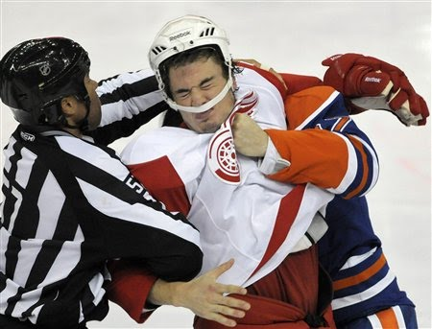
An Analysis of Penalties Called in the NHL 2008-09 &2009-10 Regular Seasons
Lauren Brozowski, Michael Schuckers
St. Lawrence University
Department of Mathematics, Computer Science and Statistics
Thanks to Ken Krzywicki for making data available
Notes:
It is most common for players, and fans to not even recognize officials as normal people. This paper analyses another aspect of hockey, the side that, without it, the game would not exist as we know it today.
40 sec

Slide 2
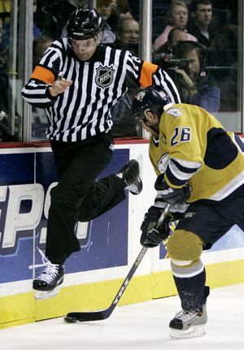
Introduction
Why are penalties so important?
There are 4 officials on the ice assigned to every NHL game:
  2 linesmen, 2 referees
Team | PIM | Penalties | Regular Season Rank
Tampa Bay Lightning | 1357 | 492 | 25th
Nashville Predators | 698 | 302 | 10th
Referee Wes McCauley working a Nashville game in February 2011
Notes:
Penalties play a large aspect in the game of hockey such that when a team draws a penalty, the probability of the other team scoring increases significantly. Look at slide…in 2009..tampa blahh blah..whereas nashville blah blah had 698 min.
With this data, The Predators finished with 20 more points in the regular season finishing in 10th place overall (7ths place in the western conference clinching them a playoff spot with 100pts, where whereas Tampa with only 80 points finished in 25th place overall (12th in the eastern conference).
Hence why
2 linesmen, 2 referees
Linesmen: are responsible for watching for violations at the blue/red lines such as icing, and offside. They also do faceoffs, and are the most involved in breaking up fights.
Referees: wear the orange armbands, they call the penalties and some faceoffs. as seen above. This is Wes McCauley who is one of the referees in our model.
1 min

Slide 3
Introduction
Level | Minor | Double Minor | Major | Major/ Misconduct
Penalty (Min.) | 2 | 4 | 5 | 10
5 vs. 4 power play for that amount of time
  Increased probability of a goal occurring within that time
The results of this study could guide teams in their style of play from game to game
Notes:
LOSE PLAYER FOR LENGTH OF TIME
…Based on which referees are on the ice
1:15min
Level
Penalty (min)

Slide 4
Previous Studies
Very little formal published in hockey
Scorecasting & Whistle Swallowing: Officiating And The Omission Bias Tobias J. Moskowitz &L. Jon Wertheim
Studies dating back to 1977 have shown home team advantage
Pollard and Pollard found the home win percentage of 55.5% in 2003
MIT Sloan Sports Analytics Conference 2011
    Referee Analytics Panel
    1st Hockey Analytics Panel
Notes:
20 seconds
NEW STUFF

Slide 5
Data for 2009-10
Penalty | Total # Penalties
Hooking | 1757
Roughing | 1502
Fighting | 1423
Tripping | 1418
Interference | 1298
Holding | 1117
High-Stick | 845
Slashing | 785
Cross Check | 484
Delay of Game | 358
Boarding | 310
Game Misconduct | 270
Bench Penalty | 248
Unsportsmanlike Conduct | 182
Elbowing | 101
Instigating | 67
Charging | 59
Diving | 35
Kneeing | 23
Closing Hand on Puck | 15
Miscellaneous | 14
Clipping | 10
Check from Behind | 5
Spearing | 4
1230 Regular season games
30 NHL teams
310, 421 total events
  12,336 penalties
23 Penalty types
38 Referees
35 Linesmen
Data from NHL.com
Notes:
1min 11 sec
There were a total of 310,421 events that occurred on the ice, 12336 of those were penalties. An event is characterized as: shot, block, penalty, face off etc.
Talk about them within the model and determine whether they are significant or not.

Slide 6
Data: Example
Variables | GAME: 21-EVENT 304 | GAME: 5 -EVENT 24
KeyPBP | RS-0910G0021E0304 | RS-0910G0005E0024
Game | 21 | 5
Gamedate | Sat. Oct 3, 2009 | Oct. 2, 2009
Venue | Rexall Place | RBC Center
Away Team | CGY | PHI
Home Team | EDM | CAR
Ref1 | 3_LEGGO_MIKE | 48_L'ECUY_FREDERICK
Ref2 | 13_O'HALLORAN_DAN | 28_LEE_CHRIS
Linesman1 | 82_GALLOWAY_RYAN | 96_BRISEBOIS_DAVID
Linesman2 | 78_MACH_BRIAN | 95_MURRAY_JONNY
Event | SHOT | PENL
Event Number | 304 | 24
Period | 3 | 1
Time | 14:35 | 4:52
EventforTeam | CGY | PHI
EventforZone | OFF | DEF
PenaltyType | - | Slashing
Perp | - | 36_POWE_DARROLL_PHI_C
PIM | - | 2
DrawnBy | -* | 59_LAROSE_CHAD_CAR_R
Notes:
TAKE YOUR TIME

Slide 7
Goal:
Model Rate of Penalties Per Event
Investigate Impact of
  Officials (Referees & Linesman)
  Home Ice
  Goal Differential
  Period (1,2, 3, 4)
  Model 2009-10 season & confirm with same model for 2008-09 season.
Notes:
Given these models, we want to use a single model to find how often a penalty occurs given these predictors.

Slide 8
Penalty Rates Per Event
NHL Play by Play files record On-Ice Events
Kept: BLOCK, FAC, GIVE/TAKE, GOAL, HIT, MISS, PENL, SHOT
2008-09: 308,139
2009-10: 310,421

Slide 9
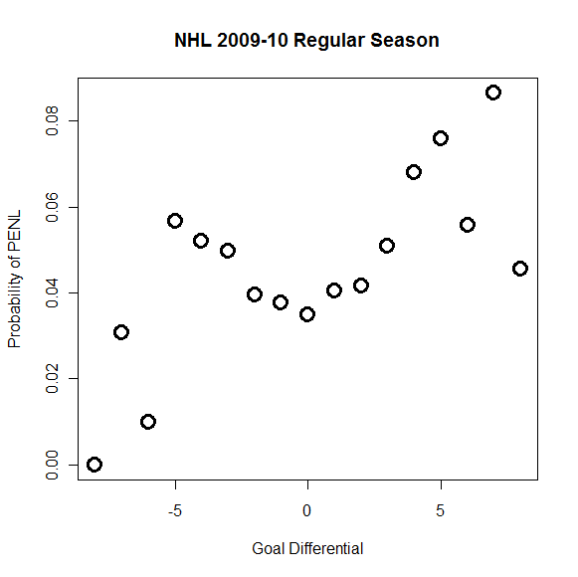
Preliminary Analysis: Goal Differential
About 90% of events occur with absolute value goal differential < 3
Notes:
Less penalties occur in overtime which is consistent with the fact that Gdiff has significant less penalties occurring when the game is tied. (The game must be tied to be in overtime).
(FIX GRAPH SO THAT IT HAS A TITLE)
How did we use Gdiff as an exponential function?
31 sec

Slide 10
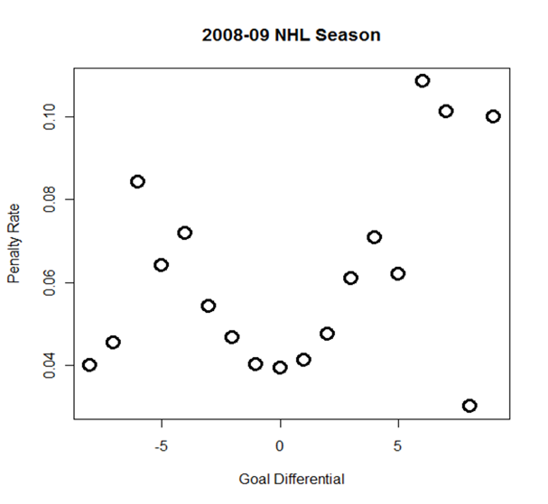
Preliminary Analysis: Goal Differential
Notes:
Less penalties occur in overtime which is consistent with the fact that Gdiff has significant less penalties occurring when the game is tied. (The game must be tied to be in overtime).
(FIX GRAPH SO THAT IT HAS A TITLE)
How did we use Gdiff as an exponential function?
31 sec

Slide 11
Preliminary Analysis:
Home v. Away PENL Rate
` | 2008-09 | 2009-10
Home | 0.0383 | 0.0351
Away | 0.0507 | 0.0453
Mean | 0.0439 | 0.0397
Notes:
Add average

Slide 12
Preliminary Analysis: Period
Period | 2008-09 | 2009-10
1 | 0.0429 | 0.0387
2 | 0.0478 | 0.0425
3 | 0.0419 | 0.0388
4 (OT) | 0.0189 | 0.0208
Notes:
Marginal rather than conditional probabilities

Slide 13
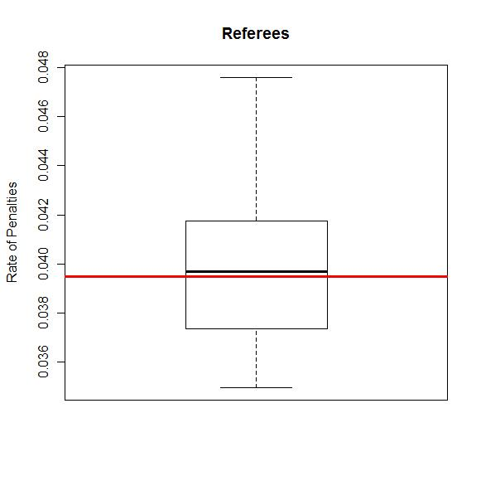
Preliminary Results: Referees
Notes:
Mean is now 0.0395, 3.95% of events are penalties
CONSISTENT BUT WE NEED TO ACCOUNT FOR OTHER FACTORS
This boxplot shows the percentage that all the Referees call a penalty compared to all the events on the ice. Skewed right…

Slide 14
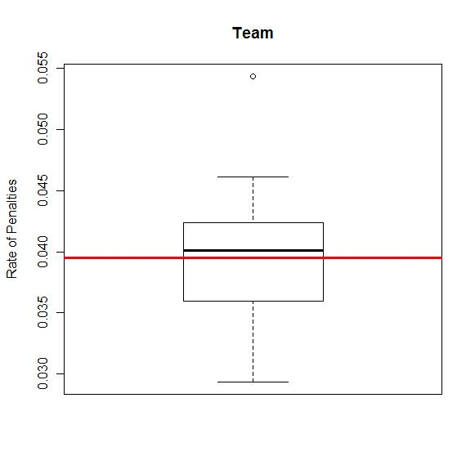
Preliminary Results: Teams
Notes:
Tampa Bay Lighting are outliers at 0.0543: Implies that 5.43% of their events are penalties. Which is consistent with the NHL data!
Nashville Predators was second lowest with: 0.03336583 (chicago, dallas, detroit (2nd least PIM) were the only ones lower)

Slide 15
Logistic Regression with 1 for EVENT= PENL
Referees, Linesmen
Absolute value of Goal Differential + value squared
Team Initiate Event
Team Take Event
The period the penalty occurred (1, 2, 3, 4)
Indicator for last 5 and last 10 minutes of 3rd
Indicator for last 5 minutes & Goal Differential <2
Notes:
Referees: each referee and linesman were a predictor variable
Abs Goal Differential: the absolute value of the difference in goals of a particular game
Penalty for team: Which team drew the penalty
Period: includes the 2,3, 4 (overtime).

Slide 16
Results: Significant Predictors p<0.001
Predictor | 2008-09 | 2009-10
Ref’s | N/S | Auger
Linesmen | N/S | Sericolo
Gdiff | + | +
Gdiff² | N/S | N/S
Period 2 | N/S | N/S
Period 3 | - | -
Period 4 | - | -
TeamCalled | several | several
TeamDraw | several | several
Home/Away | - | -
<5 min | + | +
<5 & Gdiff<2 | - | -
Notes:
TALK ABOUT 0.001 (Multiplicity Problem)
All significant predictors are within 2 sd of each other
For each dopr in abs val GD taowards zero, the odds of a penaltiy being calledrops by 12%. The odds of a penaltiey being called in the 3rd period is 82% of what it is in the 1st or 2nd period.
R returns the beta predictors in terms of log odds. (have to e the equation to get a probability)
The predictor coefficients implies that the log odds of that predictor in estimating whether a penalty will occur.

Slide 17
Summary
1. For each drop in absolute goal differential towards zero, the odds of a penalty being called drops by 12%.
2. The odds of a penalty being called in the 3rd period is 82% of what it is in the 1st or 2nd period.
3. For overtime, the odds of a penalty being called is 51% of that for the 1st or 2nd period.
4. The home team has odds of being called for a penalty that are 75% of the visiting team.
5. In a close game (tied or a one goal difference) with less than 5 minutes remaining in the 3rd period, the odds of a penalty
being called are 66% of what they would be otherwise.

Slide 18
Conclusions
Referees & Linesman seem consistent in rate of penalties
Penalties occur at significantly lower rates for
  Close game
  3rd Period
  Overtime
  Last 5 minutes of close game
  Home team
Notes:
1 min

Slide 19
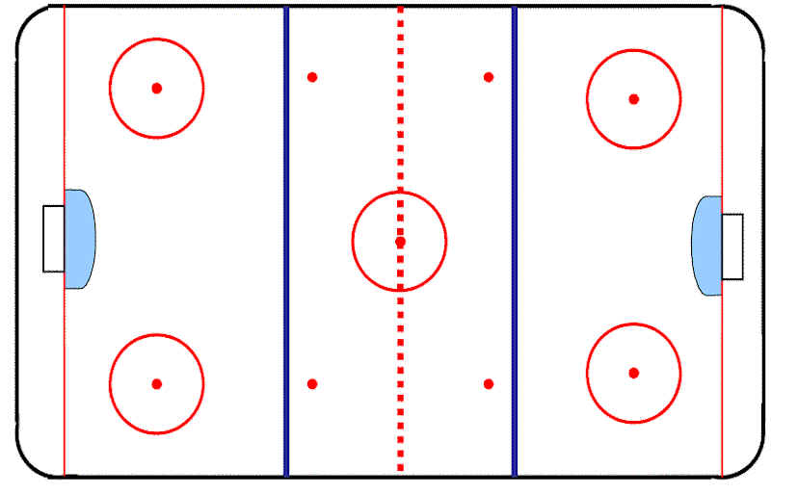
Future Work
?
How good is this model?
Look at 2010-11 Season
Playoffs?
Are there biases for/ against specific players?
  Specific types of penalties?
Tendencies of specific Refs for specific types of penalties
?
?
Notes:
How good is this model? How many of these 110 predictor variables are necessary? How many can we omit? Should we be adding a spatial aspect to find out where on the ice the penalty occurred?
Baises against specific players? Does one referee call more or less penalties against a specific player in relation to their normal rate of calling penalties?
Isa there logistic evidence that one referee calls more hooking calls than another?
Do the penalties occur more often in front of the net, neutral zone, while a player is back-checking, etc. where is the highest rate of penalties being called?

