Slide 1



Predictive Analytics at the NHL
Eric Blabac, Director of Decision Science – Membership Analytics, Sam’s Club
May 6th, 2017

Slide 2
Agenda
  Introductions
  SAP Partnership with the NHL
  Playoff Predictions
  Probability of Making Playoffs
  Q&A

Slide 3


Introductions
Global analytics expert, data science evangelist and is currently the Director of Decision Science, Membership Analytics at Sam’s Club. Prior to Sam’s Club, Eric held the role of Principal Data Scientist at SAP.
Eric’s background is based on advanced analytics with substantial experience in statistical modeling, predictive analytics, data mining, forecasting and management consulting. He has worked across a variety of industries including retail. financial services, consumer product goods, healthcare and sports and entertainment
Eric Blabac
Director of Decision Science – Membership Analytics
Sam’s Club
He is also the author of The Encyclopedia of Baseball Statistics - From A to ZR, a complete reference of all modern baseball statistics, what they really mean, how to calculate them and how to use them.
Eric holds two Masters degrees (MS), Statistics and Applied Mathematics from Iowa State University, a Master’s in Business Administration (MBA) from Grand Canyon University and a Bachelors (BSc) degree in Mathematics from Iowa State University

Slide 4

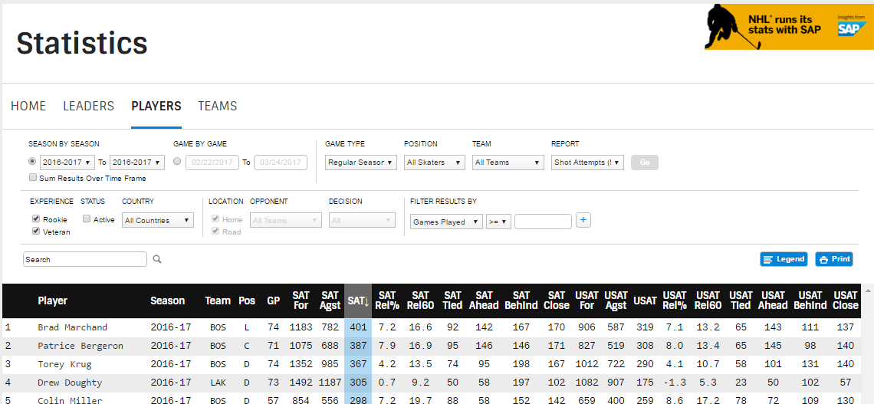
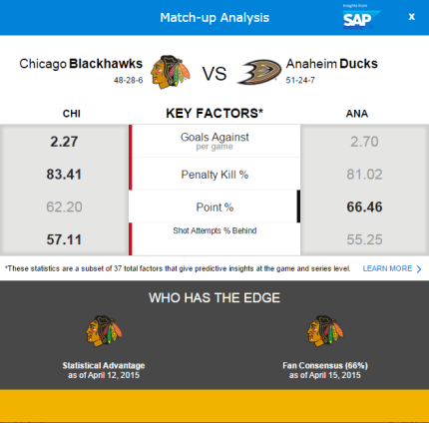
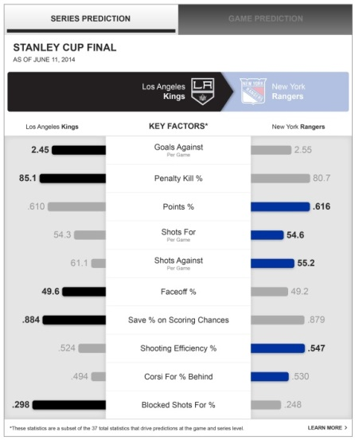
SAP Partnership with the NHL
*5-year sponsorship agreement
Phase 1a (Enhanced Stats) : Oct 2014 – Feb 2015
Phase 1b (Playoff Predictions): Jan – April 2015
Phases 2 and 3 (UX Revamp + Additional Stats): June – Aug 2015
  Advanced Game Level Filtering
  Statistic Charting/Player Comparison
  Stats by Context (Faceoffs By Zone, Shots By Type, etc …)
  Stats by Strength (e.g. 3on3 Goals)
  Team Power Index
Phase 4 (Enhancements): Nov 2015 – Jan/Feb 2016
  Probability of Making Playoffs
  Line Analysis
  In-Game Win Expectancy
Project Team: PM, 3 consultants (ETL/HANA modeling, Data Scientist, Solution Architect)

Slide 5
Playoff Predictions

Slide 6
NHL Playoff Predictions
Overview
GOAL: Predict the Stanley Cup winner
THINGS TO CONSIDER (aka Requirements):
BUISINESS
  Need to predict every game AND series leading up to the finals. What does the output need to look like?
  Model needs to incorporate “Enhanced Statistics” (SAP Marketing)
  The model needs to be EASY to explain/interpret (for the NHL)
  The output need to be EASY to understand (for fans)
  The factors used need to be EASY to understand, but compelling (for the NHL, fans, media)
‘
ANALYTICAL
  What data should I use? Do I need to calculate additional variables?
  Define “prediction” (e.g. explicit win/loss, win probability)
  Which statistical model should I use?
  How do I implement the model? How do I “simulate” the Stanley Cup playoffs?
  Predictions for game x needs to account for results in game x-1 and previous series (Bracket)
TIME
  Began in early Jan, deadline of mid-March (three weeks before playoffs start)

Slide 7
NHL Playoff Predictions
Solution Overview
A logistic regression model was developed to calculate the probability a team would win a specific playoff game. This model incorporated various factors including:
Standard regular season stats
  Penalty Kill %, Goals Against Per Game, etc …
Enhanced and Advanced regular season stats
  Shot Attempts % Behind, Save % on High Quality Shots, Shooting Efficiency %, etc …
Game Context factors
  Home vs. Away, Time Zones Travelled, Opponent Strength, etc …
Regular Season Results
Team Level Stats
Simulating Remaining Bracket (Game Level)
Game Level Win Probabilities
Game Context
Playoff Game Results
Series Level Win Probabilities
Streak and Strength Factors

Slide 8
NHL Playoff Predictions
Solution Development
DATA PREPERATION
  Created an exhaustive list of all factors that we thought may be predictive (NHL/SAP)
  We came up with 78 different factors, these factors generated 241 variables
    E.g. Factor: Winning Percentage → Variables: Current Winning Percentage, Opponent Winning Percentage, Winning Percentage Last X Games, Winning Percentage League Rank, etc …
  The data was prepared in a HANA (database) stored procedure utilizing over 20 different source tables in the NHL’s data landscape - over 1500 lines of code
‘
MODELING
  Chose a model that was appropriate for the problem (classification) and met the NHL requirements (e.g. “EASY” to develop, interpret and explain) → Logistic Regression
  I initially grouped the 241 variables into eight (8) subgroups based on the type of variable (e.g. Possession, Special Teams and Goalie, etc …). Models were ran on each subgroup to determine the factors with high predictive power. Each selected variable was then combined into one final model to yield the final 37.
SIMULATION and IMPLEMENTATION
  I then developed code to simulate the remaining bracket given the current state of the playoffs; loop through each game, series and round and predict each future game in the bracket format
  Predictions were generated every morning and were available on the HANA cloud for fans to access over any platform on NHL.com

Slide 9


NHL Playoff Predictions
Implementation
NHL.com Series Preview
SAP Match-up Analysis (Bracket Challenge)
Do you notice anything missing?

Slide 10
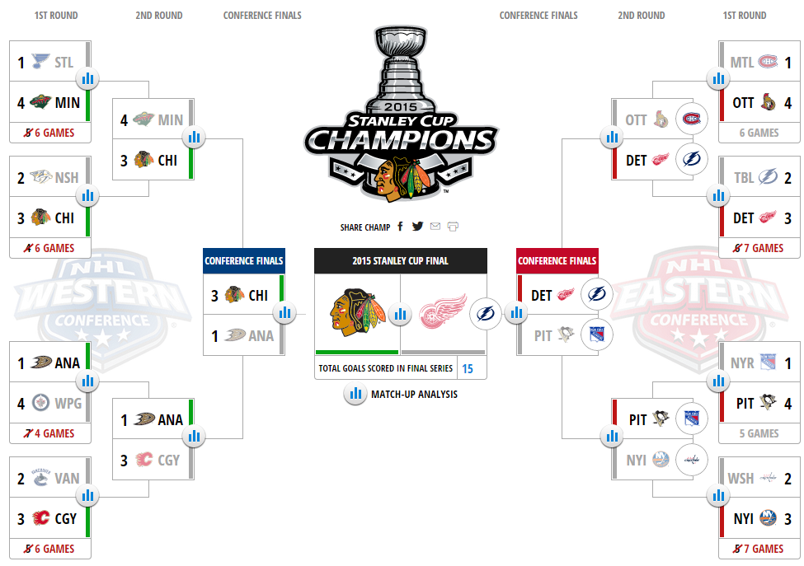
NHL Playoff Predictions
Day “0” (Before the Playoffs Began) Bracket Predictions and Results

Slide 11
NHL Playoff Predictions
Initial Results
The initial results were mixed, but overall positive as the model successfully predicted the Chicago Blackhawks to win the Cup on “Day 0” (!!)
However, the game level model had some issues:
Stubbornness and Predicting “too many” sweeps
  In many cases, the model stuck with the initial series prediction, even based on in-series performance (e.g. team lost first 2 games, team down 3 games to 1)
Picked “too many” big upsets
  While some upsets turned out to be predicted correctly, “too many” big upsets simply didn’t look right (both examples below were upsets of President’s trophy winners)
    E.g. PIT over NYR in 2014-2015
    E.g. PHI over WSH in 2015-2016

Slide 12
NHL Playoff Predictions
Second Version
The second version of the playoff predictions was structured in “phases”. The first phase being a series level prediction, using all available historical playoff data (back to 1987-88 season). This series level prediction can be utilized on its own (e.g. Bracket Challenge), but is also used as an input into a new game level model.
Regular Season Results
Team Level Stats
Series Level Win Probabilities
Simulated Remaining Bracket (Series Level)*
Playoff Game Results
Game Context
Game Level Win Probabilities
Simulated Remaining Bracket (Game Level)*
Historical Playoff Performance
The new game level model takes into account game context factors (home vs. away, days between games, etc …) plus takes into account historical playoff performance for more “realistic” game predictions.

Slide 13
NHL Playoff Predictions
Results Comparison – Series Level (2015-2016)
v1
v2

Slide 14
NHL Playoff Predictions
Results Comparison – Game Level (2014-2015)
CGY vs VAN, 1st round
Note: Even though the initial series level model showed a slight edge to VAN, the game level model utilized the current series performance to give the eventual edge to CGY late in the series
NYR vs WSH, 2nd round

Slide 15
NHL Playoff Predictions
Results Comparison Notes
Better overall success at the series level (v1 vs. v2)
  2014-2015: 11/15 (73%) vs. 9/15 (60%)
  2015-2016: 12/15 (80%) vs. 8/15 (53%)
Both new series and game level predictions are much more “conservative”
  In fact, with the new model using 28 seasons of playoff data (420 series), only 39 series had more than an 80% series win probability
Better “eye test” success (NYR and WSH being Presidents’ Trophy winners)
  2014-2015: NYR vs PIT
    Old: NYR (16.01%) vs. PIT (83.99%)
    New: NYR (63.81%) vs. PIT (36.19%)
  2015-2016: WSH vs PHI
    Old: WSH (43.25%) vs. PHI (56.75%)
    New: WSH (62.69%) vs. PHI (37.31%)

Slide 16
Questions?
Thank you!

