Slide 1
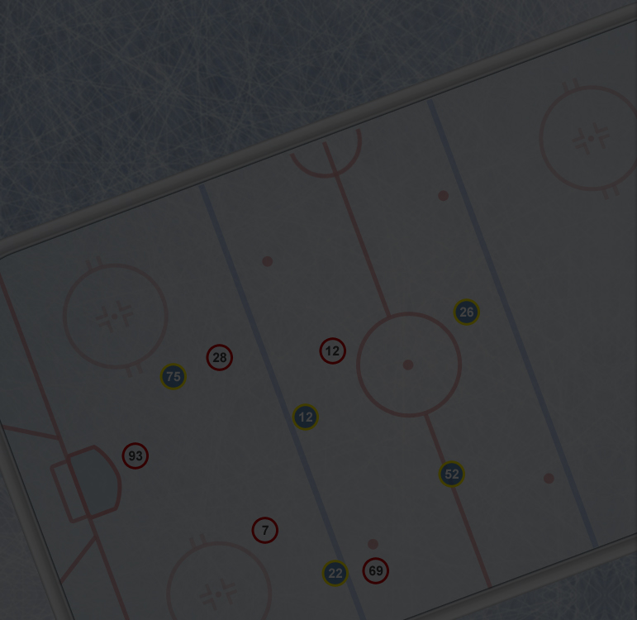
The Next Frontier:
How x/y tracking data is a game-changer for NHL analytics
Presented by: Marc Appleby
President, Solution Architect
PowerScout Sports Inc.
Ottawa Analytics Conference
January 16, 2016
Notes:
It’s great to be here, and I’m excited to share with you a bucket-full of things we’ve learned from tracking.
Big thanks to Michael Schuckers and Shirley Mills for organizing a great 2nd annual OAC
We’re not going to have enough time to get through it all I guarantee it so let’s get right to it

Slide 2
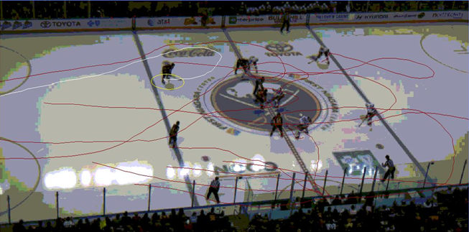
Presentation
Background
Why is tracking different?
Rapid-fire of several NHL tracking analyses on skating
The ‘secret’ to doing analytics (well) with NHL teams
All rights reserved ©

Slide 3
Tracking History
Pioneering Hockey Tracking Since 2012
In partnership with
Tracking 12,000+ games/year in hockey, soccer, basketball, rugby, handball
Tracked games in 18 NHL arenas
Projects completed/on-going with 5 NHL teams
Over 125 NHL games tracked incl. playoff games
Also CHL, IIHF U17, Memorial Cup, Ligue Magnus, Bantam
Two past PowerScout analysts now on-staff with NHL teams
Notes:
Short story is we’ve been doing this for a while now
Great partners with experience building world-class analytics
We’ve now worked out the technical and logistical challenges to track hockey ‘optically’
Lots of experience working with NHL clubs in different arenas

Slide 4
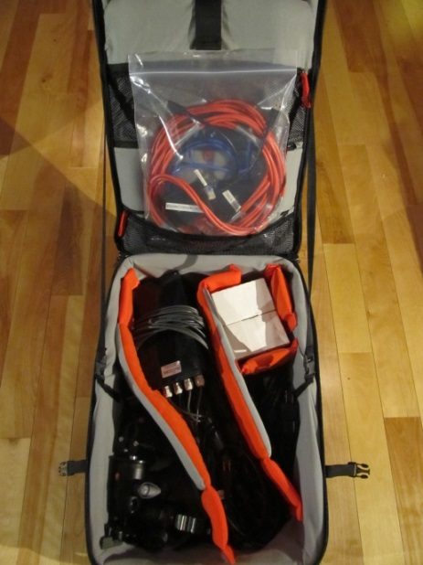
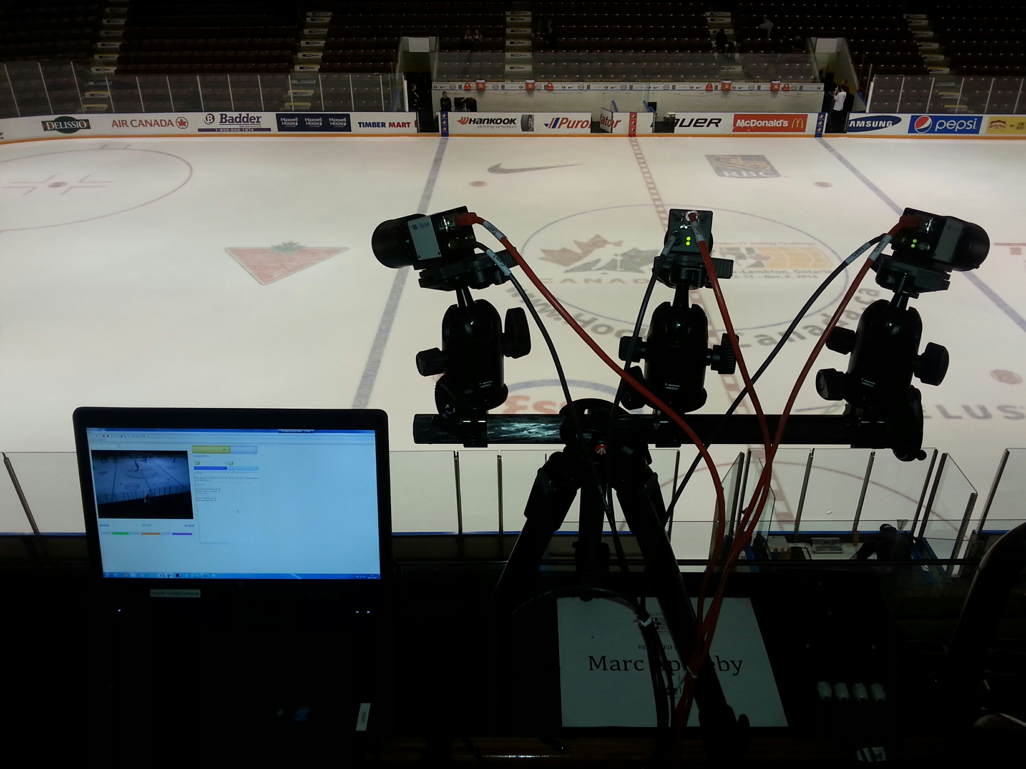
Tracking system set-up
Three ‘hand-sized’ optical tracking cameras
Permanent or mobile system
Mobile: 30 minute set-up & calibration in any arena
No need for chips/sensors/infrastructure
Next morning/day delivery of data
Entire mobile system fits
in a carry-on suitcase
All rights reserved ©
Notes:
Here are a couple pics of our mobile tracking system
Teams like this approach because its
- Simple
- Versatile
- Cost-effective

Slide 5
Visual animation
Size of player icon = 2m radius = “stick impact range”
All rights reserved ©
Notes:
Here’s a 15-sec video showing the tracking output in animation mode
In this case, let’s watch how the forwards respond ‘together’ on the back check after a breakout pass gets turned over

Slide 6
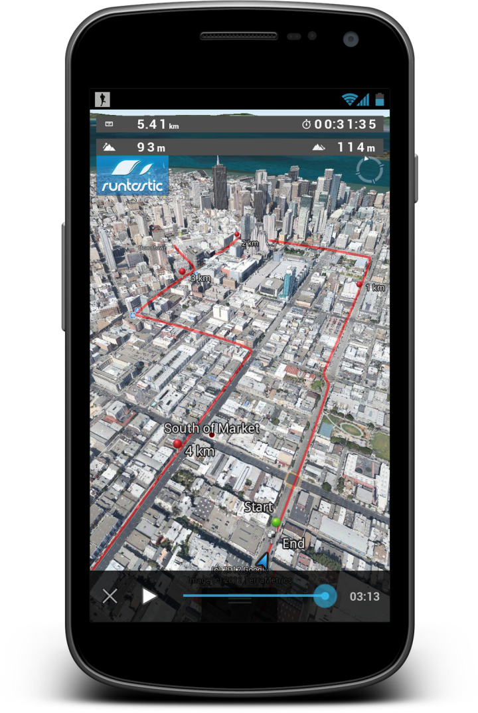
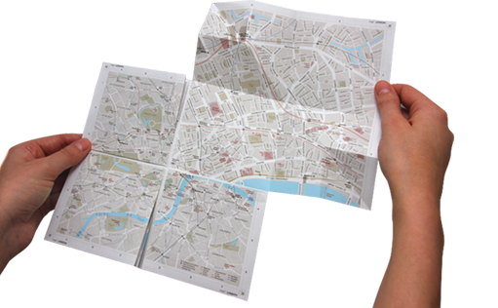
Eventing vs Tracking
Notes:
Current advanced data is like having a 2D paper map… great to know where the roads are, and impossible to fold back up ☺
But tracking differs in that it’s knowing where you are in 3D and shows you the fastest path to your destination.
Let me show the differences between them

Slide 7
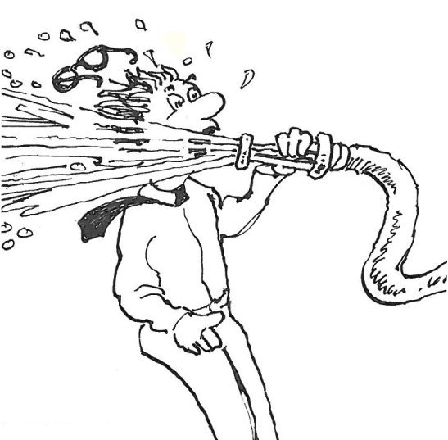
Tracking data = open wide!
NHL
6 goals
60 shots
140 shot attempts
Eventing
1,000 passes
1,500 unique possessions
5,000 puck-related events (incl. stickhandling)
Tracking
12,000 x/y locations per player (20 mins of ice-time)
400,000+ total x/y player locations per game
…and combining each event with all tracking means BIG BIG data…
2+ Billion data points per game!
All rights reserved ©
Notes:
Here’s a general sense of how sample size increases exponentially once location data is added
Combining tracking with event data, there is unlimited analytical possibilities.
The secret now is less about finding the answers, and more about asking the right questions

Slide 8
Data depth
TRACKING
Hockey sense & decision-making
Play “away from the puck”
Player zone time & heat maps
Positioning & gapping
Skating and fitness
Team structure & tactics
Play sequencing
Micro-contribution +/-
Automated eventing
Unlimited analytical opps
Full context
NHL
Shots
Scoring chances
Goals
Assists
Penalties
Giveaways
Takeaways
Hits
Blocked Shots
Ice-time
EVENTING
Possession
Passes
Stick-handling
Entries
Exits
Puck zone time
Puck battles
Saves
All rights reserved ©
Notes:
Automated eventing means we try and model every event algorithmically
then game data never goes ‘stale’
What I mean by that is that change your mind in the model at any time and update every game in your dataset in seconds

Slide 9
Skating analyses

Slide 10
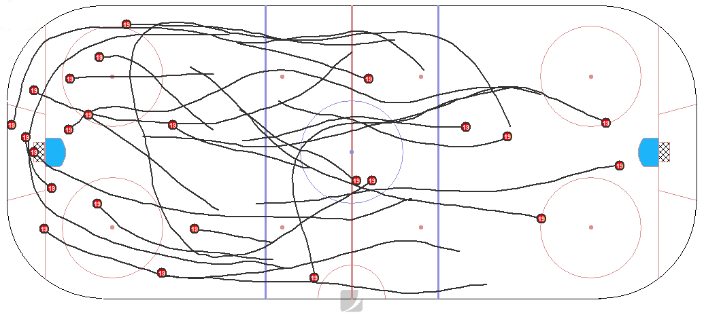
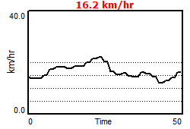
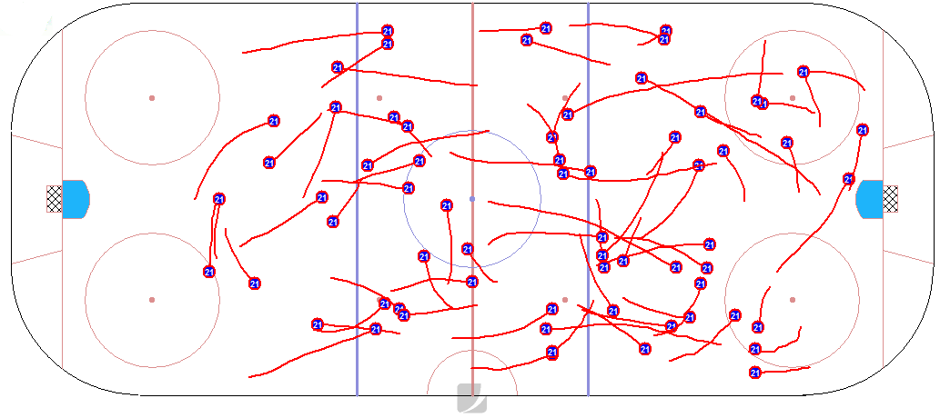
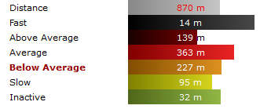
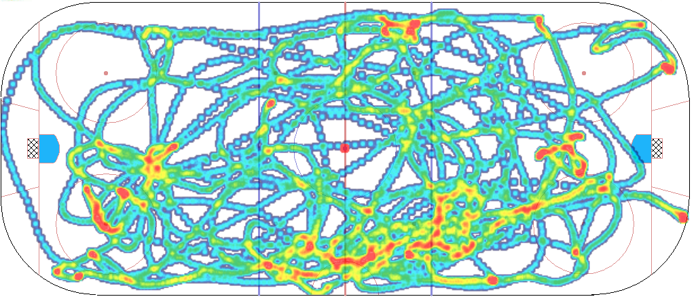
Player fitness data and mapping
All rights reserved ©
Notes:
Here are some examples of how we track and map player speed, acceleration and location data

Slide 11
Who’s the NHL’s fastest skater?
How do we measure ‘fast’?
In what situation do you need the speed?
What kind of skater do you want?
Speedster when the puck’s on his stick?
Defensive pressure specialist?
All-energy 4th liner?
All rights reserved ©
Notes:
- Great debate question at the bar with friends
- But difficult to find one skating metric to build singular ranking that matches our biases
Determining the definitive fastest skater is like trying to find a cross-eyed rainbow unicorn
And in my experience teams are looking for specific skill sets to address areas of weakness

Slide 12
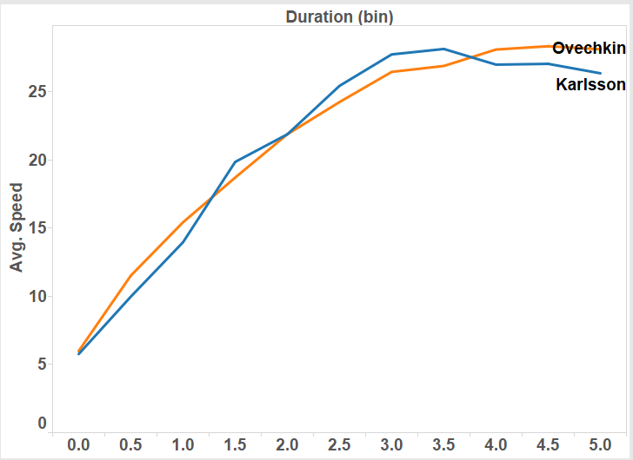
Speed curve – Great8 vs K65
Time in seconds
5v5
All rights reserved ©
Start speed < 2km/hr | End speed > 25km/hr | Distance skated < 50m | 0.5 second duration bins
Notes:
Ovi faster off the start
Karlsson second gear
Karlsson tails late potentially due to defensive responsiblities

Slide 13
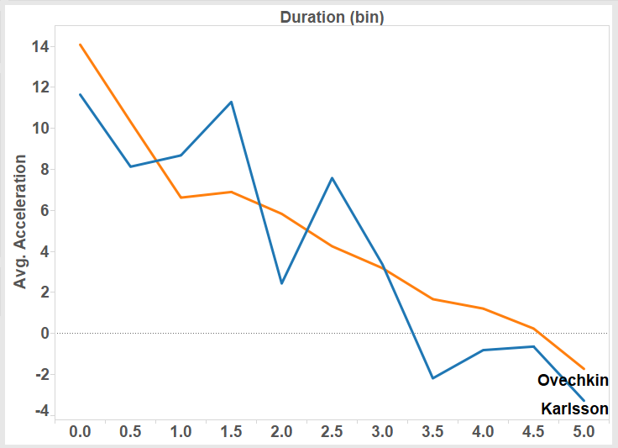
Acceleration – Great8 vs K65
Time in seconds
5v5
All rights reserved ©
Start speed < 2km/hr | End speed > 25km/hr | Distance skated < 50m | 0.5 second duration bins
Notes:
Karlsson’s second gear is clear here in his acceleration curve

Slide 14
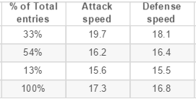
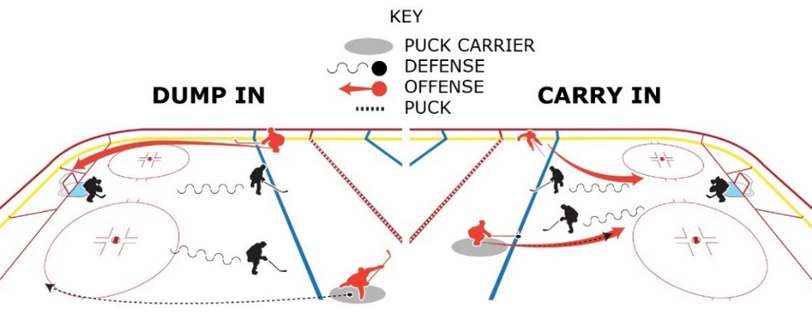
Entries Speed
Km/hr
+1.6
-0.2
+0.1
All rights reserved ©

Slide 15
Pace is a measure for what % of play was at “high-speed”
Speed to Pace conversion
Pace
Average speed in km/hr
All rights reserved ©
5v5 | PACE = % of distance skated where player was skating above 20 km/hr (12.5 mph)
Notes:
Get rid of units problem of km/hr to mph
Provide contextual stat that was more reflective of skill

Slide 16
Who plays @high-speed most often?
Rank | Player | Pace | Pace with Puck
1 | James Neal | 53% | 47%
2 | Evgeni Malkin | 51% | 55%
3 | Jakub Voracek | 49% | 64%
4 | Andrew Shaw | 49% | 60%
5 | Sidney Crosby | 48% | 47%
6 | Evgeni Kuznetsov | 47% | 55%
7 | Troy Wilson | 46% | 56%
8 | Casey Cizikas | 45% | 50%
9 | Travis Zajac | 45% | 51%
10 | Sean Monahan | 45% | 59%
All rights reserved ©
5v5 | >20min TOI | PACE = % of distance skated where player was skating above 20 km/hr (12.5 mph)
Notes:
By this metric, one could argue that Voracek is #1 all-around Pace player
Shaw/Malkin rounding out the top3

Slide 17
Pace = game context
All rights reserved ©
5v5 | PACE = % of distance skated where player was skating above 20 km/hr (12.5 mph)
Notes:
Every event/moment can now be understand relative to the current pace of the game
For ex some players pass/stickhandle/shoot better in higher-pace moments
Some teams are poor responders to changes in pace

Slide 18
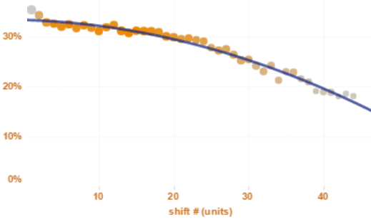
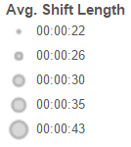
Avg pace per shift over a game
All rights reserved ©
5v5 | PACE = % of distance skated where player was skating above 20 km/hr (12.5 mph)
Notes:
Natural drop off 33% to 18%
Rest time is shortened
Shift length shrinks (whistle to whistle)

Slide 19
Pace - 5v5 vs 4v4 vs 3v3
Strength | AVG PACE | DZ | NZ | OZ
5 v 5 | 31% | 25% | 45% | 26%
4 v 4 | 32% | 29% | 54% | 26%
3 v 3 | 40% | 35% | 58% | 35%
All rights reserved ©
PACE = % of distance skated where player was skating above 20 km/hr (12.5 mph)
Notes:
4v4 was a faster game through the NZ only, a little in the DZ
3v3 has really opened up the game at all ends

Slide 20
(vs all situations)
League-wide pace data
Attacking
Defending
attacking
All rights reserved ©
5v5 | PACE = % of distance skated where player was skating above 20 km/hr (12.5 mph)
Notes:
Puck on stick vs without puck (but attacking)
Zone data same as previous but color denotes DZ slower (and OZ faster) at 5v5 than all other situations
Position breakdown

Slide 21
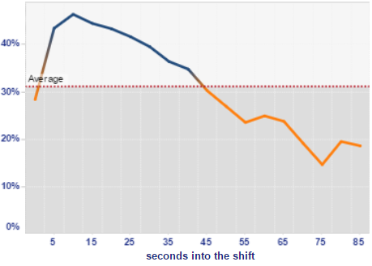
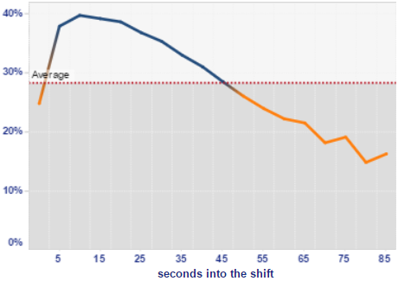
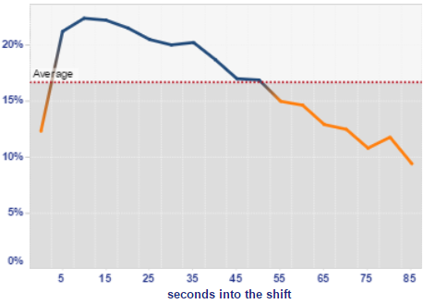
Pace vs shift length (secs)
CENTER = 46% peak
WINGER = 40% peak
All fall back to their average Pace at ~45 seconds
DMAN = 22% peak
All rights reserved ©
Notes:
This is the average pace over the length of an individual shift
Similar shapes here, but all of different amplitudes
But there is one interesting pattern shared by each- Can you spot it?

Slide 22
Pre-shift recovery time
4 mins
3 mins
2 mins
Shift #
All rights reserved ©
5v5 only
Notes:
1st period is 3.5mins of recov time
End of game is <2mins
Likely reasons are line utilization, double-shifting, 4th line sitting

Slide 23
Importance of speed
Analyzed 17,220 NHL games (every season since 2000/01)
‘Win shares’ regression model on player and team performance
Analyzed the standard NHL individual skater stats plus ‘career GP’ plus ‘skating’ vs team wins
Evaluated 11,340 unique skaters
Skating categories = Average, Above Average, or Fast
Scouting reports, Hockey News, McKeens Hockey, Hockey Prospects, eye-test
Skating =~ 5% of winning
All rights reserved ©
Notes:
Research done by my dad Terry as a labor of love, After exhaustive lit review to quantify skating into 3 categories:
- In simple terms, all skaters are at least avg, the guys we know are ‘decent skaters’ are above avg, and pull-away speed is Fast

Slide 24
What we’ve learned from NHL teams

Slide 25
Time for analytics explosion?
Tracking technology solved
Grassroots analysts & innovators
In-house analysts with teams
Coaching buy-in
All rights reserved ©

Slide 26
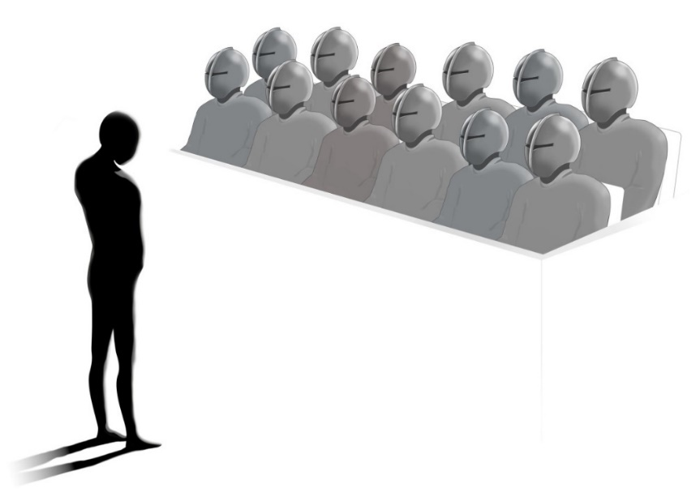
Simplified coaching interaction
How did you calculate that new stat?
Ok… is that number good or bad?
Alright… the numbers align with our intuition… so…
How now do I make the on-ice adjustments?
All rights reserved ©
Notes:
And this is when it feels like a jury of T1000 terminators ☺

Slide 27
The key for coaching adoption
Evaluative vs Actionable
What vs Why?
event happened?
did it happen?
How?
can I fix it, or keep it up?
All rights reserved ©

Slide 28
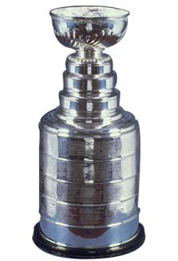
Analytics success cycle
Start
DATA COLLECTION
ACTION
ANALYSIS
INSIGHT
What?
How?
Why?
All rights reserved ©

Slide 29
Thank You
Any questions, comments, inquiries?
OAC@powerscouthockey.com
Want to get involved with tracking?
We’re now taking applications for our summer internships
intern@powerscouthockey.com
All rights reserved ©

