Slide 1
Empowering analytics through data capture Cary Moretti, CTO | HockeyTech Ottawa Hockey Analytics, Carleton University, Ottawa
the world’s premier provider of digital tools, analytics and data services for the elite level of hockey

Slide 2
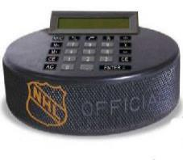
The Challenge
The demand for analytic data has risen sharply in the past decade; coaches, players, fans and the media are demanding a wider range of statistical data be delivered faster than ever before.
Notes:
At every level of hockey, limited access to financial and human resources has resulted in an ever increasing gap between supply and demand.

Slide 3
The Opportunity
Scouting
Stats and Scoring
Live video
Player Testing
Notes:
HockeyTech is the global leader in hockey IT services.
Our existing customer base includes all 30 NHL teams.
We provide services to pro and semi-pro leagues and teams around the world

Slide 4
The Solution
Real Time HockeyTech Analytics tracking and scoring system
Leverage existing scoring system and process
Minimize staff requirements
Financially accessible from Pro down through every level of elite hockey
Track more game events and metrics
Store raw data indefinitely to allow for new events/metrics in the future

Slide 5
Game Events and Metrics
Puck and Player tracking
On Ice Officials and Zamboni (because we can)
TOI, Possession, Velocity, Direction, Zone, x,y,z (puck), Heart Rate
Faceoffs, Shots (Quality, Misses, Blocked Shots) and Passes
Goals, Assists, Plus/Minus, Penalties, Shoot Outs, Penalty Shots
Turnovers, Odd Man Rush and Regroups

Slide 6
Tracking and Scoring

Slide 7
Opening Face Off

Slide 8
Event: Goal

Slide 9
Raw Data
Puck Tracking 50 Hz to 100 Hz
Player Tracking 20 Hz to 100 Hz
RF means the puck is always visible
> 4 million rows of raw data per (regulation time) game
Aggregated Player, Puck, Official, and Clock data for real time chart and report generation

Slide 10
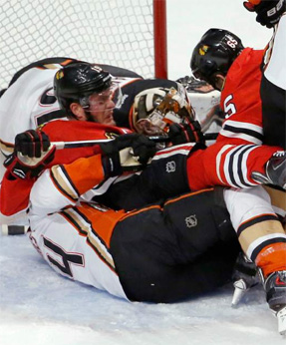
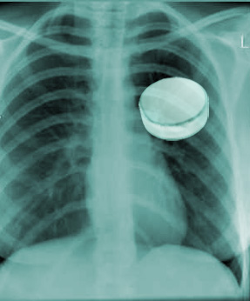
We Always See The Puck
What you see.
What we see.

Slide 11
Real Time
Fully automated possession, TOI and shift tracking
Machine Learning algorithms improve data consistency and input speed:
Face Offs
Shots (and type), Passes and Turnovers
Goals and Assists

Slide 12
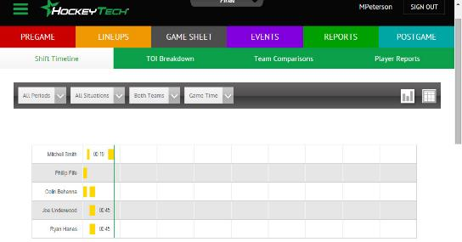
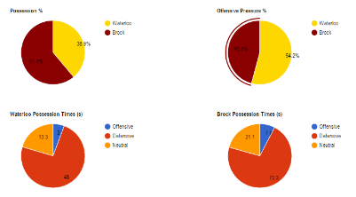
Real Time Reporting

Slide 13
Shameless Plug
Contact us for more data than you ever thought possible. Installing now.
HockeyTech
Cary Moretti, CTO
180 Columbia Street West, Suite 300
Waterloo, Ontario N2L 3L3 Canada
Phone: (519) 746-7200
Fax: (519) 746-9466
Email: info@HockeyTech.com

