Slide 1
The Analytics Power Play
Efficient Data Movement
From Capture to Reporting
Notes:
Basketball is currently one of the most data rich professional sports (next to baseball). Given that my fellow panelists will surely discuss their abilities to capture and report on their data, I will discuss the process in which this data becomes integrated within the team environment

Slide 2
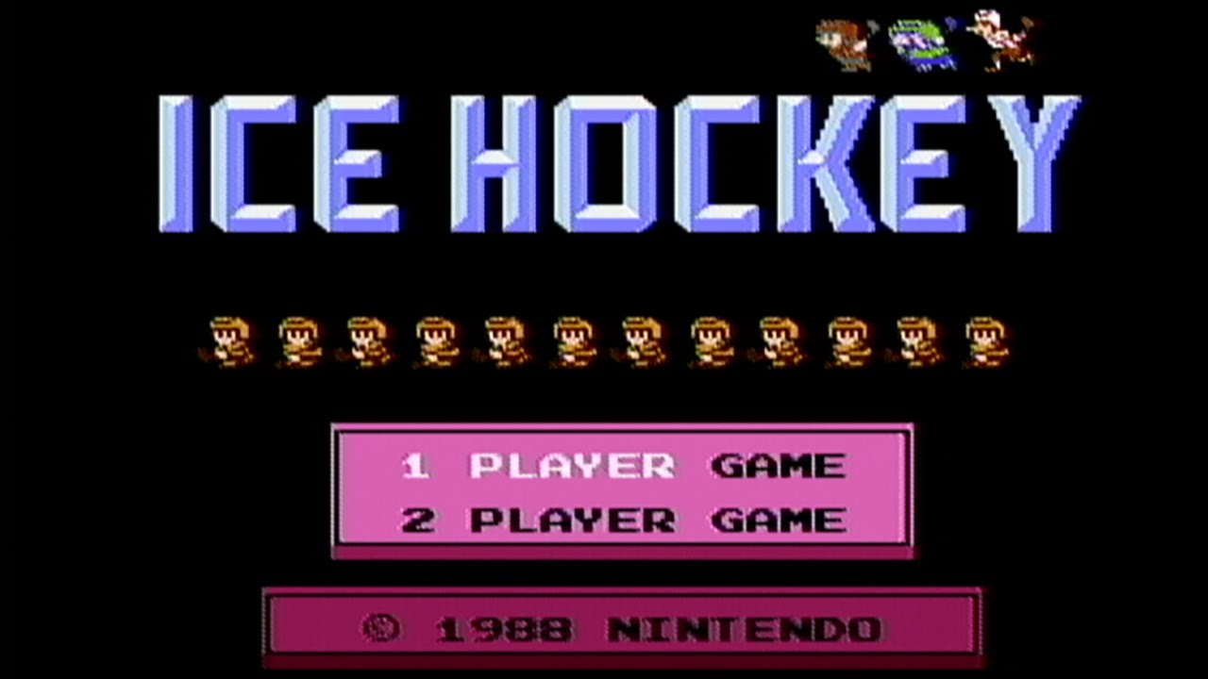
Notes:
Being able to utilize analytics as a means to evaluate team and player performance, requires the assembly of a technology architecture. I often think of this as being analogous to creating your “Ice Hockey” team in the old Nintendo game. “Not dating myself”

Slide 3
Data Capture and Processing
SportsVU
(x,y,z) of each player and ball at 25 frames / sec
Raw and processed day
NBA
Play by Play
Contract Data
NCAA
All top 25 and non-top 25 games
Measurements
High School
Game Statistics
International
Over 100 league/tournament box score data
Notes:
Every team needs a “skinny guy”. We capture and ingest a wealth of data nightly from a variety of sources. Of course, basketball has had the luxury of optical data from about 4 years (although we are in year 2 of it being mandated across the league). In additition, NBA, NCAA, High School and International data that range from play by play to box score data to measurements and player profiles. Speed is important and challenging depending on the quality of data.

Slide 4
Transformations and Daily Models
Preprocessing Data
Simple Database Transforms for rapid reporting
Granularity Changes
Daily Models
Lineup optimization
Estimate of missing predictors
Data Quality
Player matching
Notes:
“Medium Guy”. Performs tasks on the raw data we import to prepare it for larger processes or reporting

Slide 5
Complex Data Models
Involves Large Proportion of Data Set
Weekly basis
Predictive in Nature
Predictor Evaluation
Identification of Player Characteristics
Shooting and Passing
Defense and Movement
Notes:
“Fat Guy” – Long term modelling goals and thus long processes. Utilizes a large fraction of the entire dataset (but aggregated and non-aggregated). For example, trying to establish what predictors makes a player a professional, and/or an all-star

Slide 6
Presentation Layer
PDF Reporting
Varying levels of detail and timing
Offense vs Defense
Scouting vs Recap
2 weeks out vs last game
Internal Web site
Exploratory into the modeling
Concentration on visual clarity
Merge with video

Slide 7
Promise Land
Two-Way Communication
Buy in
Coaches
Front Office
Constant Dialogue
Analysts and “Basketball Types” working together
Culmination of over 10 years of work

